Slide 1



Multi Sectoral Nutrition Information System (MNIS)
By Chola Kulya
M&E Specialist, NFNC
14/09/2023

Slide 2
MARF - Where we are coming from
A harmonized excel/paper-based district multisectoral aggregation reporting tool, for subnational routine data collection and reporting to the national level.
The MARF was designed by adapting existing tools across the implementing six sectors (MoH, MCDSS, MoA, MWDS, MoE, Cross cutting.

Slide 3




MNIS Background
MNIS is an integrated web based system used by NFNC, partners, and stakeholders to collect relevant and functional information on a routine basis aimed at monitoring the Nutrition Sector indicators to enable planning, decision making, M&E of the Nutrition intervention.
Goal of MNIS - To provide quality data that supports evidence-based decision making at all levels of the nutrition programme.
It was developed by NFNC with financial support from UNICEF

Slide 4

MNIS Log in to the system
Landing page - https://nmis.nfnc.org.zm
A landing page as shown below should show. If you don't see this page, please clear your browser history and try again.

Slide 5
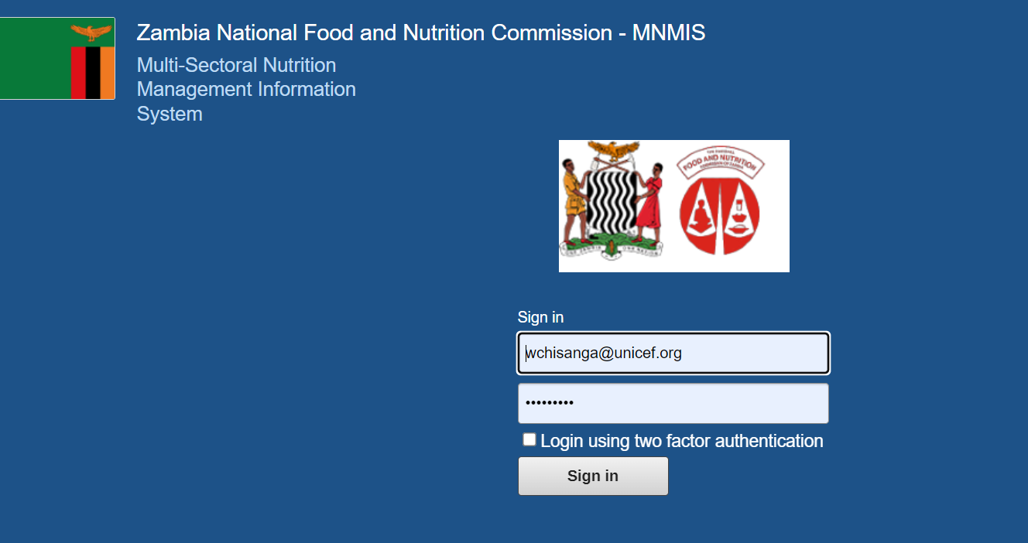
MNIS Log in to the system - Usernames and passwords
To access the database, you need to have a username and password provided by the system administrator.
Account Usernames are email addresses
Once you log in, change password and update your account in terms of personal information
If you are unable to access the system use:
username: test
password: Nfnc@2023

Slide 6
Districts where MNIS is being implemented
PROVINCES (7) | DISTRICTS (17)
Lusaka Province | Lusaka | Chongwe
Eastern Province | Chipata | Lundazi
Muchinga Province | Chinsali | Isoka | Mpika
Luapula Province | Chiengi
Southern Province | Choma | Monze
Western Province | Mongu | Kalabo | Kaoma | Shangombo
N. Western Province | Solwezi | Zambezi | Mwinilunga

Slide 7
Integrated Data Repository
National Food and Nutrition Commission
Community Development and Social Services
Ministry of Health
Ministry of Education
Ministry of Agriculture
MNIS
Ministry of Water Development and Sanitation
Ministry of Green Economy and Environment
Ministry of Local Govt and Housing / Local Authorities
Ministry of Fisheries and Livestock

Slide 8

MNIS Users
National (Trainer of Trainers) – Line Ministry Nutrition Focal point persons, M&E Officers, NGO project managers, NGO M&E officers, UN Partners
Provincial - NFNC PNSC, NGO Provincial M&E, Line Ministries
District - NFNC DNSC, District M&E, NGO Staff, NSG Supervisor, Partners – Districts, Line Ministries

Slide 9
Conclusions / Recommendation
MNIS will strengthen and improve the implementation of M&E and quality of the nutrition data, in terms of comprehensiveness, reporting and utilization
Improve multi-sectoral coordination, technical supervision, capacity building on M&E and NIS, dissemination and utilization of M&E data
MNIS provides potential opportunities for nutrition information and Liaison with DHIS2 – MoH, Liaison with UN partners and NGOs and scale up to other projects/provinces
Explore possible networking with different partners for strengthening of the govt nutrition and food security

Slide 10


questions?

