Slide 1
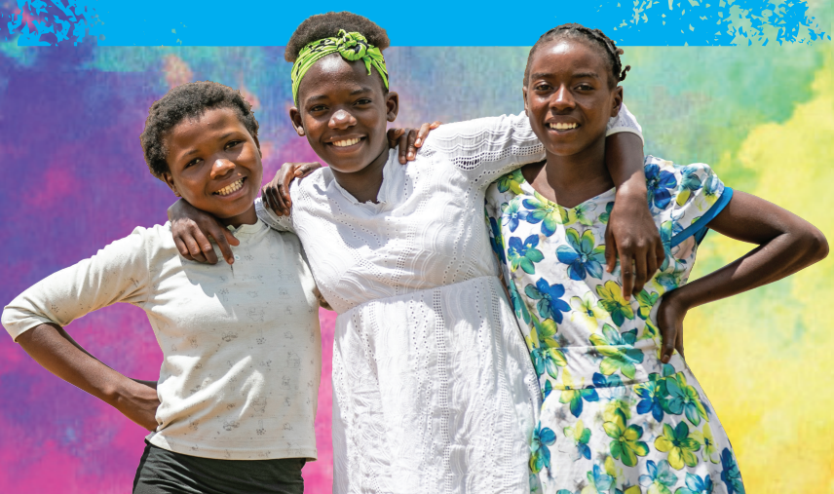



KEY FINDINGS FROM ADOLESCENT NUTRITION SURVEY IN ZAMBIA
SUMIT KARN, NUTRITION SPECIALIST [SKARN@UNICEF.ORG]

Slide 2
The 2022 Adolescent Nutrition Study was implemented by IQVIA under the aegis of the National Food and Nutrition Commission and unicef. The funding for the study was provided by the EU, Irish AID, KfW, SIDA and FCDO through the SUN-II Programme, a multi-donor programme to deliver multi-sectoral interventions for stunting reduction in 17 districts in Zambia

Slide 3
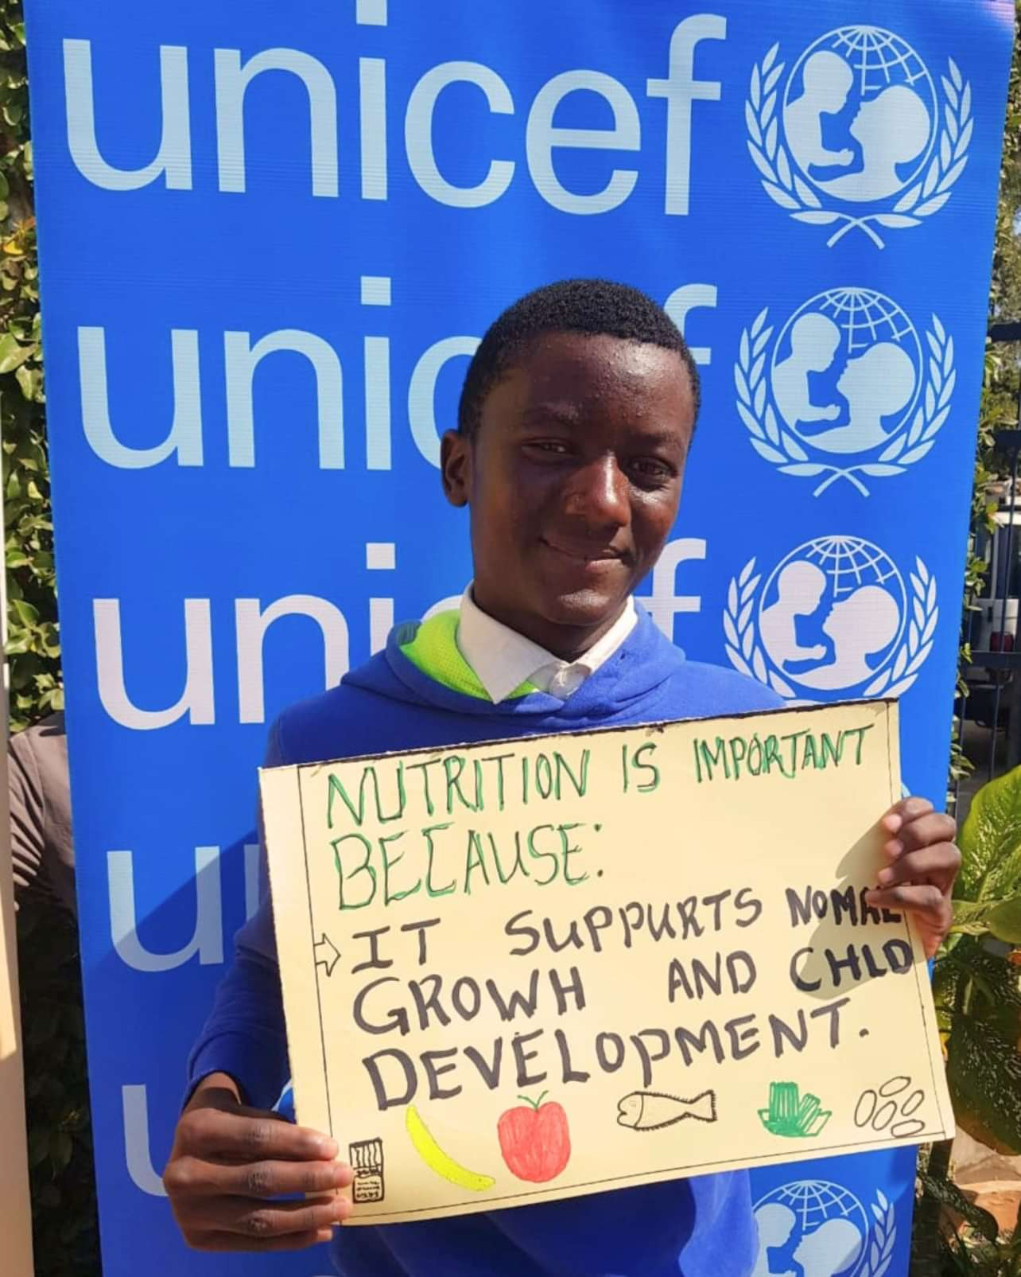
background
Adolescence is marked by continued steady growth and provides the window of opportunity for establishing lifelong healthy eating habits for themselves and the next generation
In many parts of the world, including Zambia, adolescents face a triple burden of malnutrition as they are affected by undernutrition (thinness) and micronutrient deficiencies (anaemia) and overweight and obesity whose rates are also raising
In Zambia, adolescents make up a substantial 25% of the population. Adolescent population in Zambia is expected to increase from current 3.7 million to 9.8 million in 2050

Slide 4
Zambia has one of the highest adolescent fertility rates in Eastern and Southern Africa
Adolescent population expected to more than double from 3.7 million to 9.8 million in 2050
High prevalence of child marriage and teenage pregnancy contributes to high fertility and population growth
Higher rates of malnutrition for adolescent girls can have adverse effects on their own health and that of their children
Important to address the sexual and reproductive health, nutrition, and behaviors of adolescents in Zambia
Source: ZDHS 2018 and Global Mapping Report 2020
ZDHS 2018
Notes:
challenges for society to provide health, education and job training services to prepare them for a productive future
Married adolescent Zambian girls use modern contraception less than older married women, and over the past decades, have increasingly reported unmet needs for modern contraception.
Adolescent girls in Zambia engage in risky sexual behaviors more than older women, putting them at higher risk for illness and death

Slide 5
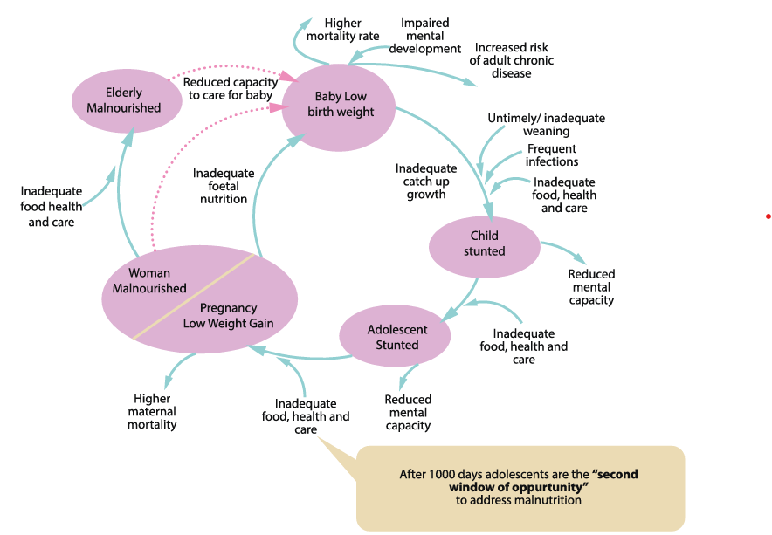
After 1000-Days, adolescents are the “Second Window of Opportunity” to address all forms of malnutrition

Slide 6
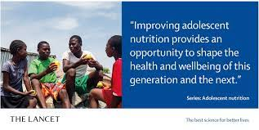
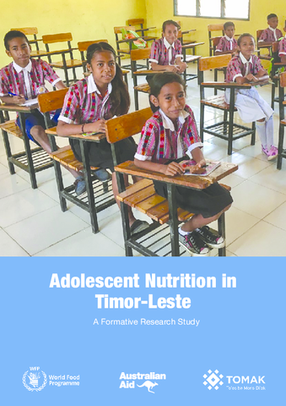
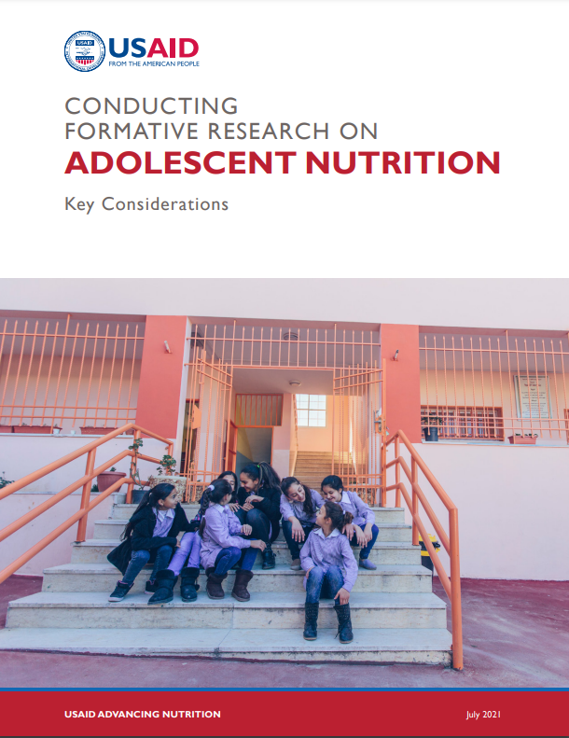
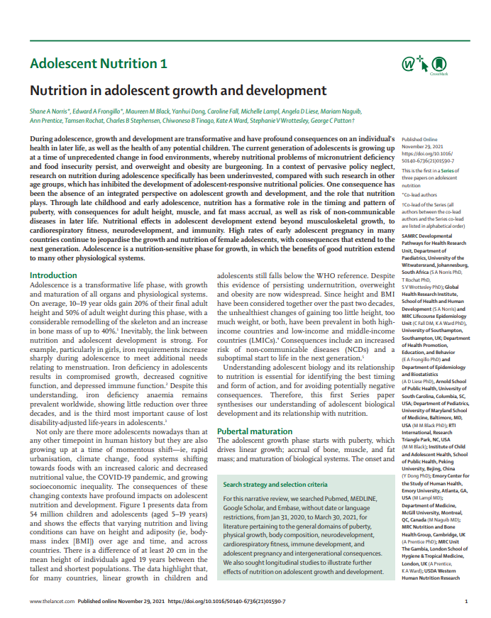

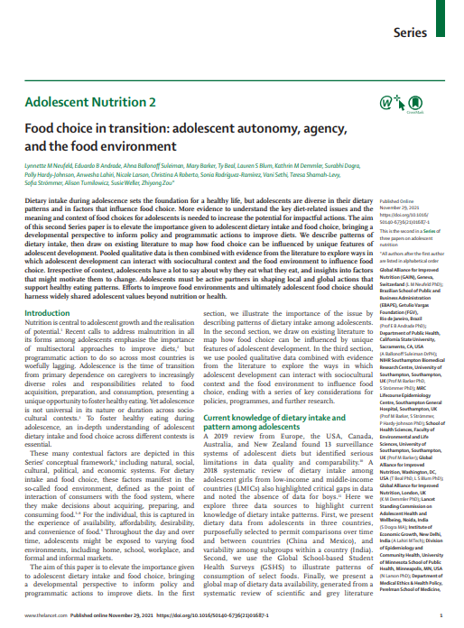
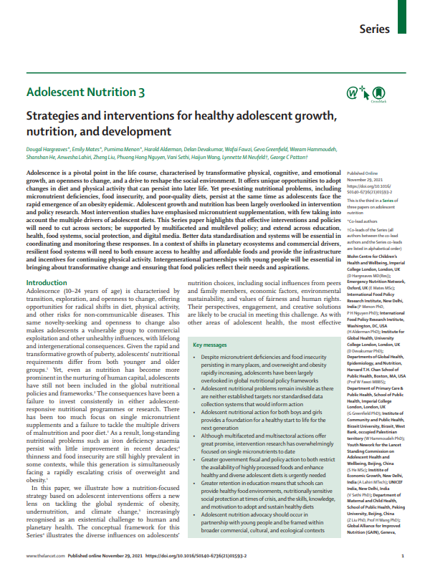
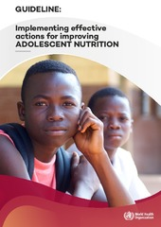
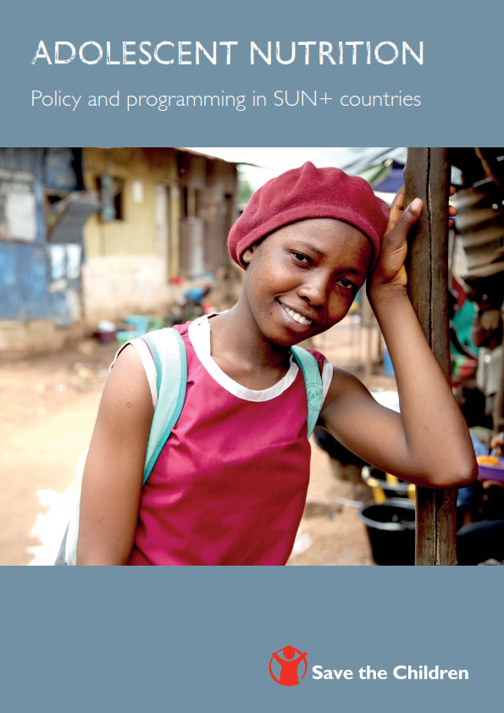
Increasing interest on adolescent nutrition

Slide 7

OBJECTIVES
Undertake a situation analysis of nutrition of adolescents in Zambia
Undertake an assessment of the food and social environment influencing adolescent nutrition status and their dietary practices, and the main channels of information and influence

Slide 8
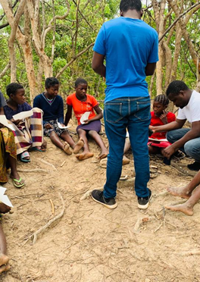
METHODOLOGY
Formation of Adolescent Technical Working Group under NFNC
Ethical approval granted by National Health Research Authority in August 2022
Data Collection was done in September – December 2022
Adolescent workshops were conducted in January 2023

Slide 9
METHODOLOGY
Literature Review and Stakeholder Analysis
Adolescent Workshops
Primary Study
DHS Data Analysis (2013-14 and 2018)
Existing literature review
Stakeholder mapping
4 workshops with 79 In-school and out-of-school adolescents from two districts (Ndola and Lusaka)
Anthropometric, socio-economic, dietary practices and food environment are assessed
Household Survey with adolescents in 10 districts

Slide 10
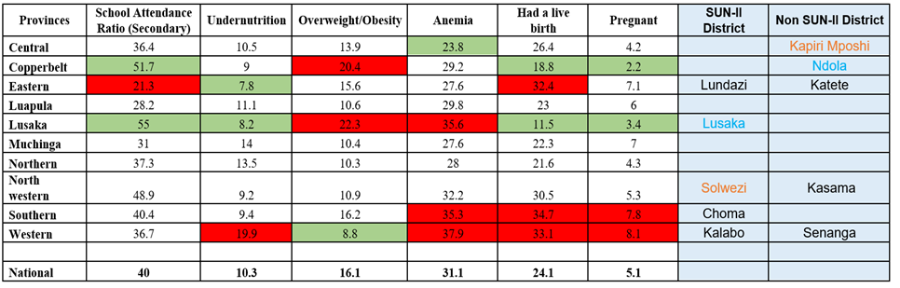
METHODOLOGY
A total of 10 districts [5 SUN-II districts and 5 non-SUN-II districts] was selected purposively

Slide 11
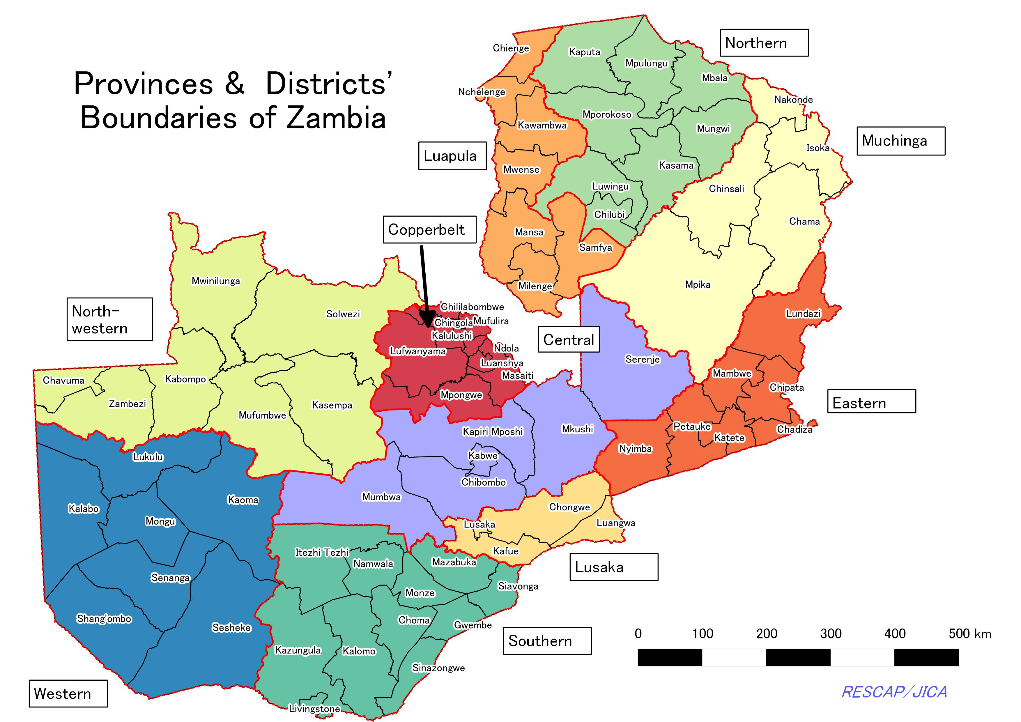
METHODOLOGY
A combination of multistage and stratified random sampling was used to select a representative sample
2 enumeration areas (EA) were randomly selected in each sampled district in such a way that 1 EA was urban, and 1 EA was rural
Sampling of EAs was done with assistance from the Zambia Statistical Agency
EAs in each sampled district were listed by ward, urban/rural category, number of households, and population
1 EA each was randomly selected from the list of urban and rural EAs respectively using PPS
Stratified random sampling was employed to select 20 households with adolescents from the selected EA

Slide 12
METHODOLOGY
Survey collected responses from a total of 456 adolescents
Lundazi (53) | Lusaka (47) | Solwezi (44) | Choma (48) | Kalabo (42)
Kapiri Mposhi (41) | Ndola (46) | Katete (47) | Kasama (43) | Senanga (45)

Slide 13
results

Slide 14
Adolescent background characteristics

Slide 15
Nutritional status of adolescents boys and girls
Overall
21% adolescents were stunted
5.2% adolescents are thin
9.7% adolescents are overweight/obese

Slide 16
Nutritional status of adolescents boys and girls
Overall
21% adolescents were stunted
5.2% adolescents are thin
9.7% adolescents are overweight/obese

Slide 17
Comparison of findings from DHS Analysis and Household Survey
Sample size for adolescent girls 15-19 is relatively small compared to DHS (n=123)

Slide 18
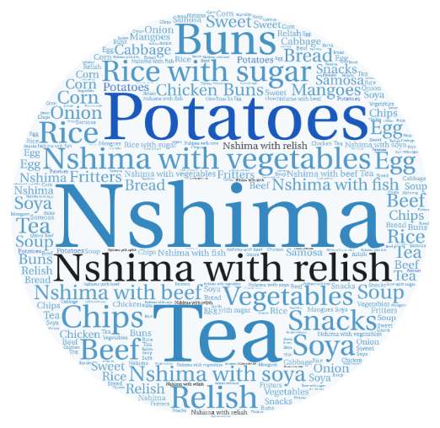
What do adolescents eat?
Seventy-seven of the 79 workshop participants had consumed at least one maize-based meal or drink in the previous 24 hours

Slide 19


Adolescents’ Frequently Missed Meals
66% of adolescents reported having breakfast the previous day, 75% reported that they had lunch the previous day, and 90% reported that they had dinner
A significant number of adolescents in Zambia have reported missing at least one meal per day, with breakfast being the most commonly missed meal.
Reasons given for missing meals include the lack of access to food, unavailability of food in the markets, lack of funds to purchase food, or leaving home early without anyone to cook. Some respondents reported missing meals due to food scarcity or the food being unappetizing.
While some respondents reported not missing any meals, the mixed responses suggest that meal-skipping is a common occurrence among adolescents in Zambia, which can have adverse effects on their health and nutritional status.
I sometimes miss breakfast because food is not enough in the house
FGD with out of school adolescent boys 15-19, Solwezi
Sometimes there is no mealie meal at the shops, then we don't eat and other times we don't find relish at the market
FGD with in school adolescent girls 10-14, Kalabo

Slide 20

Adolescents’ desired Meals
Many adolescents wished for meals like “chicken and chips with fruticana fruit juice”, “pizza and fanta”, “smoked ribs, sauce, chips and sprite”, “shawarma, hungry lion chicken, pizza and ice-cream”, amongst others
Notably, the meals most of the adolescents “dreamed of'' were not the most commonly available local meals
[The adolescents] were able to visualize what their desired meals were without a problem. While most chose modern fast-food options, some still chose the traditional food options like nshima. Those who chose the more traditional options were somehow frowned upon by their peers for not thinking outside the box.
Adolescent Workshop Facilitator, Lusaka
Notes:
This could partly be explained by advertising and social media which have been described as factors strongly associated with dietary habits and perception among Zambian adolescents. Fast food and snack manufacturers have previously been reported to directly target young Zambians through TV, social media and “road shows” to encourage sales to this particular demographic

Slide 21








What influences adolescents’ dietary habits
Accessibility
“Distance (to the market) is far from my place, and I have no transport money to buy what I want”
Family and Home Environment
“(My) mom makes the food rules at home.
Affordability
“My mama and papa don’t have enough money every day and I don’t work””
Media and Advertisements
“I like the Hungry Lion advertisements because they are sometimes funny. I would like to eat it once every day”
Individual Factors
External Factors
Peer Group
“When I am with my grandma, we eat nshima and sausage. When I am with my friend, we eat chicken, chips, fanta and popcorn”
Availability/Food Insecurity
““Sometimes there is drought and no rain for maybe up to two years”
Desirability
“Most of the unhealthy foods are attractive”
School Food Environment
“Too many bad snacks and drinks are sold in school e.g jiggies, lollipops and munkoyo”

Slide 22
Family and home environments play a critical role in adolescents’ food choices
Majority of adolescents (89.9%) during the assessment survey reported that their parents are the major influencers of what they eat, followed by friends/peers (29.3%)
FGD and adolescent workshop findings also confirmed that the primary influencers of dietary habits among the respondents were the parents, with other family members such as grandparents, siblings, and uncles mentioned
Influences of Food Choices | Number of Adolescents | %
Parents | 410 | 89.9
Friends / Peers | 134 | 29.3
Other | 53 | 11.6
Advertisements | 43 | 9.4
Promotions / Sales | 26 | 5.7
Celebrities / Influencers | 13 | 2.8

Slide 23
Media and advertisements
Questions | Options | Number of Adolescents | %
Have you ever seen advertisements for the foods and drinks that you want to consume? (e.g., signs, billboards, posters, road shows, TV, Radio, etc.) | Yes | 327 | 71.7
 | No | 124 | 27.2
 | Not sure | 5 | 1.1
Did any advert you have seen influence the food and/or beverage you have purchased? | Yes | 214 | 46.9
 | No | 221 | 48.5
 | Not sure | 21 | 4.6
[“(My favourite is) Appy Pine advertisement. It started with T-sean and Yemi Alade. They went to buy Hungry Lion. After buying Hungry Lion, he also bought a drink called Appy apple. Appy apple is a drink and it has many flavours e.g Appy Pine, Appy apple and Appy Grapo. After he tasted the drink, he started dancing and said the drink was nice. This advertisement is on TV, billboards and social media”
Two girls (18 & 15), Lusaka (Adolescent workshop)

Slide 24
Influences of Other Social Settings
The adolescents, as part of the adolescent workshops, were asked questions on which places they normally hung out, and what food they consumed there. The most frequently mentioned settings were church, school, market, sports facilities, friend’s house, and family member’s house.
1
2
In most of these settings outside their homes, adolescents often consumed snacks and soft drinks. This was seen especially when hanging out with their friends, at school or in church. Notably, when with family, they more often ate locally prepared full meals such as nshima.
3
Peer groups were associated more with snacking food patterns. The majority of adolescents reported majorly eating sweets and ultra processed snacks when with their friends.
4
Religious establishments which adolescents frequent have the potential to serve as entry points for nutrition interventions for adolescents especially in the out of school population.

Slide 25
School food environment in zambia remain unregulated
“Too many bad snacks and drinks are sold in school e.g jiggies, lollipops. He started dancing and said the drink was nice. This advertisement is on TV, billboards and social media”
Absence of well-defined policies, regulations, and standards specifically targeting the school food environment was reported by KII respondents to allow the unchecked advertising and sales of sweetened foods and beverages in and around school settings
All adolescents who were part of the in-school group in the workshops reported that they had snacks and soft drinks available for sale within, or in very close proximity to the school premises
Snacks eaten during school hours included biscuits, freezits, popcorn, donuts, samosas, lollipops and packaged juices. Some participants of the workshops sometimes had packed lunches from home, however overall, most participants consumed what was being sold in or around the school premises. None of the participants reported having any fruits or vegetables available while at school
Group Activity, Lusaka (Adolescent workshop)

Slide 26
acknowledgement
EU, KfW, FCDO, SIDA and Irish AID for their financial support through SUN-II Program
UNICEF HQ and ESARO for technical oversight
Technical Committee under NFNC
All adolescents boys and girls who participated in the study

Slide 27
Thank you

