Slide 1
2023 SCALING UP NUTRITION NATIONAL CONFERENCE
Increasing Nutrition Services through Community-led Total Nutrition (CLTN) Triggering

Slide 2
AGENDA
Background
Introduction
Importance of the topic
Results
Discussion and Conclusion
Challenges/Lessons

Slide 3
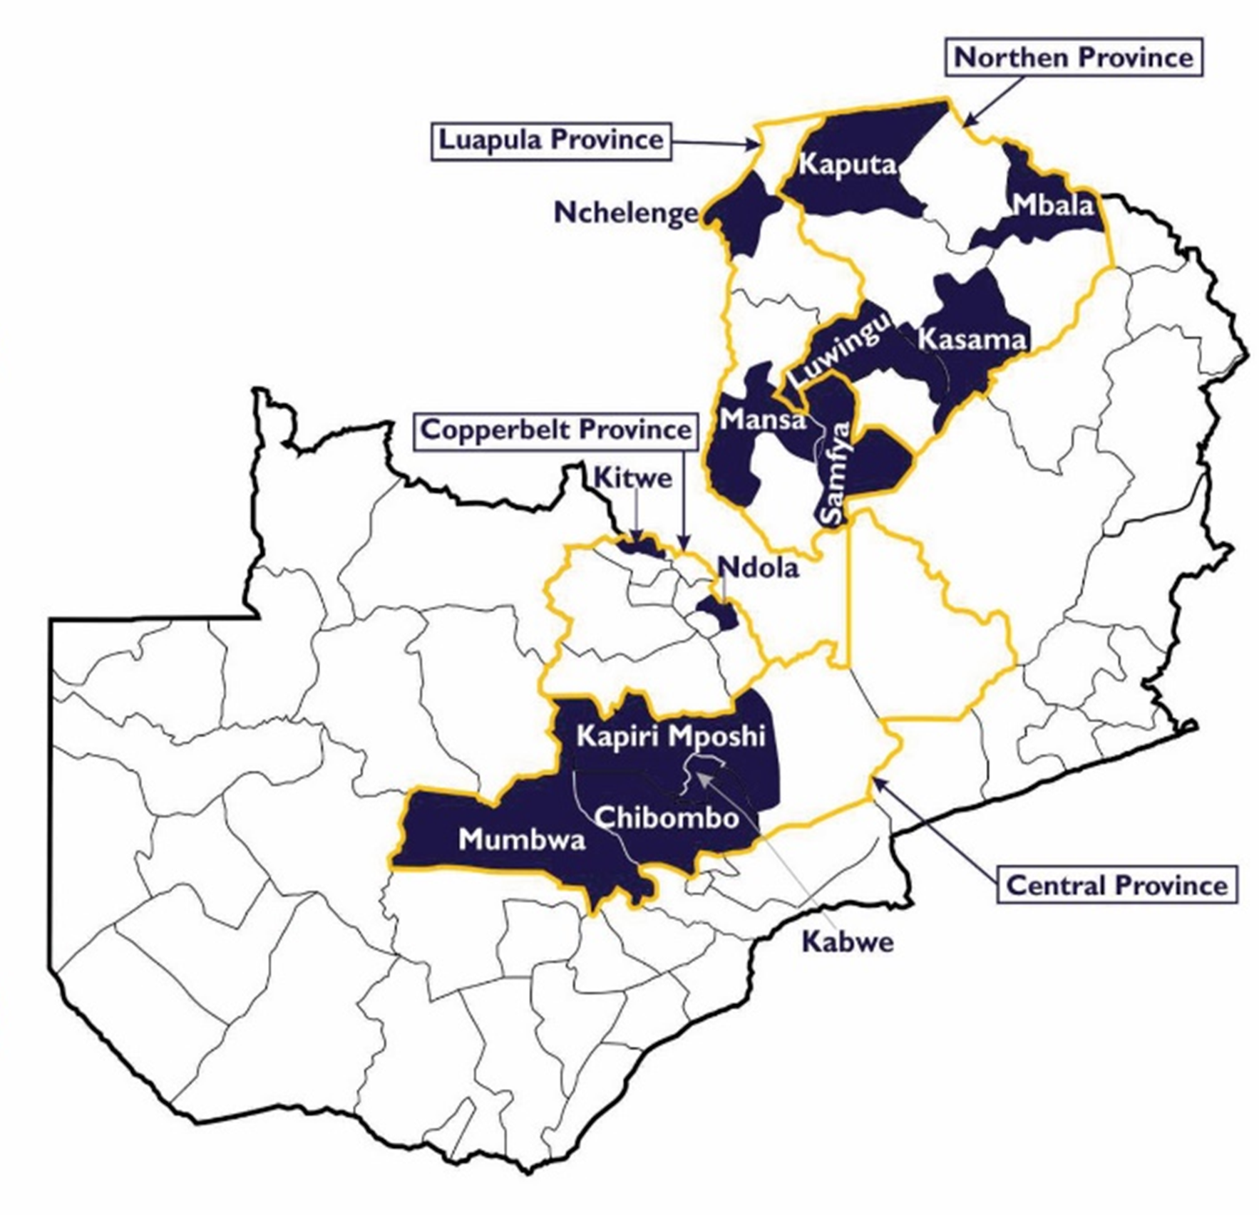




BACKGROUND
Stakeholders:
GRZ /National Food and Nutrition Commission (NFNC) and Key Line Ministries
Contractor:
DAI Global LLC
Scaling Up Nutrition Technical Assistance (SUN TA) is funded by United States Agency for International Development (USAID)
USAID SUN TA
Subcontractor: TechnoServe
USAID SUN TA is in 4 Provinces and 13 Districts – covering over 400 Health Facilities and 190 Wards

Slide 4
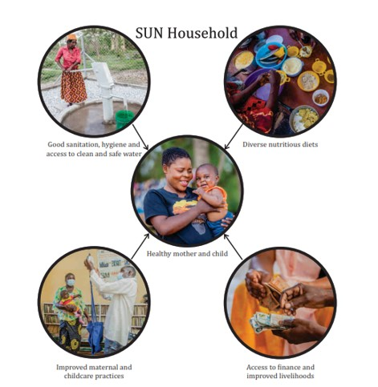
INTRODUCTION
Community Led Total Nutrition (CLTN) triggering is a concept borrowed from Community Led Total Sanitation (CLTS) in WASH
Helps create community awareness on nutrition issues through an integrated community mobilization approach to roll out the four project pillars (Health and Nutrition, Agriculture, Livelihoods, WASH) alongside Social and Behavior Change
Approach uses Catchment Area Nutritional Coordinating Committees (CANCCs) to increase the coverage and reach of activities while focusing on behavioural change to stimulate collective action using local solutions at community level
Process does not promise external support

Slide 5
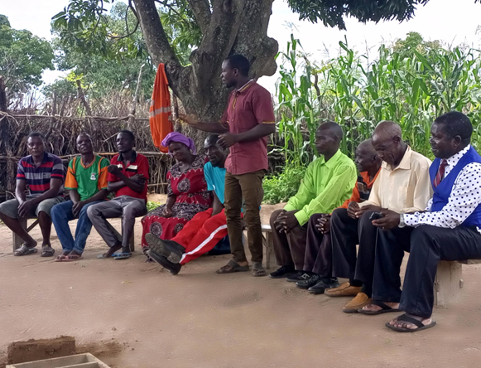
INTRODUCTION
CLTN is an community approach USAID SUN TA is using to increase coverage and reach of program activities across the thematic areas while promoting convergence
Informed by project monitoring – via mapping tool
Ignites need for change through a participatory approach driven by action both at community level as a whole and household level
Delivery of activities uses existing Government implementation structures up to the lowest CANCC level

Slide 6
IMPORTANCE OF THE TOPIC
Increase coverage and reach while layering thematic activities at community level (convergence)
Consensus/evidence is that layering of interventions is key to positively impacting nutrition outcomes
Improves collaboration with respective GRZ structures and other stakeholders to enhance linkage to nutrition support services (CANCCs)
Creates opportunities for active case finding and/or initiate/linking children to immediate necessary support, including emphasizing on data utilization
Offers a real-time opportunity to know a community’s nutrition status e.g., number of children who are wasted, underweight and stunted, leading to appropriate case management being applied

Slide 7
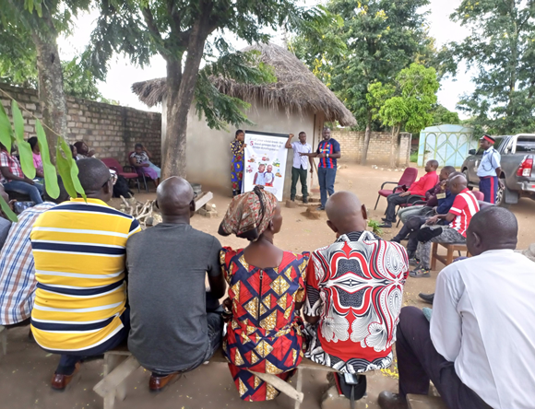
NUTRITION TRIGGERING STAGES
Step 1 – Planning and Preparation
Planning and preparation for facilitators
Community selection and mobilization
Step 2 – Triggering Session
Rapport creation
Engagement
Ignition
Triggering moment
Action planning
Step 3 – Post Triggering and Review Meetings

Slide 8
RESULTS
Immediate Results
Information on nutrition status of pregnant women and children available on the spot (nutrition assessment)
Stimulated demand for services (e.g., women joining SMSGs, community savings groups, follower farmers, etc.)
Identification of natural leaders to work with CBVs and households
Post-triggering
Improvements in sanitation and hygiene via new toilets, sanitation practices, dish racks, etc.
Homestead gardens established, with follower farmers in crop and livestock value chains
Increased number of women joining SUN Mother Support Groups and Community Savings and Loan Groups
Notable improvements in children such as weight gain, MUAC measurements

Slide 9
RESULTS
Comparison of Pre-and-Post Triggering Results | Post-triggering
Pre-triggering | Post-triggering
Ntwinga Village under Misamfu Health Catchment Village had only 30 out of 138 households with improved latrines that met open defection-free (ODF) standards 23 households had backyard gardens No savings and loan groups or SMSGs existing in the village 26 assessed children aged 0 – 23 months during the triggering meeting – four were stunted (15 percent), two were underweight (8 percent), and two were wasted (8 percent) | Ntwinga Village under Misamfu Health Catchment Number of households with improved latrines that meet ODF standards increased from 30 to 65, improving sanitation by 47 percent Households with backyard gardens increased to 78, representing a 23 percent increase Four SMSGs had been formed, each with an average membership of 13 caregivers and pregnant women, in addition to forming savings and loan groups

Slide 10
DISCUSSION AND CONCLUSIONS
Triggered villages are self-motivated: | Attending SMSG sessions Establishing vegetable gardens Forming savings groups and maintaining hygiene (building toilets and maintaining clean surroundings)
Self referrals: villages that are not triggered are requesting to be triggered | Positives noted from neighboring triggered villages e.g., Kalupa Village under Misamfu RHC in Kasama
Activities are community driven in triggered villages | Sense of ownership of activity implementation - by CANCCs e.g., Lwabwe in Kasama is currently conducting SMSG activities such as cooking demonstrations, orienting CFs and savings groups and orienting lead farmer and Health promoters. All this is being done with very little USAID SUN TA presence
Increased coverage for CBVs as each triggered village has a presence of CBVs across all the thematic areas | Convergence of activities has been strengthened through the presence of CBVs from all thematic areas in the triggered villages.

Slide 11
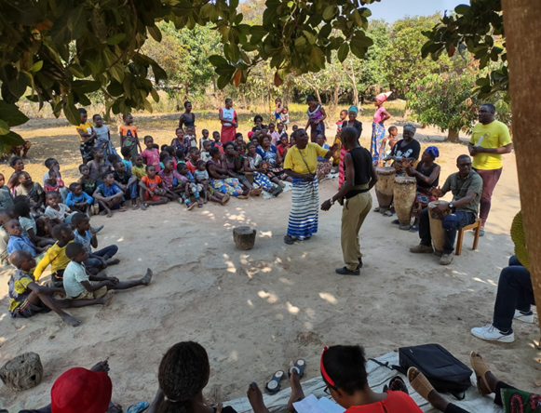
CHALLENGES/LESSONS
Low attendance of men at triggering sessions
Lack of proper planning for the Triggering session resulting in making the communities wait long hours
Availability of trained providers for example at health facilities to conduct anthropometric measurements (nutrition assessment)
Mobility of the CANCC members to support triggering activities in vast catchments with a lot of villages

Slide 12


Thank you for your attention.
Any questions?

