Slide 1
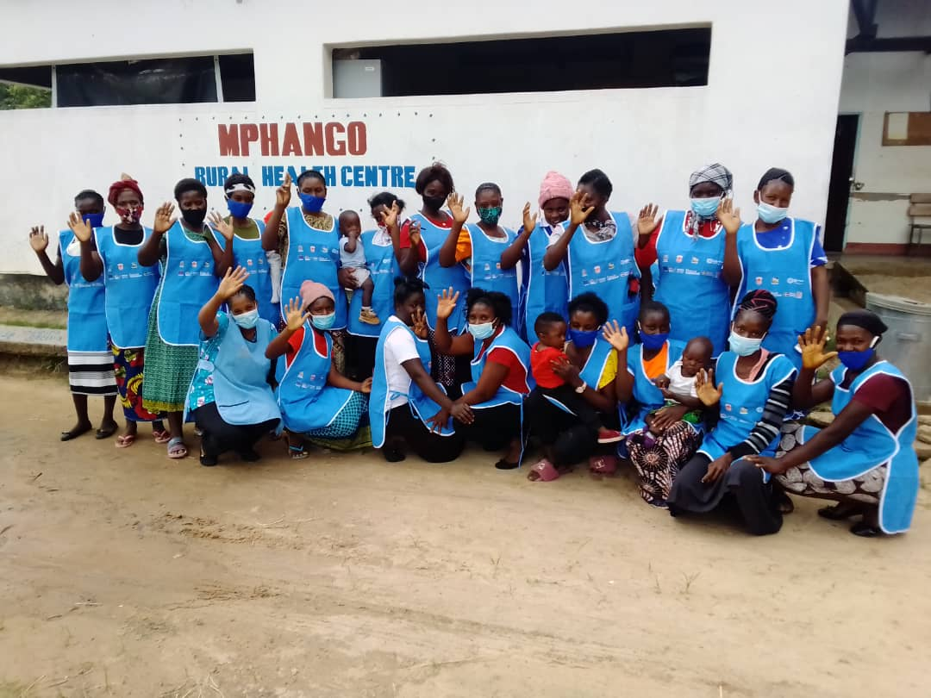
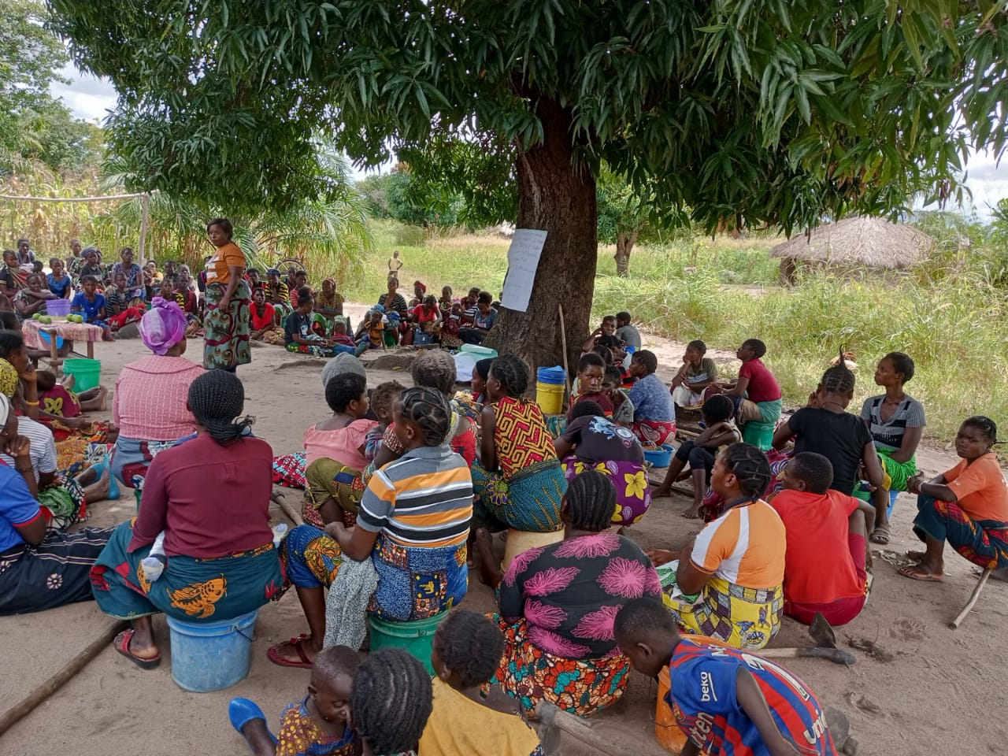
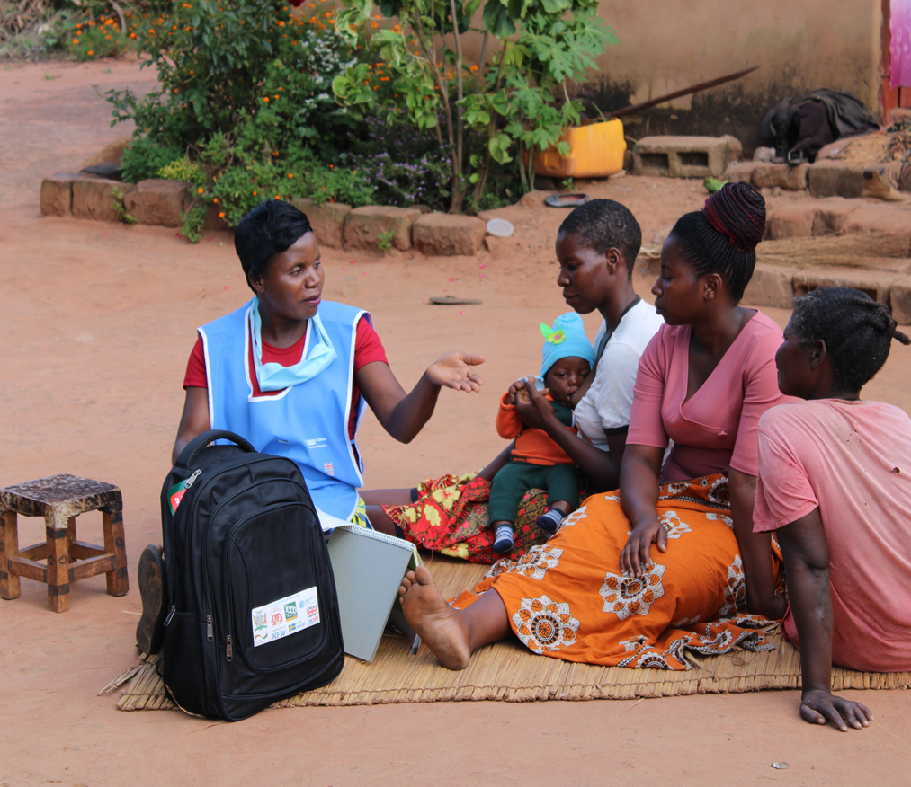
Programme Performance Monitoring Updates and Lessons:
Community Platforms

Slide 2
Outline
Back ground
Target group
Topics taught in lessons
Lessons learnt
Challenges
Way forward

Slide 3
Acknowledgements
Contributors
NFNC Jane Chilembo
MoH Freddie Chalula
SUN TA Beatrice Kawana
GIZ Gladys Kabaghe and Patrick Kolala
Catholic Relief Services Barbara Chisangano, Dorothy Banda, Levyson Banda and Elizabeth
UNICEF Jane Chitanda & Ruth Siyandi

Slide 4
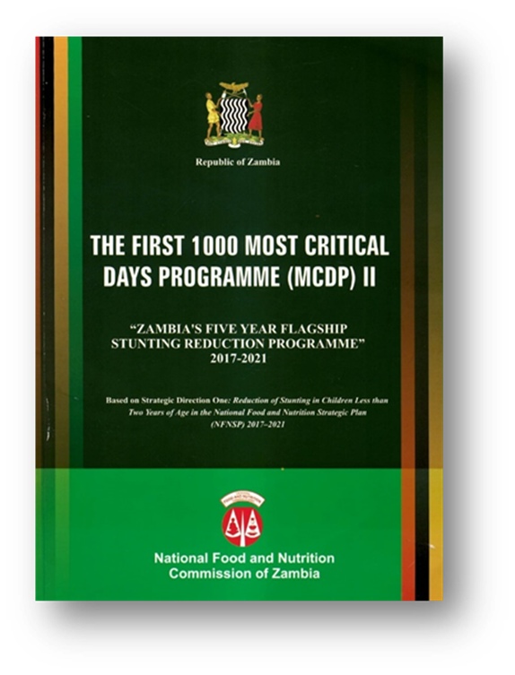
Background
First 1000 Most Critical Days Programme (MCDP)
Objective of reducing the national prevalence of stunting among children less than 2 years of age to 25% by 2025.
1st phase of the MCDP
Low coverage of the beneficiary households with the priority nutrition interventions.
Nutrition Support Group(care group model) purpose:
Increasing coverage to 90% and
Negotiate for behaviour change through nutrition counseling
Notes:
In phase 2 of the MCDP, the Care group model was adapted as the community level infrastructure to channel the priority nutrition interventions to reach the beneficiary HH.
The government’s vision is for the Nutrition Support Group model to be implemented and managed through the existing government structures.
This is indicated in the strategy for MCDP II.

Slide 5
Nutrition Support Groups and how they work
A Community-based strategy that aims at improving coverage and behavior change related to health and nutrition (sensitive and specific) practices.
An approach that ensures target beneficiaries and households are reached with or inked to intervention and reduced the workload of the traditional volunteers
Nutrition Support Group is a group of 10-12 volunteers who regularly meet together with a promoter and staff to received training and supervisory support.
Nutrition Support Groups focus:
Pregnant women
Lactating women
Children under the age of two
Nutrition Support Group structure
NSG comprises 10 NSG volunteers
Households (Neighbor Households)
District Nutritionist
NSG Field Supervisor
NSG Promoters
5-6 NSG (50-60 volunteers.(500-600 HH)
Notes:
Each volunteer (chosen by fellow mothers) is responsible for regularly visiting 8-12 of her neighbor household and shares what she has learned and facilitates discussions that promote behavior change at the household level

Slide 6
Nutrition Support Groups and how they work
Establishment of the structure
Neighbour households
Volunteers
Promoters
Supervisors
District nutritionist
How it works.
Cascaded training
Cascaded lesson delivery
Reporting
Monitoring and supervision
Nutrition Support Group structure
NSG comprises 10 NSG volunteers
Households (Neighbor Households)
District Nutritionist
NSG Field Supervisor
NSG Promoters
5-6 NSG (50-60 volunteers.(500-600 HH)
Notes:
Each volunteer (chosen by fellow mothers) is responsible for regularly visiting 8-12 of her neighbor household and shares what she has learned and facilitates discussions that promote behavior change at the household level

Slide 7



Notes:
Focus is no mothers and not HH
Volunteers are CBVs – ? Peer to peer
Coordinator is at subdistrict level
Reports are received and reviewed by the respective ministries at district and the DNCC
Definition: A community-based nutrition support group where mothers and other caregivers meet to share nutrition knowledge and practices aimed at fighting all forms of malnutrition.
TALKING POINTS:
SMSGs are formed within each Health Facility catchment area following this structure:
Health Facility appoints a coordinator who supports a network of CBV supervisors
Each supervisor supports/ supervises 6 group of Community Based Volunteers
Each trained CBV forms/ in charge of 4 SUN Mother Support Groups that include up to a maximum of 15 mothers per groups
SUN Mother Support group is the unit of interaction where interventions are layered (Health and Nutrition, WASH and Agriculture)
Each CBV meets each group once a week and facilitate 1 group discussion every week
Discussions are on various Health and Nutrition topics mainly being drawn on IYCF and caring practices, but also includes WASH, Agriculture and Community savings topics.
SMSGs provide an opportunity where mothers within the SMSG that might require more assistance are identified by CBVs and these are followed and provided individualized counseling/assistance through targeted home visits.

Slide 8
NSG/MSG topics covered in lessons
Model 2 – 6 Districts
Lesson 1: Why Good Nutrition Matters? - Introduction to Nutrition Support Groups
Lesson 2: Feeding a Child 6-23 Months
Lesson 3: Catching Child Health Problems Early
Lesson 4: Food Processing, Preservation and Storage
Lesson 5: Handwashing
Lesson 6: Breastfeeding
Lesson 7 Sanitation
Lesson 8: home gardening
Lesson 9: Food hygiene
Model 3 – 13 Districts
Lesson 1: Nutrition during pregnancy
Lesson 2: Importance of ANC and Postnatal services
Lesson 3: Family planning
Lesson 4 Nutrition for infants less than six months (Early initiation and EBF)
Lesson 5: Feeding of infants at 6-11, 12-24 months
Lesson 6: Hygienic preparation and storage of complementary foods
Lesson 7: Nutrition for breastfeeding mothers
Lesson 8: Importance of regular growth monitoring and promotion
Lesson 9: Water and Sanitation and hygiene education (Prevention of diarrhoea diseases).
Lesson 10: Agriculture and livelihoods (Promotion of backyard gardening and savings)
Model 1 - 17 Districts
Lesson 1: Why Good Nutrition Matters? - Introduction to Nutrition Support Groups
Lesson 2: Feeding a Child 6-23 Months
Lesson 3: Catching Child Health Problems Early
Lesson 4: Food Processing, Preservation and Storage
Lesson 5: Handwashing
Lesson 6: Breastfeeding
Lesson 7: Food groups and diversity
Lesson 8: Feeding a child during and after illness
Lesson 9: Sanitation
Notes:
Colour codes: nutrition (green), agriculture (pink), WASH (blue), social protectrion (no colour)

Slide 9
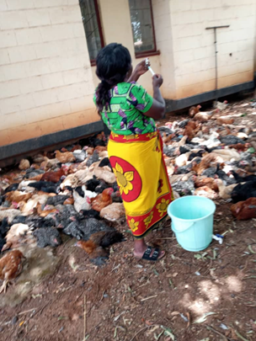
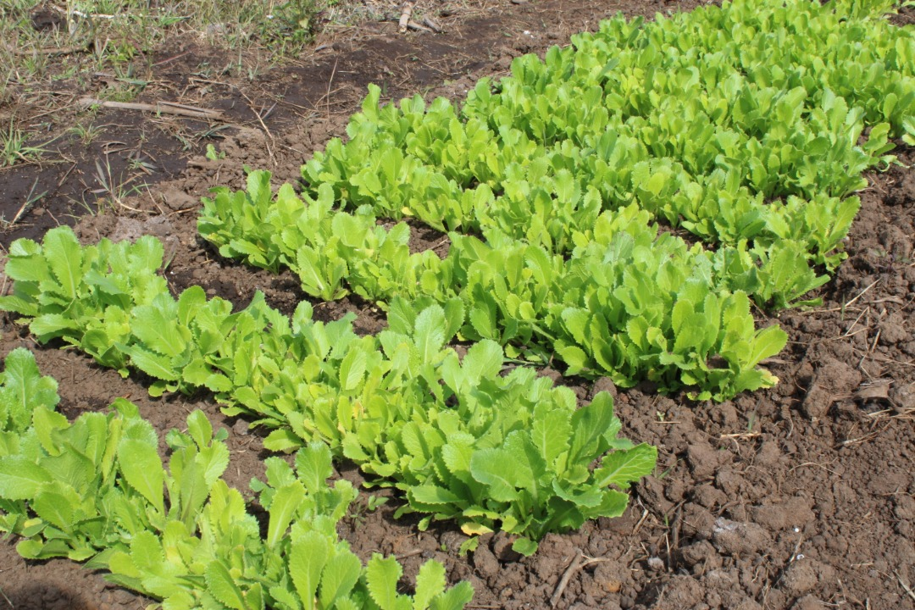
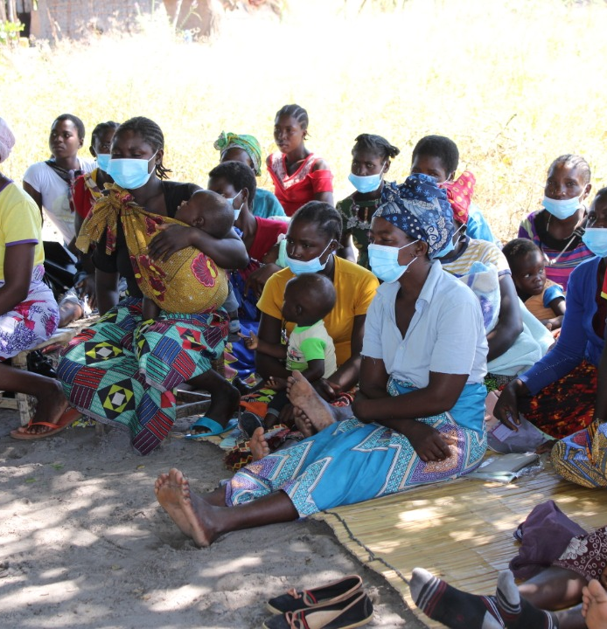
Integration of other services
NSG Neighbor Households Groups have been linked to the lead farmers in some districts. e.g. NSG groups planted the biofortified field crop seeds on demonstration plots
beneficiaries in Savings Groups are SUN II households who also use money to
NSG Neighbor Households provide an appropriate platform for delivering livestock (chickens), targeting of pass on goats and the construction of fish ponds that benefits the vulnerable SUN Households

Slide 10
Unique aspects of 3 models
Model 1 - 17 Districts
Model 2 – 6 Districts
Model 3 – 13 Districts
Triggering allows for the layering of interventions for the different sectors

Slide 11
Lessons Learnt
The NSG Model has proved very effective and efficient in reaching households of the 1000 MCDP.
1
Lesson coverage >90% in the 6 districts and about 80% in the 17
The inclusion of the gatekeepers especially the traditional leaders has helped to encourage the beneficiary households to participate in the programme.
2
The importance and necessity of male involvement have been realized they are a key significant other.
3
Notes:
Efficient in the sense that beneficiary HH are followed up if lesson is missed.
Effective in that the HH can make commitments relevant to them

Slide 12
Integration into the government system
Model 1 - 17 Districts
Working with GRZ staff in the
Working with DNCC and WNCC
Model 2 – 6 Districts
Working with provincial, district and subdistrict level staff
Signed transition agreements with provincial PSs
Training province and district staff on NSG methodology as part of the transition plan
Model 3 – 13 Districts
Working with subdistrict GRZ staff who are supervising the CBV

Slide 13
Achievements
Successfully established care groups to support the prevention and reduction of stunting in 36 selected districts.
Lessons are being delivered and repeated where need be.
Grouped household have been linked to sector activities or service providers
75% of HH in 3 districts, Kawambwa, Mwense and Mwansabombwe,

Slide 14
Challenges
Dropout for both volunteers and Households/mothers.
Staff transfers at health facilities.
48% moved
Notes:
Challenges of dropouts are similar for all programs using volunteers
Staff transfers – loose trained personnel in the methodology. Mitigate by training provincial and district staff.

Slide 15
Way forward
Documentation of the lesson learnt in the use of the adapted models to inform future implementation and finalization of the guidelines

Slide 16
Thank you.

