Slide 1







Manufacturers’ Licenses and Permits – At What Cost
National Nutrition Conference
September 2023

Slide 2


Outline
Introduction
Methodology
Study Findings
Conclusion
Recommendations

Slide 3
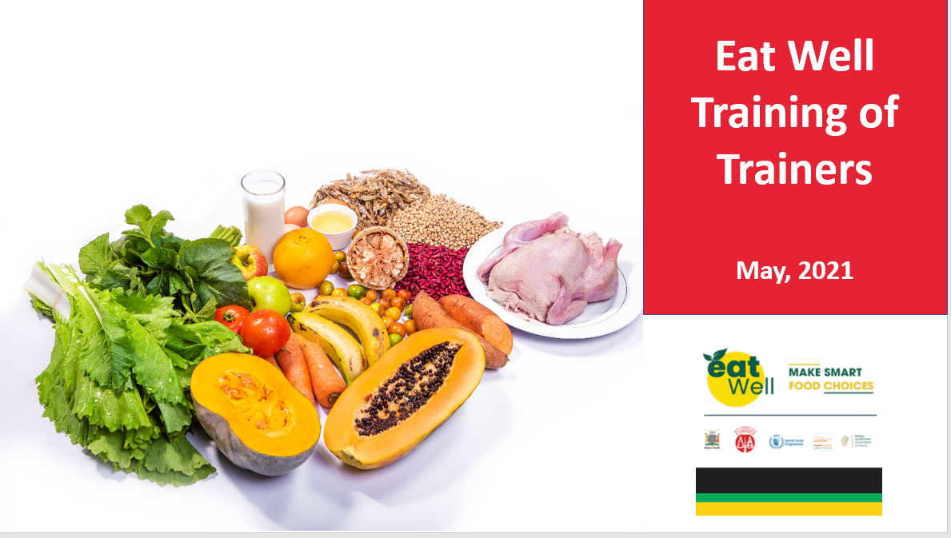
Health Diet campaign
A series of TOT were supported to NFNC and MOH with four initial districts reached
SBN supported MoH/NFNC to roll out of HDC to 4 districts with 547 people trained at national, provincial, district and community level
A plan to extend this support to 12 districts targeting schools and community base health volunteers is underway
Sensitisation on the HDC is currently ongoing at community level using social media and mass media
SBCC materials available

Slide 4
Health Diet campaign and Good Food Logo
Good Food Logo continues to be implemented with NFNC and ZABS taking the lead.
Currently 41 food products have been certified with the GFL
127 private sector companies have been recruited through the SBN initiative to date
74 companies engaged on GFL.

Slide 5


SBN Overview
Background
It’s the key coordinating platform that enables the private sector to sustainably contribute to improving nutrition.
The SBN is part of the global SBN platform and the broader SUN Movement.
Established in 2014
Co-convened by WFP and NFNC and currently has
Total Membership 127
SBN Strategy - outcomes
Empower the private sector to increase ability and willingness to invest in products and practices that
contribute to ending malnutrition
Increase awareness and drive consumer demand for nutritious foods
Support policy and regulatory efforts that enable business action in nutrition
.
Currently 41 food products have been certified with the GFL

Slide 6


Introduction
ZAM undertook a study to understand the impact of the cost of Statutory Licenses and Permits on Manufacturers of Nutritious Foods and Beverages.
Nutrition is key to reducing poverty as is said “ a healthy nation is a wealthy nation”. As such, it is imperative to understand the working environment of producers of nutritious foods and beverages to safeguard consumers from consuming products that might have health implications once consumed as well as to ensure protection of the environment among other things

Slide 7
Working Definitions
Small scale manufacturer: a manufacturer who has an annual turnover of less than 200,000 and/or employs between 1 to 10 employees.
Manufacturer: an enterprise that produces nutritious foods and beverages.
Medium scale manufacturer: a manufacturer who has an annual turnover between 200,000 and 800,000 and employs about 11 to 50 employees.
Nutritious foods and beverages: foods and beverages that provide beneficial nutrients (e.g. vitamins, major and trace minerals, essential amino acids, essential fatty acids, dietary fibre) and minimises potentially harmful elements (e.g. antinutrients, quantities of saturated fats and sugar).
Large scale manufacturer: a manufacturer who has an annual turnover of more than 800,000 and employs 51 employees or more.
Duplication: similar licences or permits which has the same effect or addresses the same issue.
Harmonisation: the process of collecting all similar licences and permits which have the same effect or address a similar issue and combining them.

Slide 8





Methodology
Sample Selection Technique
Public Sector (Respondents were purposively selected from departments dealing with policy and administration of permits and licences)
Private Sector (Purposive and Snowballing)
Desktop Review
Key Informant Interviews and questionnaire administration with public and private sector
Sample size :
manufacturers 22+ and 14 Government entities
Manufactures interviewed were from Lusaka, Mongu, Mumbwa and Ndola.
36+

Slide 9



Study Findings
Manufacturing companies may face up to
49
18
Licences and Permits
Voluntary
31
Compulsory

Slide 10
Study Findings
90%
Obtaining licences and permits negatively affected business operations of the majority of manufacturers of nutritious foods and beverages.
48%
Obtaining licences and permits improves how consumers perceive products

Slide 11
Study Findings
Time Cost of Obtaining Licences or Permits
Procedure Cumbersome, even after full payment.
120 Days
Certificate of industrial Design
Certification of registration for Trademarks
Title Deeds
14 Days
Council
ZMA
Health

Slide 12


Study Findings
Cont'd
The total cost of obtaining licences and permits negatively impacted small and medium manufacturers more than large manufacturers.
On average, licences and permits accounted for 4.42% of turnover, 12.56% of gross profit and 14.85% of the net profit for the small-scale manufacturers.
Average costs of licences and permits for medium manufacturers accounted for 1.06% of turnover, 8.08% of the gross profit and 8.08% of the net profit.
For large manufacturers, average costs of licences and permit accounted for 0.37% of turnover, 1.75% of gross profit and 3.22% of net profit.

Slide 13

Conclusion
Food safety is an absolute necessity in any food and or beverage manufacturing entity and requires licencing and certification. However, it creates unintended costs in processing and procedure times, inconvenience
Licence and permit costs come in many forms including time costs, inconvenience costs, duplicity but licenced goods are perceived in a positive light by consumers
The cost of permits and licences was higher among small enterprises compared to medium and large enterprises. Cost analysis revealed that small manufacturers bear the highest brunt of licences
Small manufacturers bear the brunt of licences and permits at 76% of their turnover.

Slide 14




Recommendations
Given that food safety is an absolute necessity in any food and or beverage manufacturing entity and requires licencing and certification but creates unintended costs in processing and procedure times, inconvenience, Government should remove the unintended costs that have arisen with respect to licensing and certification
The high cost of permits and licences more especially among small enterprises compared to medium and large enterprises should be reduced to ensure that small manufacturers do not bear the highest brunt of licences
To remedy the licence and permit costs that come in many forms including time costs, inconvenience costs, duplicity but licenced goods are perceived in a positive light by consumers.
Reduce the percentage of licences and permits in the turnover of small manufacturers.

Slide 15

Thank you!

