Slide 1
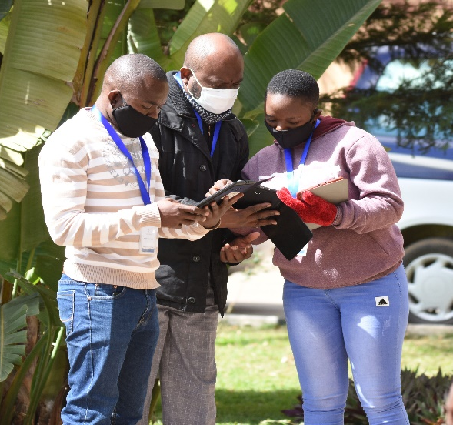





SUN/MCDP II 2022 Performance Assessment
National Nutrition conference
13 September 2023
Radisson Blue Hotel, Lusaka
“Sustaining stunting reduction through creating an enabling environment for nutrition programmes”

Slide 2
Presentation Outline
Acknowledgements
Introduction/Background
Methods
Findings and Implications
Conclusions
Recommendations
“Sustaining stunting reduction through creating an enabling environment for nutrition programmes”

Slide 3

Acknowledgements
USAID/Zambia for financial and technical support
Government of Zambia (GRZ) staff through various line ministries for input in design and participation in interviews
Multilateral and bi-lateral donors, Cooperating Partners, and NGOs for their valued technical contribution
NFNC for leadership in design, implementation, and coordination
Assessors for their dedication in ensuring that quality data was collected
“Sustaining stunting reduction through creating an enabling environment for nutrition programmes”

Slide 4
Introduction / Background

Slide 5



Background
Scaling Up Nutrition Learning and Evaluation (SUN LE) is a USAID-funded project implemented by Khulisa Management Services, Inc. in partnership with the Government of the Republic of Zambia (GRZ) and in consortium with 3 institutional partners.
Khulisa Management Services, Inc.
Indaba Agricultural Policy Research Institute
ICF International
University of North Carolina at Chapel Hill

Slide 6
PA Aims and Objectives
Overall objective:
To assess the adequacy of SUN 2.0/MCDP II core systems, structures, and capacities at all management levels (national and subnational) and across all sectors.
Specifically, the PA sought to:
To assess progress made on necessary elements (e.g., enabling environment, inputs, and processes) to facilitate the achievement of SUN 2.0/MCDP II objectives at national, provincial, district, and ward levels in the 30 priority districts.

Slide 7
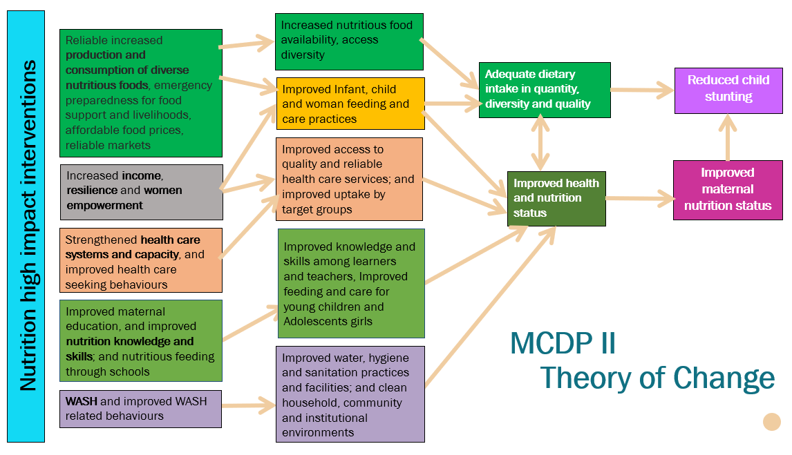
SUN/MCDP II Programme - Theory of Change

Slide 8
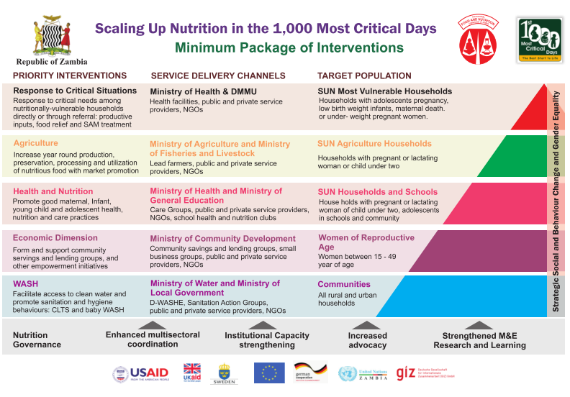
SUN/MCDP II Programme - Interventions
SUN/MCDP II GOALS
Reduce stunting among children < 2 yrs. from 40% to 25% in 7 years.
Contribute to the achievement of the Sustainable Development Goals (SDGs)

Slide 9
8 Areas of PA SUN/MCDP II assessment
1
Strategic policy frameworks, plans, guidelines; effective oversight; coalition-building; regulation; attention to system-design; and accountability.
8
1
Governance and Leadership
2
Routine information about nutrition status/needs; use of information to set/implement priorities; continual learning/adaptation based on emerging evidence/data.
7
Funding
Service Organization and Management
2
3
Performance of supply chains; availability of essential consumables, products, and technologies at health facilities/community level
Adjustment to Population Needs
4
Availability, coordination, and interoperability of civil registration/vital statistics, routine MIS, and beneficiary records systems and infrastructure.
Population Nutrition Management
Equipment, Supplies, Infrastructure
5
Sufficiency and distribution of workers to meet population nutrition needs and access to quality services; quality of workforce education and practice.
6
3
6
Priority setting, community engagement, empanelment, population outreach
Workforce
Information Systems
5
4
7
Effective service operation organization; HR deployment in multidisciplinary teams; routine reporting against targets, QI initiatives; and management oversight.
8
Management of funds to address recurrent and fixed program costs incurred at all levels, including payment of staff salaries.

Slide 10
PA: 8 Domains & 28 Measures Assessed
1. Governance and Leadership
1. Nutrition leadership
2. Adjustment to Population Needs
Surveillance of nutritional related AEs
3. Commodities, Supplies, & Service infrastructure
Availability of essential commodities
4. Information Systems
Priority setting (and allocation of resources)
Learning and Innovation
Availability of basic equipment
12. Management information system (both multi-sectoral coordination and sector specific)
13. Beneficiary records (for individuals and households)
Coverage of the package of services, distribution, and convergence
2. Leadership
4. Social Accountability (collaboration with external stakeholders)
5. Social Accountability – multi-sectoral action (within Government sectors)
3. Quality Management Infrastructure
“Sustaining stunting reduction through creating an enabling environment for nutrition programmes”

Slide 11
PA Domains & Measures Assessed
5. Workforce
14. Workforce density and distribution (based on defined complement of staff)
6. Funding
17. Budgets
7. Population Nutrition Mgt
20. Local priority setting
8. Service Organization and Management
24. Team-based services delivery (single unit, shared identity, coordinated)
18. Financial Management Information System
19. Remuneration (community workers)
21. Community engagement (in design, financing, governance, and implementation)
22. Empanelment (providers know who they are responsible for and how many)
23. Proactive population outreach
25. Existence of service management capability and leadership (professionalised, service trained and evaluated)
26. Information system use
27. Performance targets
28. Supportive supervision
15. Workforce competencies
16. Community workers
“Sustaining stunting reduction through creating an enabling environment for nutrition programmes”

Slide 12
Focus of the 2022 PA
The PA was designed to allow for common measurement of performance across GRZ vertical and horizontal levels
Horizontal (sectoral) levels
Vertical Levels
Health
Agriculture
Fisheries and Livestock
Community Development and Social Services
Water Development, Sanitation, and Environmental Protection
Education
National
Provincial
District
Wards

Slide 13
Assessment Methodology
“Sustaining stunting reduction through creating an enabling environment for nutrition programmes”

Slide 14
Sampling Techniques
Both non-probability and probability sampling techniques applied
Non - probability sampling
Purposive sampling technique used for national, provincial, district and ward level (focal point persons/staff working on the SUN/MCDP II Programme)
Implementing partners supporting the SUN/MCDP II at national and in the 30 priority districts
Probability sampling
Selection of two (2) wards in each of the 30 priority districts using simple random sampling
“Sustaining stunting reduction through creating an enabling environment for nutrition programmes”

Slide 15
Interview Approach
Conducted as a group discussion, with at least two respondents per group.
In addition, records were requested to verify responses (where necessary)
“Sustaining stunting reduction through creating an enabling environment for nutrition programmes”

Slide 16
Targeted and Actual Interviews
Vertical Level | Group | Targeted Interviews |  | Actual interviews
 |  | No | Details | No | % of target
National | GRZ staff | 7 | 6 reps from key line ministries 1 NFNC | 7 | 100.0%
 | Implementing Partners | 6 | 1 interview x reps from 6 partners (UNICEF, GIZ, SUN TA, WFP, FAO, WHO) | 6 | 100.0%
Provincial | GRZ staff | 67 | 6 reps from key line ministries x 10 provinces 1 NFNC interview x 7 provinces | 66 | 98.5%
District | GRZ staff | 197 | 6 reps from key line ministries x 30 districts, 1 NFNC interview x 18 districts | 198 | 100%
 | Implementing Partners | 30 | 1 IP interview per district (n=30) | 30 | 100%
Ward | GRZ staff | 360 | 2 ward interviews x 30 districts x reps from each of the 6 key line ministries. | 304 | 80%
TOTAL No. Interviews |  | 667 |  | 659 | 98.9%

Slide 17
Selection and Training of the PA Team
Participation in SUN LE’s previous PA (26) and (4) new members with experience in previous surveys
2 senior assessors and 30 assessors participated in a 10-day training workshop
Training conducted by 2 senior assessors and SUN-LE’s Zambia staff
Training involved going through each question in the PA and associated guidance, role plays, and correctly scoring the domains and measures.

Slide 18
Data Collection, Management, and Quality
Fieldwork Dates: 3 October to 30 November 2022
To enhance data management and quality, data was collected using Kobo Collect
Ensure real time collection of data
Minimised entering out-of-range scores, skipping questions, and recording incorrect responses
“Sustaining stunting reduction through creating an enabling environment for nutrition programmes”

Slide 19
Data Collection, Management, and Quality
Completed questionnaires were checked by the assessors and team supervisors before submission.
Submitted data was randomly checked by senior assessors who provided comments for the teams to address/rectify before final submission/uploading on to the server.
Weekly meetings were held with team leads to ensure that assessors were correctly scoring the sectors and providing appropriate comments and evidence to justify the scores.
“Sustaining stunting reduction through creating an enabling environment for nutrition programmes”

Slide 20
Data Cleaning and Analysis
Data cleaning and analysis was done using STATA version 17.
Data cleaning was conducted to identify duplicates, missing values, and mismatches.
Once flagged, team leads provided clarity/resolution.
Stata was used to compute mean scores for each of the domains and their respective measures.
Qualitative data from the comments sections where reviewed, coded, and themes developed to facilitate identification of factors behind the observed variability between the 2020 and 2022 findings.
“Sustaining stunting reduction through creating an enabling environment for nutrition programmes”

Slide 21
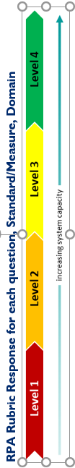
PA - Data analysis
Meaning
The attribute is in an ideal state
Attribute exists; some improvement is required to make it ideal
Attribute exists but needs significant improvement
Attribute is weak or non-existent
Variables/Measures scored during interviews
Performance scored on a rubric scale to assign capacity/ performance level
Rubric scores averaged at the domain, measure, and dimension levels
2020 scores compared with 2022 scores

Slide 22
Calculation of Performance Scores
Each domain’s respective measures and dimensions.
To compute the level (1 – 4 based on the Rubric) for each measure, the mean score was computed from the scores from each of the dimensions
To compute the overall score for each domain, the mean scores for each of the measures were equally computed
“Sustaining stunting reduction through creating an enabling environment for nutrition programmes”

Slide 23
Validity of the PA methodology
The methodology was developed by several development partners and UN agencies:
The World Health Organization, the World Bank Group, UNICEF, Results for Development, Ariadne Labs, and The Bill & Melinda Gates Foundation
The methodology has been extensively validated in various developmental settings
The approach has been used by over 150 countries across the global to assess performance of primary health care performance, among others

Slide 24

FINDINGS

Slide 25

Domain 1: GOVERNANCE AND LEADERSHIP

Slide 26
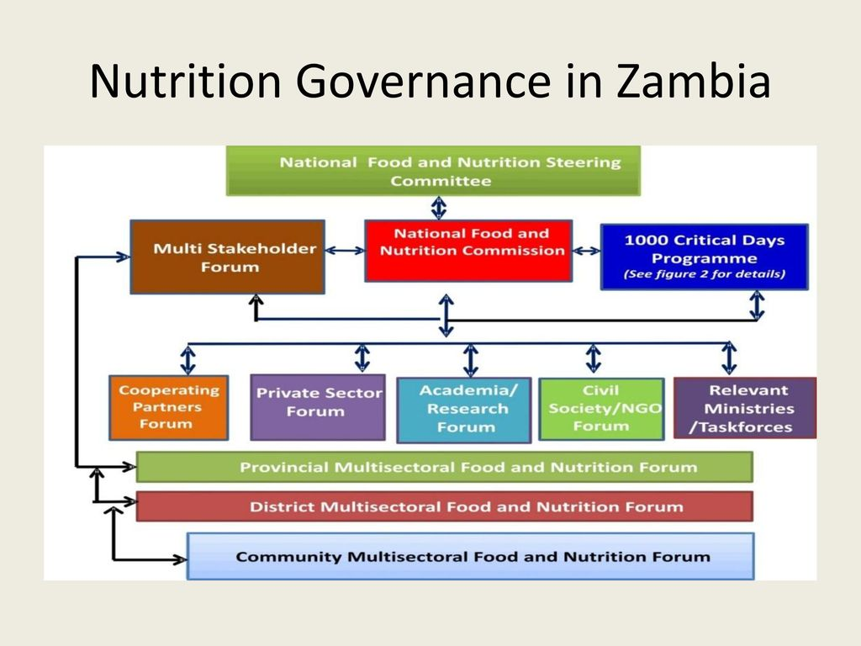
Governance and Leadership
Nutrition / SUN Policies
Quality Management
Collaboration within Government sectors
Collaboration with External stakeholders
Leadership
Notes:
Nutrition/SUN policies
This measure is designed to assess Zambia’s governmental commitment to SUN/nutrition both in theory and in practice
Leadership
This measure is about leadership for coordinating, monitoring, integrating, and implementing SUN-related policies. It assesses Zambia’s ability to follow through on policies and strategies, specifically through the leadership of a national coordinating entity
Leadership
This measure is about leadership for coordinating, monitoring, integrating, and implementing SUN-related policies. It assesses Zambia’s ability to follow through on policies and strategies, specifically through the leadership of a national coordinating entity
Collaboration between Government sectors
social accountability addresses national-level collaboration and input
Collaboration with external stakeholders
This measure is specifically about multi-sectoral action across relevant government ministries/sectors whose work relate to Nutrition

Slide 27
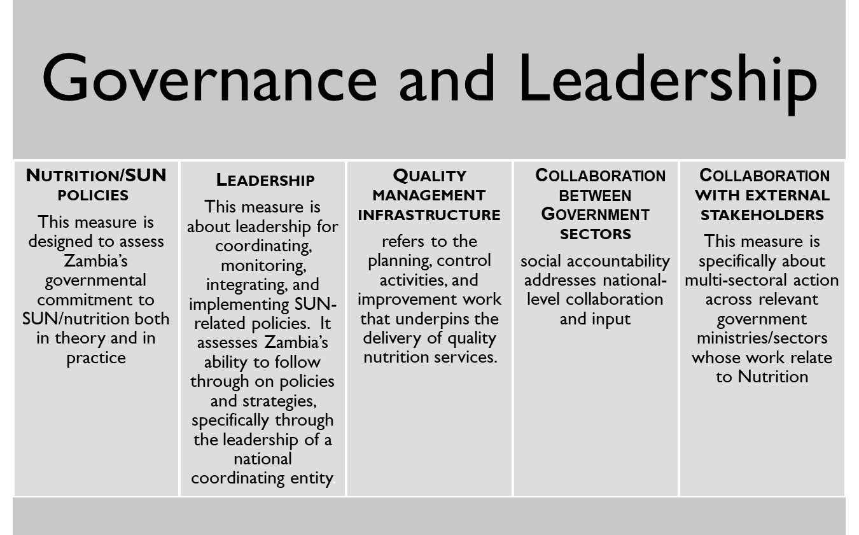
Measures in Governance & Leadership
“Sustaining stunting reduction through creating an enabling environment for nutrition programmes”
Notes:
The Governance and Leadership domain focused on assessing whether strategic policy frameworks exist and are combined with effective oversight, coalition-building, regulation, attention to system-design, and accountability

Slide 28
Governance and Leadership: Overall performance
Overall average score improved from 2.5 in 2020 to 3.3 in 2022
All measures improved their scores from level 2 in 2020 to level 3 in 2022, except for “collaboration with external stakeholders”, which remained within level 2
Quality management infrastructure scored highest in both assessments (2.9 in 2020 and 3.4 in 2022)
Notes:
The score of 2 indicates that some attributes of governance are in place, but significant effort is required to ensure that we reach the ideal of 4.
Compared to 2020 Nutrition has sufficiently featured in the government plans in 2022

Slide 29
Governance and Leadership: Performance by Sector
All line ministries improved their scores in this domain since 2020, with NFNC and MoH having higher scores than the others in both assessments.
MoE scored lower than all the other line ministries. This could be attributed to limited time to implement the school health and nutrition (SHN) revised guidelines, which were distributed mid-year of 2021.
Notes:
The score of 3 indicates that some attributes of governance are in place, but significant effort is required to reach the ideal.

Slide 30
Governance and Leadership - National Level
Sector | Overall, Domain |  | Measures
 |  |  | Nutrition/ SUN Policies |  | Leadership |  | Quality Management |  | Collaboration with …
 |  |  |  |  |  |  |  |  | … GRZ stakeholders |  | … external stakeholders
 | 2020 | 2022 | 2020 | 2022 | 2020 | 2022 | 2020 | 2022 | 2020 | 2022 | 2020 | 2022
MOH | 3.4 | 3.3 | 4.0 | 3.8 | 3.0 | 3.0 | 3.2 | 3.8 | 3.6 | 2.7 | 2.8 | 3.4
MOA | 3.0 | 3.6 | 3.6 | 4.0 | 2.8 | 3.0 | 2.6 | 3.6 | 2.9 | 3.7 | 2.8 | 3.8
MoFL | 2.8 | 3.4 | 3.0 | 3.2 | 2.8 | 3.4 | 2.4 | 3.8 | 2.6 | 3.7 | 3.0 | 3.0
MWDS | 3.3 | 3.3 | 3.4 | 3.5 | 3.0 | 3.2 | 3.2 | 3.8 | 3.4 | 2.9 | 3.0 | 3.4
MCDSS | 3.2 | 3.4 | 4.0 | 3.3 | 2.6 | 3.0 | 2.8 | 3.6 | 3.0 | 3.4 | 3.2 | 3.6
MOE | 3.1 | 3.1 | 3.7 | 3.3 | 3.0 | 3.2 | 2.6 | 3.4 | 2.9 | 3.1 | 3.2 | 2.4
Total | 3.1 | 3.4 | 3.6 | 3.5 | 2.9 | 3.1 | 2.8 | 3.7 | 3.1 | 3.3 | 3.0 | 3.3
At national level, this domain remained within level 3, though it improved slightly.
All measures under this domain improved, except for nutrition/SUN policies, which remained relatively high (3.5).
Leadership, quality management, and collaboration within government stakeholders improved from level 2 in 2020 to level 3 in 2022
MoA improved in Nutrition/SUN policies performance from level 3 in 2020 to 4 in 2022
MoH and MCDSS’ performance dropped from level 4 in 2020 to 3 in 2022.
Notes:
The score of 2 indicates that some attributes of governance are in place, but significant effort is required.

Slide 31
Why Quality improvement performed better
Implementation of quality assurance interventions, such as registration and accreditation of staff working in the sector, inspection of institutions for minimum quality standards, etc.
Commitment to institutionalise quality
Culture of learning around provision of quality services
“Sustaining stunting reduction through creating an enabling environment for nutrition programmes”

Slide 32
Governance and Leadership by Province
Province | Overall Domain Score |  | Measures
 |  |  | Nutrition/ SUN plans |  | Leadership |  | Quality Management |  | Collaboration across Govt Ministries
 | 2020 | 2022 | 2020 | 2022 | 2020 | 2022 | 2020 | 2022 | 2020 | 2022
Central | 2.4 | 3.1 | 2.0 | 3.2 | 2.3 | 2.7 | 3.1 | 3.5 | 2.0 | 2.9
Copperbelt | 2.2 | 3.1 | 2.0 | 3.0 | 2.0 | 2.9 | 2.9 | 3.4 | 2.0 | 3.2
Eastern | 2.8 | 3.1 | 2.9 | 3.2 | 2.8 | 2.9 | 3.1 | 3.1 | 2.5 | 3.0
Luapula | 2.9 | 3.2 | 2.8 | 3.2 | 3.0 | 2.9 | 3.1 | 3.4 | 2.7 | 3.1
Lusaka | 2.2 | 3.0 | 2.7 | 2.9 | 1.9 | 2.9 | 2.6 | 3.4 | 1.6 | 2.7
Muchinga | 1.9 | 3.4 | 1.6 | 3.6 | 1.8 | 3.2 | 2.5 | 3.7 | 1.5 | 3.5
Northern | 2.8 | 3.1 | 2.5 | 3.4 | 2.8 | 2.7 | 3.2 | 3.6 | 2.8 | 3.2
North-Western | 2.5 | 3.4 | 2.6 | 3.5 | 2.4 | 3.1 | 2.7 | 3.6 | 2.2 | 3.4
Southern | 2.4 | 3.2 | 2.6 | 3.2 | 2.3 | 3.1 | 2.8 | 3.2 | 2.0 | 3.1
Western | 2.5 | 3.3 | 2.3 | 3.2 | 2.5 | 3.2 | 2.9 | 3.5 | 2.3 | 3.1
All Provinces | 2.6 | 3.2 | 2.4 | 3.2 | 2.4 | 3.0 | 2.9 | 3.4 | 2.5 | 3.1
All provinces improved their overall performance in this domain.
At measure level, all provinces except Lusaka had improved performance in Nutrition policies (from level 2 in 2020 to level 3 in 2022).
Muchinga, North-Western, and Southern provinces recorded improvements in all the measures.
The observed performance was attributed to improved multi-sectoral approach in the implementation and management of activities at provincial level.
Notes:
All districts have weak governance structure

Slide 33
Governance and Leadership by District
All districts improved their performance from levels 1 and 2 in 2020 to level 3 in 2022
except for Chibombo, Ndola, Chipata, Samfya, and Kaputa, which remained at the same level as in 2020.
At measure level, all districts improved in quality management.
District | Overall Domain Score |  | Measures
 |  |  | Nutrition/ SUN plans |  | Leadership |  | Quality Management |  | Collaboration across Govt Ministries
 | 2020 | 2022 | 2020 | 2022 | 2020 | 2022 | 2020 | 2022 | 2020 | 2022
Chibombo | 2.0 | 2.9 | 1.3 | 2.9 | 1.9 | 2.6 | 3.1 | 3.5 | 1.7 | 2.5
Kabwe | 2.0 | 3.3 | 1.8 | 3.3 | 2.0 | 3.0 | 2.7 | 3.4 | 1.5 | 3.5
Kapiri Mposhi | 2.5 | 3.0 | 2.0 | 3.3 | 2.6 | 2.3 | 3.0 | 3.5 | 2.2 | 3.0
Mumbwa | 2.9 | 3.0 | 2.8 | 3.0 | 2.8 | 2.8 | 3.4 | 3.4 | 2.5 | 2.8
Kitwe | 2.1 | 3.2 | 1.6 | 3.2 | 2.1 | 3.0 | 2.7 | 3.5 | 2.1 | 3.1
Ndola | 2.2 | 2.9 | 2.2 | 2.4 | 1.9 | 3.0 | 3.0 | 3.2 | 1.8 | 2.9
Chipata | 2.7 | 3.0 | 2.7 | 3.1 | 2.8 | 2.9 | 2.9 | 3.1 | 2.4 | 2.8
Katete | 3.0 | 3.0 | 3.3 | 3.1 | 2.8 | 2.6 | 3.2 | 3.3 | 2.8 | 2.9
Petauke | 2.8 | 3.1 | 2.7 | 3.3 | 2.7 | 2.7 | 3.3 | 3.2 | 2.4 | 3.0
Lundazi | 2.9 | 3.2 | 2.9 | 3.2 | 2.9 | 3.2 | 3.1 | 3.1 | 2.5 | 3.2
Mansa | 2.8 | 3.1 | 2.6 | 3.1 | 2.8 | 3.1 | 3.1 | 3.2 | 2.6 | 3.1
Nchelenge | 3.1 | 3.2 | 3.1 | 3.4 | 3.3 | 2.8 | 3.0 | 3.4 | 2.8 | 3.2
Samfya | 3.0 | 3.0 | 2.7 | 3.1 | 3.1 | 2.6 | 3.1 | 3.5 | 2.9 | 2.6
Lusaka | 2.2 | 3.0 | 2.7 | 2.9 | 1.9 | 2.9 | 2.6 | 3.4 | 1.6 | 2.7
Chinsali | 1.9 | 3.5 | 1.8 | 3.5 | 2.0 | 3.4 | 2.4 | 3.7 | 1.5 | 3.5
Isoka | 1.8 | 3.5 | 1.5 | 3.5 | 1.7 | 3.1 | 2.5 | 3.7 | 1.4 | 3.5
Notes:
All districts have weak governance structure

Slide 34
Governance and Leadership by District (cont.)
District | Overall Domain Score |  | Measures
 |  |  | Nutrition/ SUN plans |  | Leadership |  | Quality Management |  | Collaboration across Govt Ministries
 | 2020 | 2022 | 2020 | 2022 | 2020 | 2022 | 2020 | 2022 | 2020 | 2022
Mpika | 1.7 | 3.6 | 1.4 | 3.7 | 1.5 | 3.4 | 2.6 | 3.6 | 1.4 | 3.5
Kaputa | 2.7 | 2.9 | 2.4 | 3.0 | 2.6 | 2.4 | 3.2 | 3.5 | 2.6 | 2.7
Kasama | 2.9 | 3.0 | 2.6 | 3.3 | 3.2 | 2.5 | 3.2 | 3.5 | 2.7 | 2.8
Luwingu | 2.6 | 3.1 | 2.1 | 3.2 | 2.2 | 3.0 | 3.2 | 3.5 | 3.0 | 2.7
Mbala | 3.0 | 3.4 | 2.7 | 3.7 | 3.1 | 2.8 | 3.2 | 3.7 | 2.8 | 3.2
Mwinilunga | 2.6 | 3.4 | 2.7 | 3.4 | 2.5 | 3.3 | 2.7 | 3.6 | 2.4 | 3.4
Solwezi | 2.0 | 3.3 | 2.0 | 3.5 | 1.6 | 2.9 | 2.7 | 3.4 | 1.8 | 3.4
Zambezi | 3.0 | 3.4 | 3.2 | 3.4 | 3.2 | 3.2 | 2.8 | 3.6 | 2.6 | 3.4
Choma | 2.5 | 3.3 | 2.8 | 3.3 | 2.4 | 3.3 | 2.8 | 3.4 | 2.1 | 3.3
Monze | 2.3 | 3.1 | 2.4 | 3.1 | 2.1 | 3.0 | 2.8 | 3.1 | 1.9 | 3.0
Kalabo | 2.7 | 3.3 | 2.3 | 3.2 | 2.8 | 3.3 | 2.9 | 3.6 | 2.6 | 3.0
Kaoma | 2.0 | 3.1 | 2.0 | 3.1 | 1.4 | 3.1 | 2.8 | 3.3 | 1.7 | 2.7
Mongu | 2.7 | 3.2 | 2.9 | 3.0 | 2.7 | 3.3 | 2.8 | 3.6 | 2.3 | 2.9
Shang’ombo | 2.7 | 3.2 | 1.8 | 3.4 | 3.1 | 3.2 | 3.1 | 3.4 | 2.9 | 2.9
Total | 2.6 | 3.2 | 2.4 | 3.2 | 2.4 | 3.0 | 2.9 | 3.4 | 2.5 | 3.1
Notes:
All districts have weak governance structure

Slide 35
Overall Performance at Ward Level by Sector
Ward by Sector | Overall, Domain Score by Sector |  | Nutrition/ SUN Policies |  | Leadership |  | Quality Management |  | Collaboration with External Stakeholders |  | Collaboration across Government Ministries
 | 2020 | 2022 | 2020 | 2022 | 2020 | 2022 | 2020 | 2022 | 2020 | 2022 | 2020 | 2022
MOH | 2.3 | 3.3 | 2.1 | 3.5 | 2.3 | 3.1 | 3.1 | 3.7 | 1.9 | 2.9 | 1.8 | 3.0
MOA | 2.3 | 3.0 | 2.0 | 3.0 | 2.4 | 3.1 | 2.9 | 3.4 | 2.2 | 2.4 | 2.2 | 2.7
MFL | 2.1 | 2.9 | 1.8 | 2.9 | 2.2 | 3.0 | 2.9 | 3.3 | 1.8 | 1.3 | 1.8 | 2.6
MWDS | 2.4 | 3.0 | 2.6 | 2.9 | 2.2 | 2.9 | 3.1 | 3.5 | 1.9 | 1.0 | 2.0 | 2.7
MOE | 2.1 | 2.8 | 2.0 | 2.9 | 2.0 | 2.7 | 2.8 | 3.3 | 1.8 | 1.7 | 1.9 | 2.4
MCDSS | 2.3 | 2.9 | 2.0 | 3.1 | 2.5 | 3.0 | 2.8 | 3.0 | 2.0 | 2.5 | 2.2 | 2.7
Total | 2.3 | 3.0 | 2.1 | 3.1 | 2.3 | 3.0 | 2.9 | 3.4 | 1.9 | 2.2 | 2.0 | 2.7
Ward performance improved from level 2 to 3, with major improvements recorded by MoH, MoA, and MWDS.
In contrast, MoFL, MoE, and MCDSS remained within level 2, despite recording some improvements
At measure level, three measures (Nutrition Policies, Leadership, and Quality Management) improved from level 2 in 2020 to level 3 in 2022; Collaboration with external stakeholders improved from level 1 to 2, while collaboration across government sectors improved but remained within level 2.
Notes:
The score of 2 indicates that some attributes of governance are in place, but significant effort is required.

Slide 36
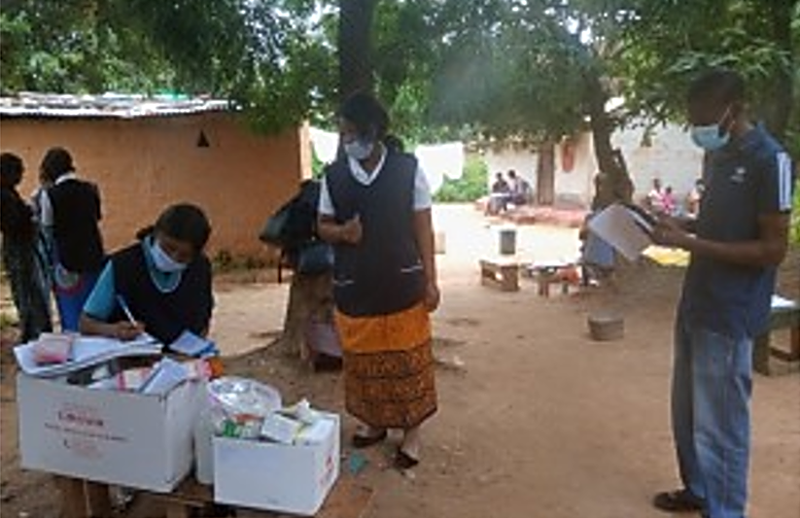
Domain 2: ADJUSTMENT TO POPULATION NUTRITION NEEDS
“Sustaining stunting reduction through creating an enabling environment for nutrition programmes”
Notes:
This domain examined 3 measures related to the SUN /MCDP II programme’s capacity to adjust to population nutrition needs.
These measures include Surveillance, Priority Setting and Learning and Innovation

Slide 37
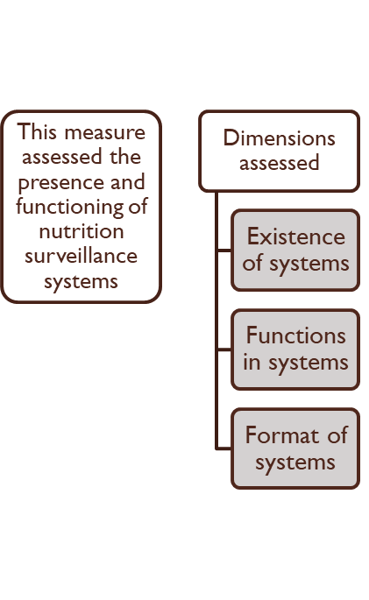
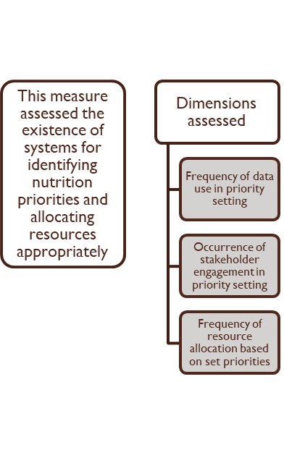
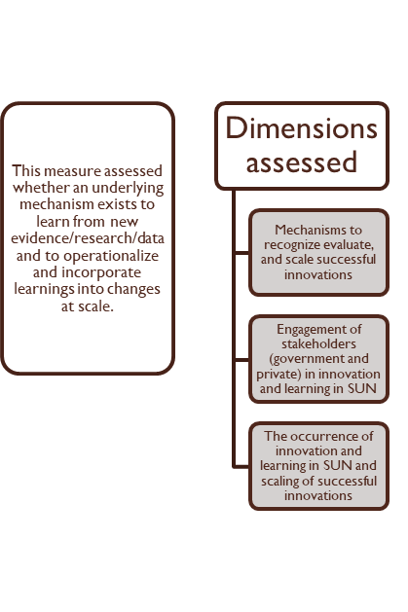
Domain 2: Adjustment to Population Needs
Surveillance system
Priority setting
Learning and Innovation

Slide 38
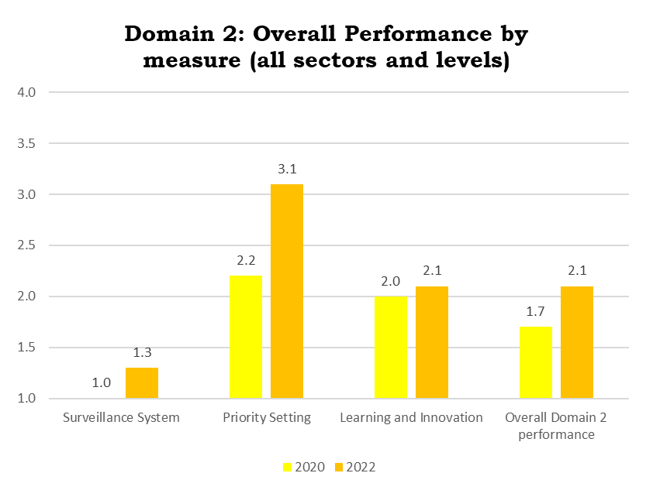
Domain 2: Adjustment to population needs
All measures in this domain improved
However, surveillance remains a weak point, with only a slight improvement (from 1.0 to 1.3)
Priority setting scored the highest in 2020 and improved further in 2022 (from 2.2 to 3.1)
Notes:
The improvement observed under priority setting can be attributed to data usage for decision making at national and provincial levels

Slide 39
Domain 2: Overall National-level Performance by Sector
 | Overall Performance |  | Surveillance |  | Priority Setting |  | Learning / Innovation
 | 2020 | 2022 | 2020 | 2022 | 2020 | 2022 | 2020 | 2022
MOH | 1.4 | 2.4 | 1.0 | 1.7 | 2.2 | 3.6 | 2.0 | 2.3
MOA | 1.6 | 2.4 | 1.0 | 1.3 | 1.6 | 3.0 | 2.5 | 2.7
MFL | 1.2 | 2.1 | 1.0 | 1.2 | 1.0 | 3.0 | 1.6 | 2.3
MWDS | 1.7 | 2.0 | 1.0 | 1.3 | 1.7 | 3.1 | 2.1 | 2.1
MCDSS | 1.3 | 2.0 | 1.0 | 1.3 | 1.7 | 2.9 | 2.1 | 2.2
MOE | 1.3 | 1.9 | 1.0 | 1.0 | 1.6 | 2.8 | 1.8 | 2.1
NFNC | 2.1 | 2.0 | 1.0 | 1.2 | 2.2 | 3.0 | 2.4 | 2.1
Overall performance | 1.5 | 2.1 | 1.0 | 1.3 | 1.7 | 3.1 | 2.1 | 2.3
Overall, all ministries’ scores improved from level 1 to 2 in this domain, except for MoE which showed progress but remained within level 1
At measure level, all ministries improved in priority setting, moving from levels 1 and 2 in 2020 to level 3 in 2022
Improvements for surveillance and learning/innovation measures both remained within their previous levels (levels 1 and 2, respectively)
The observed low improvement by MoE can be attributed to limited time to implement the SHN revised guidelines which were distributed mid-year 2021
Notes:
The score of 2 indicates that some attributes of governance are in place, but significant effort is required.

Slide 40
Domain 2: Performance by District and Measure
Sub-national levels have notably lower scores than national for this domain, although we see improvements at all vertical levels since the 2020 PA
This suggests the need to further focus on strengthening sub-national capacity to adjust SUN/MCDP to population needs
based on the use of data for priority setting, stakeholder engagement, learning, and surveillance
“Sustaining stunting reduction through creating an enabling environment for nutrition programmes”
Notes:
The score of 2 indicates that some attributes of governance are in place, but significant effort is required.

Slide 41
District | Overall Domain Performance |  | Surveillance |  | Learning / Innovation
 | 2020 | 2022 | 2020 | 2022 | 2020 | 2022
Chibombo | 1.1 | 2.1 | 1.0 | 1.6 | 1.3 | 2.3
Kabwe | 1.2 | 1.1 | 1.0 | 1.0 | 1.3 | 1.1
Kapiri Mposhi | 1.4 | 2.5 | 1.0 | 1.3 | 2.1 | 3.0
Mumbwa | 1.2 | 2.1 | 1.0 | 1.9 | 1.5 | 2.0
Kitwe | 1.2 | 1.7 | 1.0 | 1.3 | 1.5 | 1.8
Ndola | 1.4 | 1.4 | 1.0 | 1.0 | 1.6 | 1.5
Chipata | 1.5 | 2.5 | 1.0 | 1.4 | 2.1 | 2.8
Katete | 1.4 | 1.5 | 1.0 | 1.0 | 2.2 | 1.7
Petauke | 1.3 | 1.6 | 1.0 | 1.0 | 2.0 | 1.9
Lundazi | 1.4 | 1.6 | 1.0 | 1.4 | 2.5 | 1.7
Mansa | 1.6 | 1.8 | 1.0 | 1.0 | 2.4 | 2.0
Nchelenge | 1.6 | 1.9 | 1.0 | 1.0 | 2.7 | 2.2
Samfya | 1.9 | 1.9 | 1.0 | 1.4 | 3.3 | 2.0
Lusaka | 1.8 | 2.4 | 1.0 | 1.0 | 2.3 | 2.9
Chinsali | 1.4 | 2.8 | 1.0 | 1.6 | 1.9 | 3.2
Notes:
The score of 2 indicates that some attributes of governance are in place, but significant effort is required.

Slide 42
District | Overall Domain Performance |  | Surveillance |  | Learning / Innovation
 | 2020 | 2022 | 2020 | 2022 | 2020 | 2022
Isoka | 1.2 | 2.8 | 1.0 | 2.0 | 1.6 | 3.1
Mpika | 1.1 | 2.3 | 1.0 | 1.0 | 1.2 | 2.7
Kaputa | 1.4 | 1.7 | 1.0 | 1.0 | 2.3 | 1.9
Kasama | 1.8 | 2.7 | 1.0 | 1.6 | 2.7 | 2.9
Luwingu | 1.3 | 1.1 | 1.4 | 1.0 | 1.0 | 1.2
Mbala | 1.5 | 3.0 | 1.0 | 2.1 | 2.3 | 3.4
Mwinilunga | 1.6 | 1.8 | 1.0 | 1.0 | 2.5 | 2.0
Solwezi | 1.3 | 2.0 | 1.0 | 1.0 | 1.9 | 2.3
Zambezi | 1.5 | 2.0 | 1.0 | 1.4 | 2.5 | 2.2
Choma | 1.6 | 1.8 | 1.0 | 1.4 | 2.8 | 2.0
Monze | 1.6 | 1.5 | 1.0 | 1.4 | 2.8 | 1.5
Kalabo | 1.2 | 1.4 | 1.0 | 1.0 | 1.4 | 1.6
Kaoma | 1.2 | 1.6 | 1.0 | 1.0 | 1.8 | 1.8
Mongu | 1.4 | 1.9 | 1.0 | 1.2 | 1.8 | 2.2
Shangombo | 1.3 | 1.2 | 1.0 | 1.3 | 1.7 | 1.1
Overall | 1.3 | 1.7 | 1.0 | 1.1 | 1.7 | 1.9
Notes:
The score of 2 indicates that some attributes of governance are in place, but significant effort is required.

Slide 43
Domain 2: Overall Performance by Measure and Dimension
Surveillance system measure is the poorest performing measure in this domain, largely due to the Nutrition Sector lacking an overarching system.
Where the system exists, it is sector/ministry-specific (MoA & MoH).
Priority setting measure was the best performing (2.2 in 2020 to 3.1 in 2022) measure, largely due to various mechanisms for information sharing, such as quarterly review meetings, to share information for decision making.
All dimensions under the Learning and innovation measure scored level 2 in both assessments.
Notes:
The score of 2 indicates that some attributes of governance are in place, but significant effort is required.

Slide 44
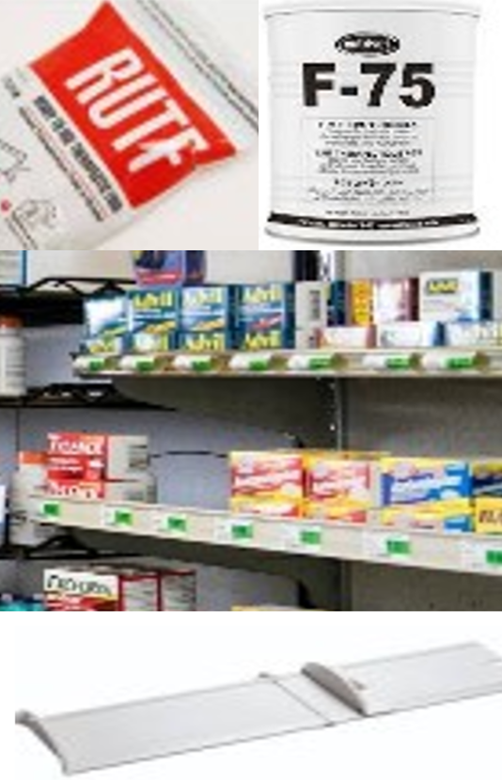
Domain 3: COMMODITIES, SUPPLIES, AND SERVICE INFRASTRUCTURE

Slide 45
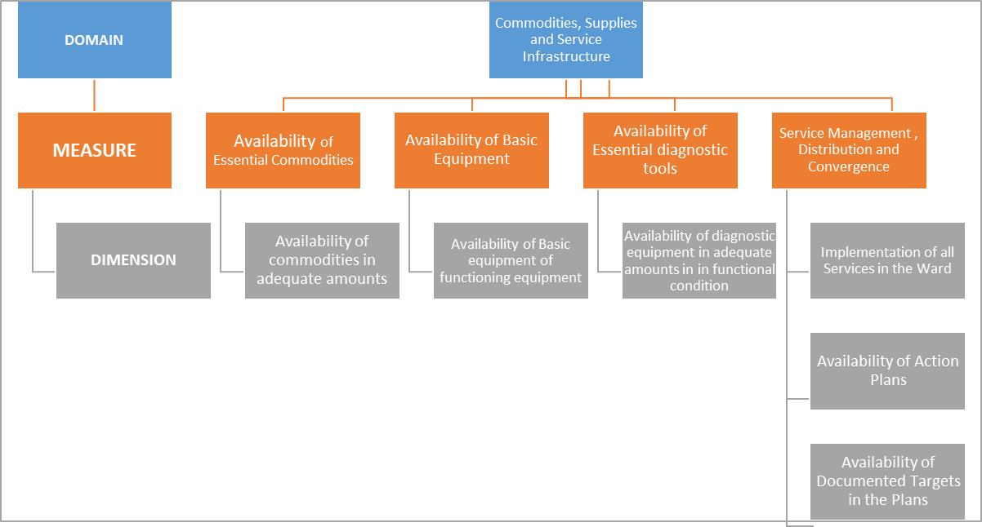
Commodities, Supplies and service infrastructure domain

Slide 46
Domain 3: Commodities, Supply, and Service Infrastructure
The overall score of this domain improved from level 1 to 2.
At the measure level, all measures marginally improved but remained within the same level in both assessments; the exception was service convergence, which improved from level 2 in 2020 to level 3 in 2022.

Slide 47
Domain 3: Commodities, Supplies, and Service Infrastructure by Sector
Ministries | Overall score |  | Availability of … |  |  |  |  |  | Service Convergence
 |  |  | Essential Nutrition Consumables |  | Basic Equipment |  | Essential Diagnostic tools
 | 2020 | 2022 | 2020 | 2022 | 2020 | 2022 | 2020 | 2022 | 2020 | 2022
MCDSS | 1.9 | 1.7 | 1.1 | 1.0 | 1.4 | 1.0 | 1.0 | - | 3.0 | 3.2
MWDS | 1.7 | 2.4 | 1.0 | 1.2 | 1.2 | 2.9 | 1.0 | - | 4.0 | 3.0
MOA | 1.7 | 1.8 | 1.0 | 1.0 | 1.2 | 1.0 | 1.0 | 1.0 | 4.0 | 3.0
MOE | 1.6 | 2.1 | - | 1.1 | 1.1 | 1.2 | - |  | 2.0 | 2.6
MOH | 2.6 | 2.5 | 1.0 | 1.0 | 2.6 | - | 1.0 | 1.0 | 2.8 | 3.4
MOFL | 1.6 | 2.3 | 1.1 | 1.9 | 1.2 | 1.1 |  | - | 1.0 | 2.7
All sectors improved their performance from level 2 in 2020 to level 3 in 2022 for the service convergence measure -- except MoE and MoFL which had marginal improvements but remained in level 2
Notes:
All ministries had less than one third of the inputs assessed. Essentail nutrition consumables and diagnostic tools continued to perform very poorly in 2022.

Slide 48
Domain 3: Performance by district and Ministry/Institution
Ministry/ Institution | Overall |  | Essential Consumables |  | Basic Equipment |  | Diagnostic Tools |  | Service Delivery Convergence
 | District |  | District |  | District |  | District |  | District
 | 2020 | 2022 | 2020 | 2022 | 2020 | 2022 | 2020 | 2022 | 2020 | 2022
MCDSS | 2.0 | 2.0 | 2.0 | 1.0 | 1.5 | 1.1 | 1.0 | - | 2.4 | 2.0
MWDS | 1.9 | 2.9 | 1.1 | 1.3 | 1.2 | 2.8 | 1.0 | - | 2.5 | 2.9
MOA | 1.9 | 2.5 | - | 1.0 | 1.2 | 1.0 | 1.0 | 1.0 | 2.5 | 2.5
MOE | 1.7 | 3.2 | - | - | 1.2 | - | - | - | 2.3 | 3.2
MOH | 2.8 | 3.5 | 1.0 | 1.0 | 2.6 | - | 1.0 | - | 3.0 | 3.5
MFL | 1.7 | 2.6 | 1.1 | 2.0 | 1.1 | 1.0 | 1.0 | - | 2.3 | 2.6
Total | 2.0 | 2.8 | 1.1 | 1.3 | 1.5 | 1.5 | 1.0 | 1.0 | 2.6 | 2.8
Overall district performance improved, but remained within the same level
All sectors improved performance from levels 1 and 2 in 2020 to 2 and 3 in 2022, except for MCDSS.
MoE and MoH improved performances from levels 2 in 2020 to 3 in 2022 at district
Notes:
All ministries had less than one third of the inputs assessed.
MCDSS performance worsed

Slide 49
Domain 3: Performance by ward and Ministry/Institution
Ministry/ Institution | Overall |  | Essential Consumables |  | Basic Equipment |  | Diagnostic Tools |  | Service Delivery Convergence
 | Ward |  | Ward |  | Ward |  | Ward |  | Ward
 | 2020 | 2022 | 2020 | 2022 | 2020 | 2022 | 2020 | 2022 | 2020 | 2022
MCDSS | 1.8 | 1.6 | 1.1 | 1.0 | 1.4 | 1.0 | 1.0 | - | 2.3 | 2.8
MWDS | 1.6 | 1.9 | 1.0 | 1.0 | 1.3 | 1.0 | 1.0 | - | 2.0 | 2.6
MOA | 1.7 | 1.5 | - | 1.0 | 1.1 | 1.0 | 1.0 | 1.0 | 2.3 | 2.9
MOE | 1.6 | 1.5 | - | 1.0 | 1.1 | 1.2 | - | 1.5 | 2.1 | 2.3
MOH | 2.6 | 2.0 | 1.0 | 1.0 | 2.5 | - | 1.0 | 1.6 | 2.7 | 3.3
MFL | 1.5 | 2.2 | - | 1.8 | 1.0 | - | - | - | 2.0 | 2.5
Total | 1.9 | 1.8 | 1.0 | 1.1 | 1.5 | 1.1 | 1.0 | 1.4 | 2.3 | 2.7
Overall performance at ward level declined slightly, remaining within the same level
MoFL at ward level improved from level 1 in 2020 to level 2 in 2022, whereas MCDSS, MoA, and MoE slightly reduced their performance, whilst remaining within level 1.
MoE and MoH improved their performance from level 2 in 2020 to 3 in 2022 for service delivery and convergence.
Notes:
All ministries had less than one third of the inputs assessed

Slide 50

Domain 4: INFORMATION SYSTEM

Slide 51
Information system: Measures and dimensions
Management Information System
Beneficiary records
This measure is about the presence and digitization of the MIS
Beneficiary records provide a longitudinal history of clients’ interaction with SUN programme services.
Dimensions
Dimensions
1. Standardized SUN indicators & consolidated SUN information systems
1. Use of HH/ personal/ group records at SDP
2. Format of personal records at SDP
Notes:
Domain 4 examines availability, coordination, and interoperability of vital statistics, routine MIS, and beneficiary records systems and infrastructure
Mgt information system - (for both multi-sectoral coordination and sector specific).
Beneficiary records- records (for individuals and households) documenting their history and experience with the programme

Slide 52
Domain 4: Information system
Overall performance in Domain 4 improved from level 1 in 2020 to level 2 in 2022.
The same pattern was observed across the domain’s two measures
Notes:
Domain 4 examines availability, coordination, and interoperability of vital statistics, routine MIS, and beneficiary records systems and infrastructure
Mgt information system - (for both multi-sectoral coordination and sector specific).
Beneficiary records- records (for individuals and households) documenting their history and experience with the programme

Slide 53
Information System Performance by Ministry/Agencies
Overall performance on the Information System domain improved from 1.4 to 2.4
Notably, NFNC improved its performance from 1.8 to 3.0
Additionally, all ministries at all levels improved their beneficiary record management from level 1.3 in 2020 to 2.6 in 2022.
Ministry | Domain 4 overall |  | MIS |  | Beneficiary records
 | 2020 | 2022 | 2020 | 2022 | 2020 | 2022
MOH | 1.4 | 2.7 | 1.4 | 2.3 | 1.3 | 2.8
MOA | 1.5 | 2.5 | 1.5 | 2.2 | 1.5 | 2.6
MFL | 1.4 | 2.4 | 1.3 | 2.0 | 1.5 | 2.5
MWDS | 1.3 | 2.2 | 1.5 | 2.1 | 1.0 | 2.4
MCDSS | 1.4 | 2.4 | 1.4 | 2.0 | 1.4 | 2.6
MOE | 1.3 | 1.9 | 1.4 | 1.8 | 1.0 | 2.2
NFNC | 1.7 | 3.0 | 1.8 | 3.1 | 1.7 | 2.7
Overall | 1.4 | 2.4 | 1.5 | 2.1 | 1.3 | 2.6

Slide 54
Domain 4: Information System by Districts
Overall district level performance improved from 1.4 in 2020 to 2.4 in 2022, mainly due to improvements in beneficiary record keeping.
Biggest improvements in MIS seen in Nchelenge district, which scored 2.9 in 2022 compared to 1.5 in 2020
In contrast, two districts, namely Lundazi and Mwinilunga, recorded declines in MIS from 1.8 and 1.7, respectively in 2020 to 1.6 (for both in 2022).
District | Domain 4 Overall |  | MIS |  | Beneficiary Records
 | 2020 | 2022 | 2020 | 2022 | 2020 | 2022
Chibombo | 1.1 | 2.3 | 1.1 | 1.8 | 1 | 2.5
Kabwe | 1.1 | 2.6 | 1.2 | 2.3 | 0.8 | 2.8
Kapiri Mposhi | 1.6 | 2.3 | 1.4 | 1.6 | 1.6 | 2.6
Mumbwa | 1.6 | 2.4 | 1.8 | 2.3 | 1.3 | 2.6
Kitwe | 1.3 | 2.4 | 1.3 | 1.9 | 1.3 | 2.6
Ndola | 1.4 | 2.2 | 1.4 | 2.2 | 1.3 | 2.3
Chipata | 1.4 | 2.1 | 1.6 | 1.7 | 1.2 | 2.4
Katete | 1.6 | 2.2 | 1.8 | 2 | 1.5 | 2.3
Petauke | 1.6 | 2.3 | 1.8 | 1.8 | 1.3 | 2.8
Lundazi | 1.7 | 2.4 | 1.8 | 1.6 | 1.6 | 2.7
Mansa | 1.6 | 2.3 | 1.7 | 2.1 | 1.4 | 2.5
Nchelenge | 1.5 | 2.7 | 1.5 | 2.9 | 1.5 | 2.5
Samfya | 1.6 | 2.5 | 1.8 | 2.4 | 1.4 | 2.8
Lusaka | 1.5 | 2.2 | 1.4 | 1.6 | 1.5 | 2.6
Chinsali | 1.2 | 2.7 | 1.1 | 2.5 | 1.1 | 2.9

Slide 55
Domain 4: Information System by Districts
District | Domain 4 Overall |  | MIS |  | Beneficiary Records
 | 2020 | 2022 | 2020 | 2022 | 2020 | 2022
Isoka | 1.1 | 2.7 | 1.1 | 2.5 | 1 | 2.8
Mpika | 1.1 | 2.3 | 1.1 | 2.2 | 1 | 2.4
Kaputa | 1.5 | 2.1 | 1.4 | 2.1 | 1.6 | 2.4
Kasama | 1.5 | 2.6 | 1.4 | 2.6 | 1.7 | 2.5
Luwingu | 1.6 | 2.2 | 1.6 | 2.1 | 1.5 | 2.2
Mbala | 1.5 | 2.6 | 1.2 | 2.5 | 1.6 | 2.7
Mwinilunga | 1.3 | 2.3 | 1.7 | 1.6 | 1.1 | 2.4
Solwezi | 1.3 | 2.1 | 1.2 | 1.5 | 1.3 | 2.5
Zambezi | 1.6 | 2.4 | 1.7 | 1.9 | 1.5 | 2.6
Choma | 1.3 | 2.2 | 1.3 | 1.8 | 1.2 | 2.6
Monze | 1.4 | 2.1 | 1.3 | 1.4 | 1.4 | 2.4
Kalabo | 1.4 | 2.2 | 1.6 | 1.8 | 1.1 | 2.5
Kaoma | 1.3 | 2.2 | 1 | 2 | 1.4 | 2.4
Mongu | 1.5 | 2.5 | 1.5 | 2 | 1.3 | 2.7
Shang'ombo | 1.5 | 2.3 | 1.8 | 2 | 1.3 | 2.4
Total | 1.4 | 2.4 | 1.5 | 2 | 1.3 | 2.6

Slide 56
Domain 4: Information System by Wards
Ministry | Domain 4 overall |  | MIS |  | Beneficiary records
 | 2020 | 2022 | 2020 | 2022 | 2020 | 2022
MOH | 1.4 | 2.4 | 1.3 | 1.8 | 1.5 | 2.7
MOA | 1.5 | 2.4 | 1.4 | 2.0 | 1.6 | 2.6
MFL | 1.4 | 2.1 | 1.2 | 1.6 | 1.3 | 2.5
MWDS | 1.3 | 2.1 | 1.3 | 1.7 | 1.0 | 2.4
MCDSS | 1.4 | 1.6 | 1.4 | 1.4 | 1.1 | 2.0
MOE | 1.3 | 2.2 | 1.4 | 1.7 | 1.3 | 2.5
Overall | 1.4 | 2.1 | 1.5 | 1.7 | 1.3 | 2.5
Performance at ward level mirrors that seen at the national and district levels.
Only MOA scored 2.0 on MIS, with the rest of the ministries at ward level remaining in level 1 for MIS in 2020 and 2022.
MOA’s relatively better performance is explained by the ministry’s requirement to keep records of distribution of agricultural inputs and training of farmers on agricultural practices.
MCDSS’s lack of performance improvement at the ward level is explained by its information management practice being mostly paper-based, especially on the community development side.

Slide 57
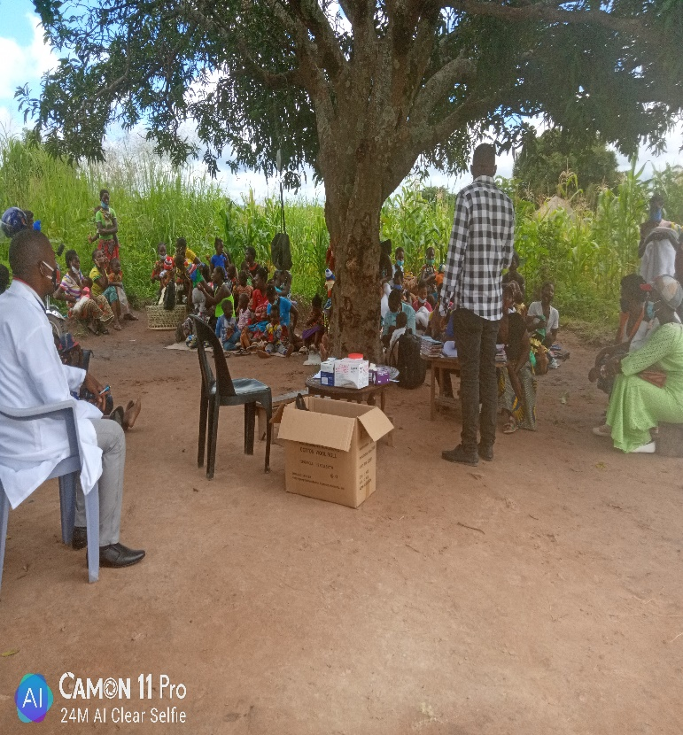
Domain 5: WORKFORCE PERFORMANCE

Slide 58
Workforce: Measures and Dimensions
SUN/MCDP II Workforce Density and Distribution
Adequacy of workforce compared to local SDP benchmarks
SUN/MCDP II Workforce Competencies
Availability of focal persons compared to local SDP benchmarks
SUN/MCDP II Community Workers
Availability of workers primarily conducting community nutrition proactive outreach
Trained, accredited, formally employed, appropriately remunerated, and supported community workers
Competencies clearly and sufficiently defined compared to local SDP benchmarks
Availability of all necessary competencies to implement SUN/MCDP II
Mechanisms to keep competencies up to date among SUN/MCDP II workers

Slide 59
Workforce Performance
Overall, the numbers and distribution of nutrition workers continues to be insufficient to promote equitable access to quality care and SUN/MCDP II service delivery.
Workforce density & distribution performance increased slightly from level 1 to 2.
Notes:
The objectives were to:​
examine the sufficiency of the number and distribution of nutrition workers to meet population needs in order to promote equitable access to quality care, service delivery, and
Assess the ability of the system to ensure quality of workforce education and practice.

Slide 60
Workforce by Ministry / Agencies-National
Workforce Density
Remained insufficient to achieve high coverage of minimum package of interventions.
Workforce Competencies
NFNC largely improved in the competence of its workforce, MWDS had significant reduction. The remainder did not change.
Community Workers
Overall, a reduction in community workers conducting proactive outreach services, mostly in MoE, MFL ,and MWDS.
Ministries/ Agency | Overall, Domain Score |  | Workforce density |  | SUN Workforce competencies |  | Community workers.
 | 2020 | 2022 | 2020 | 2022 | 2020 | 2022 | 2020 | 2022
MOH | 2.7 | 3.2 | 2.4 | 2.6 | 3 | 3.1 | 3.4 | 3.5
MOA | 2.3 | 2.8 | 2.3 | 2.6 | 2.3 | 2.7 | 3.4 | 3.2
MFL | 2.1 | 2.7 | 2.1 | 2.3 | 2 | 2.6 | 3.1 | 2.9
MWDS | 2.8 | 2.8 | 1.5 | 2.4 | 4.0 | 2.7 | 3.1 | 2.8
MCDSS | 1.9 | 2.7 | 1.6 | 2.4 | 2.3 | 2.6 | 3.2 | 3.0
MOE | 1.7 | 2.2 | 1.8 | 2.6 | 1.5 | 2.2
NFNC | 2.3 | 2.8 | 1.8 | 2.2 | 2.8 | 3.1
Total | 2.3 | 2.7 | 1.5 | 2.4 | 2.6 | 2.7 | 3.2 | 2.6

Slide 61
Workforce by Ministry/Agencies - Provincial
Overall, Muchinga had the greatest improvement
WORKFORCE DENSITY
Notable improvements for Muchinga, Southern, and Western provinces (from level 1 to 2) in 2022. Overall, results mirror national outlook.
WORKFORCE COMPETENCIES
Notable improvement in Lusaka, North-western, Southern, and Western provinces. The rest did not change.
COMMUNITY WORKERS
Other than Central, Lusaka, and Western, provinces had fair presence of community workers conducting proactive outreach services.
Province | Overall |  | Workforce density and distribution |  | Workforce competencies |  | Community workers.
 | 2020 | 2022 | 2020 | 2022 | 2020 | 2022 | 2022
Central | 2.3 | 2.7 | 2.0 | 2.4 | 2.6 | 2.7 | 2.8
Copperbelt | 2.4 | 2.7 | 2.1 | 2.4 | 2.6 | 2.6 | 3.2
Eastern | 2.6 | 2.6 | 2.5 | 2.5 | 2.8 | 2.4 | 3.2
Luapula | 2.8 | 2.9 | 2.8 | 2.4 | 2.7 | 2.9 | 3.1
Lusaka | 1.9 | 2.3 | 2.1 | 2.5 | 1.8 | 2.2 | 2.5
Muchinga | 1.9 | 3.0 | 1.6 | 2.6 | 2.3 | 2.9 | 3.3
Northern | 2.5 | 2.8 | 2.5 | 2.7 | 2.6 | 2.7 | 3.3
North-western | 1.9 | 2.7 | 2.0 | 2.4 | 1.9 | 2.5 | 3.2
Southern | 1.6 | 2.6 | 1.8 | 2.2 | 1.5 | 2.5 | 3.1
Western | 1.8 | 2.9 | 1.7 | 2.7 | 1.8 | 2.9 | 2.9

Slide 62
Workforce by Ministry/Agencies-District
Overall, MoH had the greatest improvement
WORKFORCE DENSITY
In 2022, still suboptimal
WORKFORCE COMPETENCIES
Notable improvement for MoH, MWDS, MCDSS (all moved from level 2 to 3). MFL moved from level 1 to 2. Ministries performed better at district level than at higher levels.
COMMUNITY WORKERS
Like national level, there’s been an overall reduction in community workers conducting proactive outreach services; as well as preventive nutrition services, mostly in MoE, MFL, and MWDS.
District Sector | Overall |  | Workforce Density & distribution |  | SUN workforce competencies |  | Community workers
 | 2020 | 2022 | 2020 | 2022 | 2020 | 2022 | 2020 | 2022
MoH | 2.8 | 3.4 |  | 2.6 | 2.6 | 3.3 | 3.3 | 3.5
MoA | 2.8 | 2.9 |  | 2.5 | 2.5 | 2.9 | 3.3 | 3.1
MFL | 2.3 | 2.8 |  | 2.2 | 1.9 | 2.8 | 3 | 2.8
MWDS | 2.3 | 2.9 |  | 2.3 | 2.1 | 3.1 | 2.8 | 2.5
MCDSS | 2.4 | 3.1 |  | 2.5 | 2.1 | 3.0 | 3.2 | 3.3
NFNC | 3.1 | 2.7 |  | 2.2 | 3.2 | 3.1
MoE | 2.4 | 2.3 |  | 2.5 | 2.1 | 2.3
Total | 2.6 | 2.9 |  | 2.4 | 2.4 | 2.9 | 3.1 | 2.7
Notes:
Community-based workers have been shown to effectively deliver a range of preventive, promotive, and curative nutrition services, and they can contribute to reducing inequalities in access.

Slide 63
Workforce by Ministry/Agencies-Ward
Overall, MoH also had the greatest improvement at ward level
WORKFORCE DENSITY
Continued to be insufficient.
WORKFORCE COMPETENCIES
MoH had registered significant improvement. MFL and MoE also improved but essentially had few competent workforce.
COMMUNITY WORKERS
Overall performance remained the same.
Significant improvements for MFL (moves from level 1 to 2)
No improvement for MoE.
Ward Ministries | Overall, Domain 5 Performance |  | Workforce Density and Distribution |  | SUN Workforce Competencies |  | Community Workers
 | 2020 | 2022 | 2020 | 2022 | 2020 | 2022 | 2020 | 2022
MoH | 2.6 | 3.1 | - | 2.6 | 2.1 | 3.0 | 3.4 | 3.6
MoA | 2.6 | 2.8 | - | 2.7 | 2.2 | 2.6 | 3.4 | 3.2
MFL | 2.2 | 2.7 | - | 2.5 | 1.8 | 2.5 | 2.9 | 3.1
MWDSSEP | 2.4 | 2.6 | - | 2.4 | 2.0 | 2.3 | 3.1 | 3.2
MoE | 2.0 | 2.0 | - | 2.5 | 1.7 | 2.0
MCDSS | 2.4 | 2.5 | - | 2.4 | 2.0 | 2.4 | 3.1 | 3.0
Total | 2.3 | 2.6 | - | 2.5 | 2.0 | 2.5 | 3.1 | 3.0

Slide 64
Possible reasons for the overall meagre performance
Gaps in staff establishments due to high staff turnover because of staff transfers etc.
Very few management units have mechanisms in place to ensure that competencies are up to date.
Some sectors do not have clearly defined responsibilities for SUN-focal persons.
Insufficient community workers proactively focusing on nutrition-related community initiatives.

Slide 65
Domain 6: Mechanisms for Managing Funds

Slide 66
Mechanisms for Funding Management – Measures and dimensions
Maintenance of SUN MCDP II Budget
Maintenance of an annual budget for SUN/MCDP II or Nutrition interventions at MUs compared to local SDP
Proportion of SDPs /MUs that engage in a systematic SUN budget forecasting exercises.
Existence of FMIS
Maintenance/use of a FMIS for SDPs/MUs to track revenue and expenditure flows
Stability of flow of SUN/MCDP II funds (GRZ) to SDPs and MUs
Remuneration of community volunteers
Stability of remuneration at ward level
Predictability of volunteer remuneration at ward level
Proportion of the budget that is directed to administrative vs direct implementation
Timeliness of flow of GRZ SUN/MCDP II funds to SDPs and MUs
Timeliness of flow of IP SUN/MCDP II funds to SDPs and Mus
Predictability of flow of GRZ SUN funds to SDP and Mus
Predictability of flow of IP SUN funds to SDP and MUs
Remunerations typically made in time

Slide 67
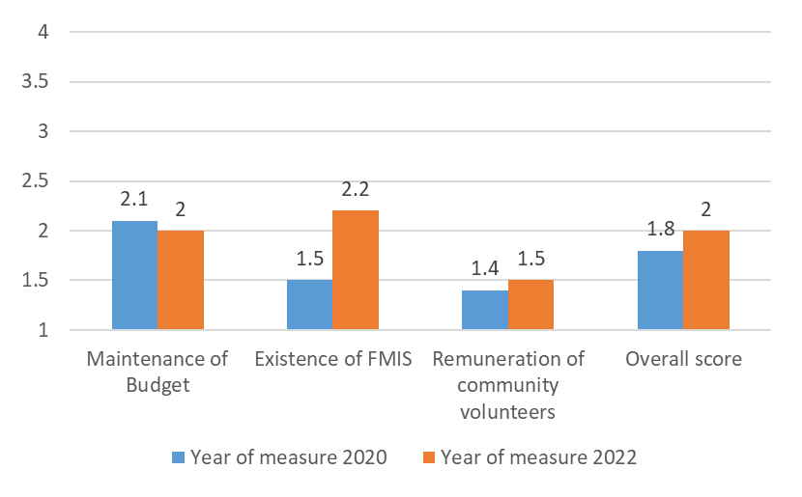
Mechanisms for Managing funds by Ministry or Agencies - Overall
Overall MCDP II funding mechanisms are still weak.
Remuneration of community volunteers continues to be perform poorly
Notes:
On the whole, funding systems to facilitate appropriate management of funds was poor.
Budget
Only a few management units maintained an annual budget for SUN, engaged in budget forecasting and
proportion of the budget that is directed to administrative vs direct implementation was moderate i.e. (50-79%) of the total budget

Slide 68
Mechanisms for Managing funds by Ministry or Agencies - National
Ministry/ Implementer | Overall Domain 6 |  | Maintenance of budget |  | Existence of FMIS |  | Remuneration of volunteers
 | 2020 | 2022 | 2020 | 2022 | 2020 | 2022 | 2022
NFNC | 2.7 | 2.1 | 3.0 | 2.6 | 2.3 | 1.7
MOH | 1.5 | 2.3 | 2.0 | 2.4 | 1.0 | 2.7 | 1.7
MOA | 2.2 | 1.8 | 3.0 | 2.1 | 1.3 | 1.8 | 1.6
MFL | 1.4 | 2.1 | 1.0 | 2.3 | 1.8 | 2.5 | 1.5
MWDS | 1.5 | 2.0 | 2.0 | 2.3 | 1.0 | 2.0 | 1.6
MCDSS | 1.5 | 1.9 | 2.0 | 2.2 | 1.0 | 1.8 | 1.6
MOE | 2.3 | 2.0 | 2.5 | 2.2 | 2.0 | 2.3 | 1.4
Overall score | 1.9 | 2.0 | 2.2 | 2.3 | 1.5 | 2.1 | 1.6
Overall, mechanisms for funding remain weak for SUN/MCDP II across all line ministries, despite improving from level 1 to 2.
Mechanisms for Funding for MoA declined and MCDSS remained very poor.
Maintenance of SUN/MCDP II budgets declined at NFNC and MoA
Maintenance of FMIS still remains poor (less than 50% of the MUs)

Slide 69
Mechanisms for Managing funds by Ministry or Agencies - Provincial
Ministry/Agency | Overall, Domain 6 |  | Maintenance of Budget |  | Existence of FMIS
 | 2020 | 2022 | 2020 | 2022 | 2020 | 2022
MOH | 1.3 | 2.9 | 1.4 | 2.4 | 1.2 | 3.2
MOA | 1.4 | 2.3 | 1.7 | 2.1 | 1.1 | 2.5
MFL | 1.4 | 2.4 | 1.6 | 2.3 | 1.1 | 2.5
MWDS | 1.3 | 3.3 | 1.3 | 2.8 | 1.3 | 3.7
MCDSS | 1.3 | 2.2 | 1.4 | 2.0 | 1.2 | 2.5
NFNC | 1.7 | 1.5 | 2 | 2.0 | 1.4 | 1.1
MOE | 1.5 | 2.7 | 1.5 | 2.5 | 1.4 | 2.8
Overall | 1.4 | 2.6 | 1.6 | 2.3 | 1.2 | 2.8
Overall, mechanisms for funding at provincial level mirrored national results.
Overall, NFNC’s performance under mechanisms for funding was the lowest and poorest, which was also reflected in the existence of FMIS measure

Slide 70
Mechanisms for Managing funds by Ministry or Agencies - District
Ministry/ Agency | Overall |  | Maintenance of Budget |  | Existence of FMIS
 | 2020 | 2022 | 2020 | 2022 | 2020 | 2022
MOH | 2.1 | 2.7 | 2.4 | 2.7 | 1.8 | 2.8
MOA | 1.9 | 2.3 | 2.3 | 2.2 | 1.4 | 2.5
MFL | 1.7 | 2.7 | 1.9 | 2.6 | 1.5 | 2.9
MWDS | 1.8 | 2.1 | 2.1 | 2.4 | 1.5 | 1.9
MCDSS | 1.9 | 2.3 | 2.4 | 2.3 | 1.4 | 2.6
NFNC | 2.2 | 2.1 | 2.9 | 2.4 | 1.5 | 1.7
MOE | 1.7 | 2.4 | 1.9 | 2.3 | 1.5 | 2.6
Overall | 1.9 | 2.4 | 2.3 | 2.4 | 1.5 | 2.4
Similarly, funding results at district level reflected higher-level results.
Maintenance of SUN/MCDP II budget improved in MFL and MoE
NFNC and MWDS remained the worst performers under existence of FMIS at district level.

Slide 71
Mechanisms for Managing funds by Ministry or Agencies - Ward
General performance of the funding domain at ward level remained poor across all measures.
Maintenance of MCDP II budget of budgets actually declined in 2022.
Only MoH and MoE registered improvements under FMIS
Ministry | Overall domain |  | Budgets |  | FMIS |  | Remuneration of Volunteers
 | 2020 | 2022 | 2020 | 2022 | 2020 | 2022 | 2020 | 2022
MOH | 1.6 | 1.9 | 2.1 | 2.0 | 1.3 | 2.1 | 1.4 | 1.7
MOA | 1.5 | 1.5 | 2.0 | 1.5 | 1.3 | 1.5 | 1.3 | 1.5
MFL | 1.4 | 1.6 | 1.9 | 1.7 | 1.2 | 1.9 | 1.3 | 1.5
WASH | 1.4 | 1.7 | 2.1 | 1.6 | 1.4 | 1.8 | 1.3 | 1.6
MoE | 1.5 | 1.8 | 2.1 | 1.9 | 1.4 | 2.4 | 1.3 | 1.3
MCDSS | 1.6 | 1.5 | 2.0 | 1.4 | 1.4 | 1.5 | 1.4 | 1.6
Overall | 1.5 | 1.7 | 2.0 | 1.7 | 1.3 | 1.9 | 1.4 | 1.5

Slide 72
Performance on Funding management by District
Funding performance declined in Mumbwa, Chipata, Nchelenge (from level 2 to level 1).
Budget maintenance scores for Lundazi, Nchelenge, and Lusaka decreased significantly.
District | Overall, Domain Score |  | Maintenance of Budget |  | Existence of FMIS |  | Remuneration of Volunteers
 | 2020 | 2022 | 2020 | 2022 | 2020 | 2022 | 2020 | 2022
Chibombo | 1.7 | 1.7 | 2 | 2.1 | 1.4 | 1.7 | 1.2 | 1.2
Kabwe | 1.9 | 1.8 | 2.2 | 2.3 | 1.6 | 1.5 | 1.2 | 1.5
Kapiri Mposhi | 1.7 | 2.3 | 2.0 | 2.5 | 1.3 | 2.3 | 1 | 2.1
Mumbwa | 2.3 | 1.8 | 2.9 | 2.2 | 1.6 | 1.9 | 1.5 | 1.3
Kitwe | 1.7 | 1.8 | 1.8 | 1.9 | 1.6 | 2.3 | 1 | 1.1
Ndola | 1.8 | 1.7 | 1.9 | 2.1 | 1.7 | 1.7 | 1.1 | 1.2
Chipata | 2.1 | 1.9 | 2.9 | 2.2 | 1.3 | 2.3 | 1.6 | 1.1
Katete | 2.4 | 2.3 | 2.8 | 2.5 | 1.9 | 2.5 | 1.5 | 1.7
Petauke | 2.4 | 2.5 | 2.8 | 2.4 | 1.9 | 2.9 | 1.2 | 2.2
Lundazi | 2.5 | 2.3 | 3.1 | 1.9 | 1.8 | 2.9 | 1.5 | 1.8
Mansa | 2.3 | 2 | 2.7 | 2.2 | 1.8 | 2.4 | 1.9 | 1.4
Nchelenge | 2.3 | 1.5 | 2.6 | 1.5 | 1.9 | 2.3 | 1.7 | 1.2
Samfya | 2.3 | 2.4 | 2.6 | 2.5 | 1.9 | 2.7 | 1.3 | 1.7
Lusaka | 1.9 | 1.8 | 2.3 | 1.8 | 1.4 | 1.6 | 1.4 | 2
Chinsali | 1.6 | 2.1 | 1.8 | 2.2 | 1.3 | 2 | 1.4 | 2.1
Isoka | 1.5 | 1.8 | 1.4 | 2.3 | 1.5 | 1.3 | 1.2 | 1.8
Mpika | 1.6 | 2.4 | 1.9 | 2.5 | 1.2 | 2.8 | 1.6 | 2

Slide 73
Performance on Funding management by District
Funding performance declined in Kasama, Luwinga, Mwinilunga, Zambezi & Mongu.
Budget maintenance for Luwingu and Mwinilunga reduced significantly.
On the other hand, Solwezi significantly improved in FMIS, moving up from level 1 to level 3.
Disrict | Overall |  | Maintenance of Budget |  | Existence of FMIS |  | Remuneration of Volunteers
 | 2020 | 2022 | 2020 | 2022 | 2020 | 2022 | 2020 | 2022
Kaputa | 1.9 | 2.0 | 2.6 | 2.5 | 1.1 | 2.3 | 1.7 | 1.0
Kasama | 2.1 | 1.7 | 2.7 | 2.3 | 1.5 | 1.6 | 1.7 | 1.3
Luwingu | 2.4 | 1.9 | 3.2 | 1.8 | 1.6 | 2.4 | 1.0 | 1.4
Mbala | 2.8 | 2.2 | 2.1 | 2.6 | 1.5 | 1.9 | 1.6 | 2.0
Mwinilunga | 2.2 | 1.3 | 2.7 | 1.4 | 1.6 | 2.0 | 1.3 | 1.1
Solwezi | 1.5 | 2.2 | 1.6 | 2.0 | 1.3 | 3.5 | 1.3 | 1.3
Zambezi | 2.1 | 1.5 | 2.6 | 2.2 | 1.5 | 1.5 | 2.0 | 1.0
Choma | 1.8 | 2.0 | 1.7 | 1.7 | 1.9 | 2.7 | 1.2 | 1.9
Monze | 1.9 | 1.8 | 1.9 | 1.7 | 1.9 | 2.5 | 1.0 | 1.6
Kalabo | 1.6 | 1.6 | 1.4 | 2.0 | 1.7 | 1.3 | 1.2 | 1.4
Kaoma | 1.3 | 1.9 | 1.2 | 2.2 | 1.4 | 1.8 | 1.0 | 1.6
Mongu | 2.0 | 1.7 | 2.0 | 2.5 | 1.9 | 1.2 | 1.0 | 1.3
Shang'ombo | 1.5 | 2.0 | 1.4 | 2.3 | 1.5 | 1.8 | 1.0 | 1.8
Overall | 1.9 | 2.0 | 2.2 | 2.0 | 1.6 | 2.2 | 1.4 | 1.5
Notes:
Categorization of the FMIS levels. Level 3 meets any of the three criteria
1.The system and its processes clearly defined and understood.
2.The system is consistently used across SDP/management unit types
3.The system is Electronic.
4.The system account for Line-item SUN budgets; Internally generated funds & Other income

Slide 74
Some Reasons for poor funding performance
Inadequate and unpredictable flow of Funds from GRZ and cooperating partners.
Higher proportion of SUN funds are still channeled to administrative purposes
Financial management systems are not clearly linked between management units and SDPs
Motivation of community volunteers is still very unstable and usually not included in budgets at higher level management units

Slide 75

Domain 7: POPULATION NUTRITION MANAGEMENT

Slide 76
Measure
Priority Setting
Community Engagement
Empanelment
Proactive Population Outreach
District and Ward units collect or receive data to use for strategic action plans on at least an annual basis
District units yearly -solicit local (ward-level) input from diverse members of the community on the design, financing, governance and implementation of SUN activities
Proportion of the population at this SDP or community service level that is empanelled to a nutrition related provider, care team or SDP
The districts /Ward/SDP provides proactive population outreach according to local nutrition needs and priorities
Dimension(s)
Involvement of communities and local leaders in data interpretation and priority setting
Ward implementation units regularly solicit local input from diverse member of the community on the design, financing, governance and implementation of SUN activities
The district /ward/SDP have registries or lists to identify relevant priority beneficiaries for proactive outreach
Frequency at which panels are updated at least once per year in the district/ward
Impact of community engagement/input on the way in which services are structured and delivered

Slide 77
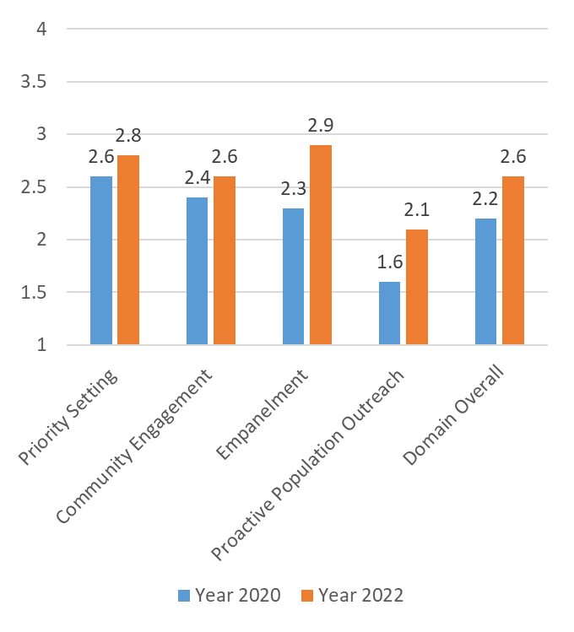
Domain 7: Population Nutrition Management
Overall, population nutrition management remained relatively poor:
Little involvement of communities in decision-making processes.
Proactive population outreach improved from level 1 to 2
Notes:
Refers to the translation of national or provincial policies into local strategic action plans that respond to the needs and preferences of the population
2. a process of developing relationships that enable stakeholders to work together to address nutrition-related issues and promote well-being to achieve positive nutrition impact and outcomes
3. (sometimes referred to as rostering) is a continuous, iterative process to identify and assign populations to services, teams, or providers who have a responsibility to know the individuals in their assigned population and to proactively deliver coordinated nutrition services to them
4. nutrition systems put in place to actively reach out to communities, particularly those that are underserved or marginalized, to provide necessary services aligned with local priorities and burden of disease, and link those in need to SUN

Slide 78
Population Nutrition Management by Sector - District
Ministry | Overall score |  | Priority setting |  | Community engagement |  | Empanelment |  | Proactive Population Outreach
 | 2020 | 2022 | 2020 | 2022 | 2020 | 2022 | 2020 | 2022 | 2020 | 2022
MOA | 2.2 | 2.7 | 2.5 | 3.0 | 2.4 | 2.6 | 2.4 | 3.1 | 1.7 | 2.2
MCDSS | 2.3 | 2.7 | 2.7 | 3.0 | 2.5 | 2.7 | 2.6 | 3.0 | 1.5 | 2.2
MOH | 2.5 | 3.1 | 3.2 | 3.6 | 2.7 | 3.0 | 2.6 | 3.2 | 1.6 | 2.5
MFL | 2.2 | 2.5 | 2.5 | 3.0 | 2.2 | 2.6 | 2.1 | 2.3 | 1.9 | 1.9
MOE | 2.2 | 2.5 | 2.4 | 2.9 | 2.3 | 2.4 | 2.1 | 2.3 | 2.0 | 2.1
MWDSSEP | 2.3 | 2.7 | 2.6 | 3.1 | 2.7 | 2.7 | 2.0 | 2.5 | 1.9 | 2.2
NFNC | 2.4 | 2.6 | 3.2 | 2.9 | 2.5 | 2.6 | 2.3 | 2.6 | 1.5 | 2.0
Overall | 2.3 | 2.7 | 2.7 | 3.1 | 2.5 | 2.7 | 2.3 | 2.7 | 1.7 | 2.2
Overall, there was no improvement in performance of SUN/MCDP II population nutrition management between 2020 and 2022.
There was moderate involvement of communities in priority setting
Notes:
Implication
Conditions and factors that influence the services were similar across the ministries and implementing agencies. Indicating no major variations in service delivery across SUN programme implementers

Slide 79
Population Nutrition Management by District
District | Overall |  | Priority Setting |  | Community Engagement |  | Empanelment |  | Proactive Population Outreach
 | 2020 | 2022 | 2020 | 2022 | 2020 | 2022 | 2020 | 2022 | 2020 | 2022
Chibombo | 1.5 | 2.4 | 2.0 | 2.5 | 1.2 | 2.3 | 1.3 | 3.2 | 1.7 | 1.6
Kabwe | 1.5 | 2.5 | 1.8 | 2.5 | 1.2 | 2.6 | 1.3 | 2.8 | 1.9 | 2.1
Kapiri Mposhi | 2.4 | 2.9 | 2.9 | 3.3 | 2.4 | 3.0 | 2.6 | 3.0 | 1.5 | 2.2
Mumbwa | 2.5 | 2.7 | 3.1 | 2.8 | 2.9 | 2.8 | 2.6 | 2.9 | 1.5 | 2.0
Chipata | 2.2 | 2.5 | 2.5 | 2.4 | 2.3 | 2.5 | 2.3 | 2.9 | 1.7 | 2.2
Katete | 2.6 | 2.8 | 3.3 | 3.1 | 3.2 | 3.0 | 2.6 | 2.8 | 1.3 | 2.1
Lundazi | 2.5 | 2.5 | 3.2 | 2.5 | 2.8 | 2.5 | 2.5 | 3.1 | 1.4 | 2.1
Petauke | 2.8 | 2.9 | 3.2 | 3.1 | 3.1 | 3.0 | 3.4 | 3.3 | 1.6 | 2.3
Mpika | 1.6 | 2.8 | 1.7 | 3.1 | 1.3 | 2.6 | 1.5 | 3.1 | 1.8 | 2.3
Isoka | 1.8 | 3.0 | 2.0 | 3.0 | 1.7 | 3.1 | 1.5 | 3.0 | 1.8 | 2.1
Chinsali | 1.7 | 2.4 | 1.9 | 2.6 | 1.6 | 2.3 | 1.5 | 2.5 | 1.9 | 2.3
Mbala | 2.6 | 2.8 | 2.8 | 3.3 | 2.8 | 2.7 | 3.3 | 2.8 | 1.5 | 2.5
Kasama | 2.7 | 2.7 | 3.2 | 3.0 | 2.9 | 3.0 | 3.3 | 2.7 | 1.4 | 2.1
Kaputa | 2.5 | 2.4 | 3.1 | 2.8 | 2.8 | 2.8 | 2.6 | 1.7 | 1.3 | 1.9
Luwingu | 1.7 | 2.1 | 1.8 | 2.4 | 1.7 | 1.8 | 1.8 | 2.6 | 1.5 | 1.7
Isoka registered substantial improvements in population nutrition management. The district empanelment is done quarterly in a year, the local communities in the district have moderate impact on priority setting
Notes:
Implication
Conditions and factors that influence the services were similar across the ministries and implementing agencies. Indicating no major variations in service delivery across SUN programme implementers.

Slide 80
Population Nutrition Management by District
District | Overall, Domain Score |  | Priority Setting |  | Community Engagement |  | Empanelment |  | Proactive Population Outreach
 | 2020 | 2022 | 2020 | 2022 | 2020 | 2022 | 2020 | 2022 | 2020 | 2022
Lusaka | 2.1 | 3.2 | 2.9 | 3.3 | 2 | 3.2 | 1.7 | 3.7 | 1.9 | 2.5
Kitwe | 2.4 | 3.0 | 2.5 | 3.3 | 2.5 | 3.0 | 2.5 | 3.3 | 1.9 | 2.3
Ndola | 2.3 | 2.6 | 2.8 | 2.5 | 2.6 | 2.5 | 2.2 | 3.1 | 1.7 | 2.1
Choma | 2.2 | 3.0 | 2.8 | 3.3 | 2.1 | 2.9 | 2.1 | 3.6 | 1.7 | 2.2
Monze | 2 | 2.4 | 2.3 | 2.6 | 1.9 | 2.1 | 2.1 | 3.1 | 1.7 | 2.1
Mansa | 2.5 | 3.2 | 2.7 | 3.4 | 2.9 | 3.5 | 3.1 | 3.3 | 1.3 | 2.3
Nchelenge | 2.8 | 2.9 | 3.1 | 3.5 | 3.5 | 2.9 | 3.4 | 3.0 | 1.3 | 2.1
Samfya | 2.7 | 2.7 | 2.9 | 3.2 | 3.2 | 2.4 | 3.3 | 3.1 | 1.4 | 2.3
Mwinilunga | 2.3 | 2.9 | 2.5 | 3.3 | 2.5 | 3.0 | 2.3 | 3.2 | 1.7 | 2.0
Solwezi | 2.0 | 3.0 | 2.1 | 3.3 | 2.0 | 3.0 | 1.9 | 3.4 | 20 | 2.2
Zambezi | 2.5 | 2.7 | 3.0 | 2.8 | 2.9 | 2.5 | 2.4 | 3.3 | 1.6 | 2.3
Mongu | 2.1 | 2.5 | 2.5 | 3.1 | 2.2 | 2.7 | 2.2 | 2.4 | 1.4 | 1.8
Shang'ombo | 1.9 | 2.2 | 2.2 | 2.4 | 1.8 | 2.2 | 1.9 | 2.5 | 1.7 | 1.9
Kalabo | 2.0 | 2.3 | 2.3 | 2.7 | 1.8 | 2 | 2.2 | 2.7 | 1.9 | 1.9
Kaoma | 2.0 | 2.3 | 2.1 | 2.5 | 1.7 | 2.3 | 2.3 | 2.7 | 1.8 | 1.7
Overall | 2.2 | 2.6 | 2.6 | 2.8 | 2.4 | 2.6 | 2.4 | 2.9 | 1.6 | 2.1
Other districts which registered overall significant improvements were Lusaka, Kitwe, Choma, Mansa, and Solwezi.
Overall, demonstrating moderate involvement of communities in priority setting, engagement, and empanelment for the six districts.
Notes:
Implication
Conditions and factors that influence the services were similar across the ministries and implementing agencies. Indicating no major variations in service delivery across SUN programme implementers.
Moderate involvement-Communities are informed of relevant data and given the opportunity to provide feedback on analysis, alternatives and/or decisions throughout the priority-setting process

Slide 81
Domain 8: SERVICE ORGANIZATION AND MANAGEMENT

Slide 82
Measure
Team-based service delivery
Performance Targets
Supportive supervision
Percentage of district/ SDPs where all SUN sectors work as part of a multi-sectoral team.
% of SDPs that use established performance indicators for SUN
% of SDPs/management levels that implement or receive supportive supervision on at least an annual basis
Dimension(s)
% of SDPs that conduct routine monitoring of SUN indicators
Sector implementation follows the instructions / guidance of multi-sectoral district/ward committees
% of SDPs/management levels that receive any mentorship/ technical support as a result of the supervision visits team
% of SDPs that have documented quality improvement work linked to underperforming areas

Slide 83
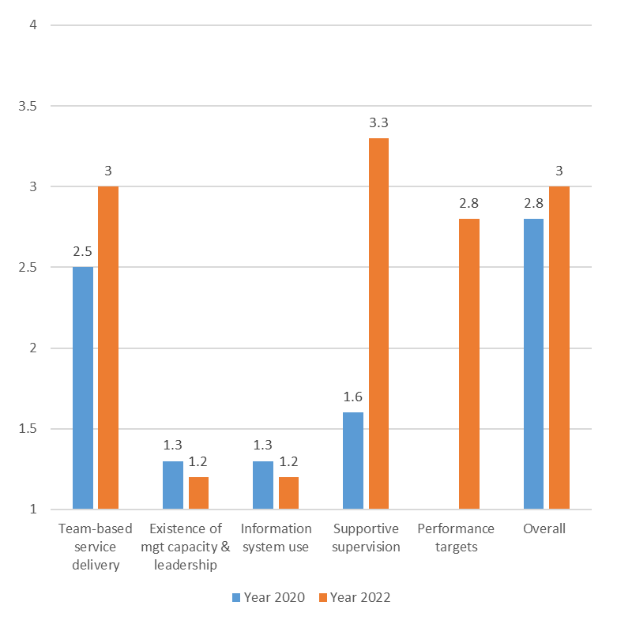
Domain 8: Service Organization & Mgmt
Overall performance improved from 2020.
Multi-sectoral platforms (e.g. DNCCs, WNCCs) exist to foster teamwork, but no structure to promote team culture.
2 measures (existence of management capacity and leadership; information use) scored lower in 2022, remaining in level 1.
Both measures deserve special attention.
Notes:
Availability of the multisectoral platform as well as availability of a system to ensure that multi-sectoral committees (e.g. DNCCs, WNCCs) systematically document the priority services to be carried out, or the beneficiaries to be targeted, by the individual sectors

Slide 84
Service Organization & Management
Overall, there is room for improvement among all sectors.
In 2022, all sectors except MoA and MoE, had evidence of availability of a multi-sectoral platform and a system to ensure multi-sectoral committees systematically document the priority services to be carried out.
Sector | Overall |  | District |  | Ward
 | 2020 | 2022 | 2020 | 2022 | 2020 | 2022
MOH | 2.7 | 3.2 | 2.8 | 3.8 | 1.0 | 2.9
MOA | 2.5 | 2.9 | 2.5 | 3.6 | 1.0 | 2.5
MFL | 1.9 | 3.0 | 1.9 | 3.5 |  | 2.6
MWDS | 2.2 | 3.2 | 2.2 | 3.5 |  | 2.6
MCDSS | 2.5 | 3.0 | 2.5 | 3.5 | 2.5 | 2.1
MOE | 2.4 | 2.5 | 2.5 | 3.0 | 1.0 | 2.6
Total | 2.8 | 3.0 | 2.5 | 3.5 | 1.4 | 2.5

Slide 85
Service Organization & Mgmt: District
Improvements were observed across all the sector ministries in the three measures.
Existence of platform for multisectoral team operations improved.
Mentoring and collective problem solving was enhanced between 2020 and 2022.
Target setting to some degree involved SDPs
Ministry | Overall Score |  | Team based care organizations |  | Performance targets |  | Supportive supervision
 | 2020 | 2022 | 2020 | 2022 | 2020 | 2022 | 2020 | 2022
MOA | 2.0 | 3.3 | 2.5 | 3.3 |  | 3.1 | 1.7 | 3.4
MCDSS | 1.9 | 3.3 | 2.5 | 3.4 |  | 3.2 | 1.6 | 3.4
MOH | 1.8 | 3.7 | 2.8 | 3.7 |  | 3.7 | 1.4 | 3.8
MFL | 1.8 | 3.2 | 1.9 | 3.3 |  | 3.1 | 1.7 | 3.3
MOE | 1.8 | 3.1 | 2.5 | 3.1 |  | 3.0 | 1.5 | 3.3
MWDS | 1.7 | 3.1 | 2.2 | 3.4 |  | 2.9 | 1.5 | 3.1
Overall | 1.8 | 3.3 | 2.2 | 3.4 |  | 3.2 | 1.6 | 3.4

Slide 86
Service Organization & Mgmt: Ward level
Overall, at ward level there was also a significant improvement albeit smaller than that at district level.
MoH outperformed all other ministries.
Collective problem solving was enhanced
Ministry | Domain 8 Overall Score |  | Performance targets |  | Supportive supervision
 | 2020 | 2022 | 2020 | 2022 | 2020 | 2022
MOA | 1.5 | 2.8 |  | 2.6 | 1.5 | 3.2
MCDSS | 1.6 | 2.9 |  | 2.5 | 1.6 | 3.2
MOH | 1.4 | 3.5 |  | 3.4 | 1.4 | 3.6
MFL | 1.7 | 2.6 |  | 2.5 | 1.7 | 2.8
MOE | 1.5 | 2.6 |  | 2.1 | 1.5 | 3.4
MWDS | 1.4 | 2.9 |  | 2.9 | 1.4 | 3.0
Overall | 1.5 | 2.9 |  | 2.7 | 1.5 | 3.2
Notes:
Include an explanation on the observations.

Slide 87
Conclusions

Slide 88
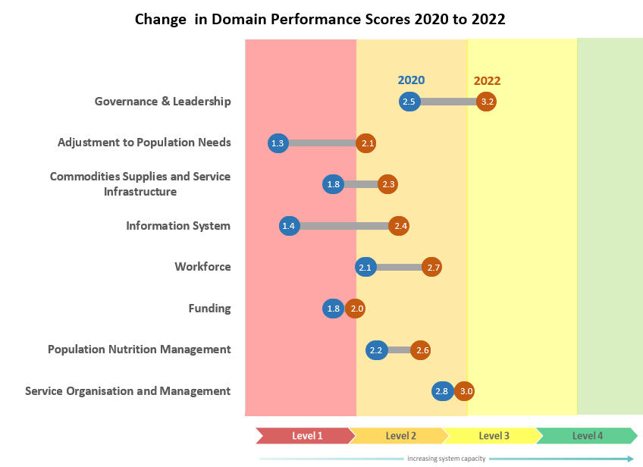
Overall MCDP II Performance
PA shows a positive trend towards establishment of structures to support programme implementation
Although constraints, such as staffing and availability of essential inputs (at lower level across all sectors), continue to limit effective implementation

Slide 89
Key Recommendations

Slide 90
Key Recommendations
Governance and Leadership
NFNC to enhance collaboration both within government and with external stakeholders at all levels.
Adjustment to Population Needs
Ensure strong sectoral surveillance systems in all the key line ministries.
The NFNC should scale up efforts to develop and operationalise a strong overarching nutrition surveillance system to facilitate timely tracking and management of potentially adverse nutrition outcomes across all the sectors.
Commodities, Supplies, and Service Infrastructure
Strengthen the availability of essential nutrition commodities, basic equipment, and essential diagnostic tools across all key line ministries.

Slide 91
Key Recommendations
Information Systems
Efforts to complete and operationalise the multisectoral IMS for monitoring MCDP II should be fast-tracked alongside capacity building within each of the key line ministries to ensure the sustainability of the IMS at the sector level.
Workforce
There is a need to continue advocating for more professional staff in government line ministries.
Improve staff competences through regular in-service trainings such refresher and short-term courses to implement SUN/MCDP II nutrition-specific and -sensitive interventions.

Slide 92
Key Recommendations
Mechanisms for managing funding
There is need for improvement for systems used for managing funds especially for remuneration of community volunteers.
Population Nutrition Management
There is a need to improve community engagement and proactive population outreach to ensure coverage of all target populations with the intended SUN/MCDP II interventions.
Service Organisation and Management
There is need to improve management capacity of leadership in the key line ministries at all levels
Enhance capacity for information system use at service delivery points.

Slide 93


Zikomo

