Slide 1
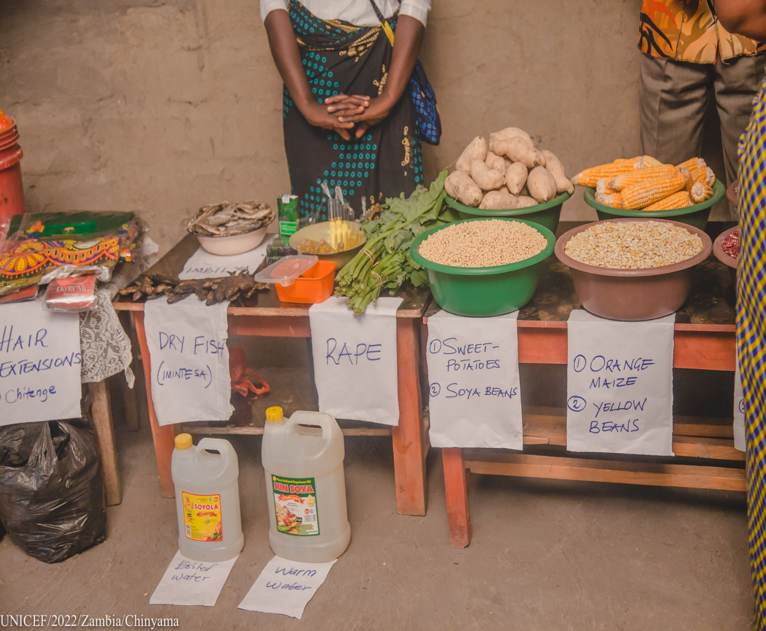

Presentation on the UN Food Systems Pathways
and
Feed Zambia – Zero Hunger Programme

Slide 2
Part I – UN Food Systems

Slide 3
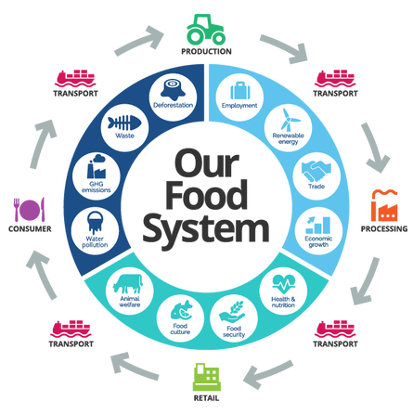
The Need for Food System Transformation

Slide 4
Interaction of the UN Food System
Planet must be protected to support more and equitable food system over generations.
People must benefit and be responsible for outcomes.
Prosperity of All Actors in the food value chain must be guaranteed with people and planet in mind.
Source: Nourishes

Slide 5
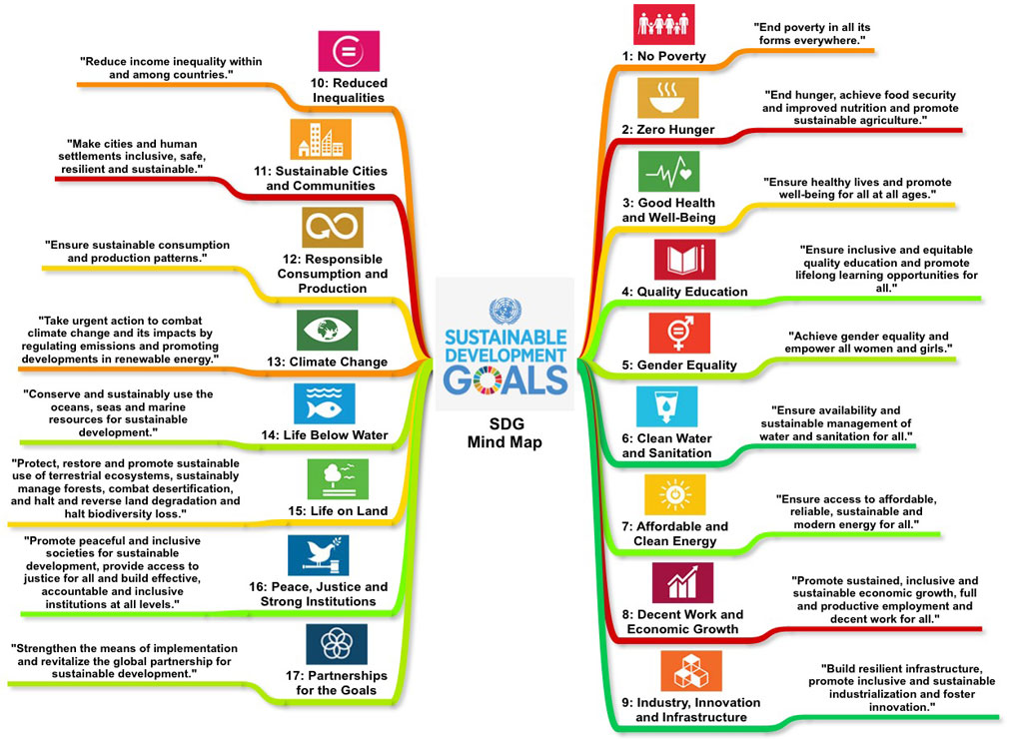
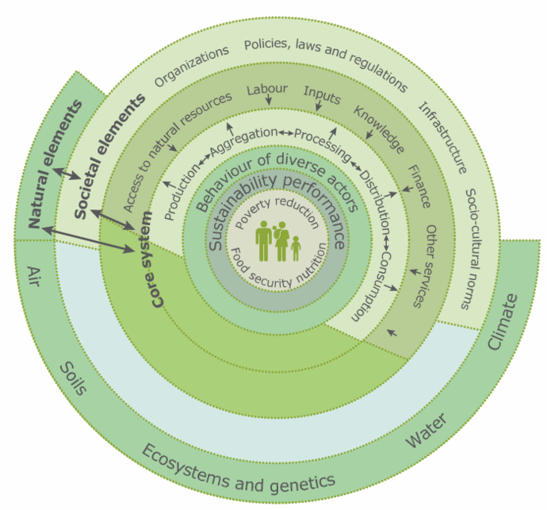
The Interaction that transforms the Food System

Slide 6
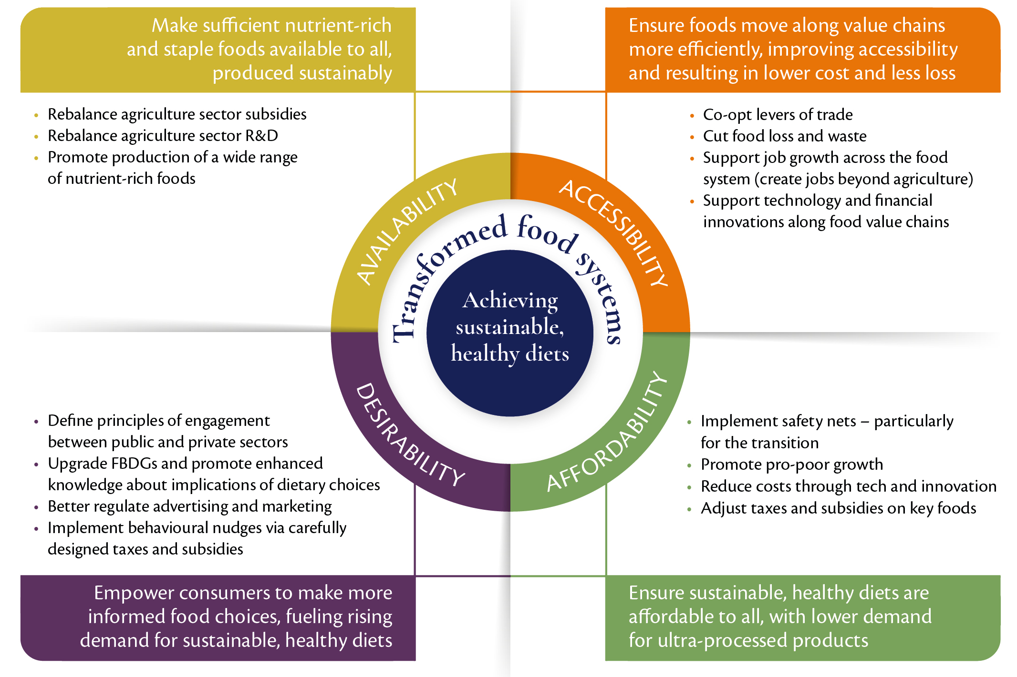
The Desired Food System Must:
The transition steps as four distinct policy objectives:
sufficient nutrient-rich and staple foods are available to all, sustainably produced;
those foods readily accessible to everyone;
foods affordable by everyone;
ensuring those foods are desirable to all consumers.
Source: Global Panel (2020)

Slide 7
Using SDG 2 Anchores all SDGs
SDG2 - ZERO HUNGER
SHIFTING TO HEALTHY AND SUSTAINABLE CONSUMPTION PATTERNS
ENSURING ACCESS TO SAFE AND NUTRITIOUS FOODS FOR ALL
BOOSTING NATURE-POSITIVE FOOD PRODUCTION
ADVANCING EQUITABLE LIVELIHOODS OF PEOPLE INVOLVED IN THE FOOD SYSTEM
BUILDING RESILIENCE TO VULNERABILITIES, SHOCKS AND STRESSES

Slide 8
Zambia’s Institutional Linkages to Sustainable Food Systems Pathways
UN FOOD SYSTEM PATHWAYS | UN SDGs LINKED TO THE PATHWAYS | INSTITUTIONS AND PARTNERS
PATHWAY 1: ENSURING ACCESS TO SAFE AND NUTRITIOUS FOODS FOR ALL | SDG 1: No Poverty SDG 2: Zero Hunger SDG 3: Good Health and Well-being SDG 10: Reduced Inequality | FAO, NFNC, GIZ, WORLD BANK, MOFNP, NUTRITION LINE MINISTRIES AND NUTRITION CPs ; UNICEF, WFP, MCDSS, USAID, WHO, MLG; GIZ,WFP, USAID, MFNP, MCDSS, MICRO FINANCIAL INSTITUTIONS MOA, WB, IFAD, MWSEP, AGRA
PATHWAY 2: SHIFTING TO HEALTHY AND SUSTAINABLE CONSUMPTION PATTERNS | SDG 3: Good Health and Well-being SDG 12: Responsible Consumption and Production | RESEARCH INSTITUTIONS, NTBC, ACADEMIA, PRIVATE, NISIR; CONSULTING FIRMS, ZAM; UNICEF, FAO, MCDSS, USAID, WHO, MLG; WFP, NFNC, MOA, ZABS, TRADERS, CCPC, MFNP, MANUFACTURERS, FOOD PROCESSORS, WHOLESALERS; WFP, NFNC, ZABS, CCPC, MISA ZAMBIA MEDIA, UNICEF, GIZ, WFP, USAID, ACADEMIA AND RESEARCH, LINE MINISTRIES
PATHWAY 3: BOOSTING NATURE-POSITIVE FOOD PRODUCTION | SDG 6: Clean Water and Sanitation SDG 7: Affordable and Clean Energy SDG 9: Industry, Innovation and Infrastructure | FAO, GIZ, MGEE, WWF, WORLDFISH; MOFNP, MCTI, MSME, MINISTRY OF INFRASTRUCTURE, HOUSING AND URBAN DEVELOPMENT, MLGRD, ACADEMIA, AND RESEARCH INSTITUTIONS; MGE, COMACO, USAID, WB, ZNFU, RESEARCH INSTITUTIONS AND ACADEMIA; FAO, GIZ, MGE, COMACO, USAID, WB, ZNFU; PRIVATE SECTOR, WFP, RESEARCH AND ACADEMIA,

Slide 9
Zambia’s Institutional Linkages to Sustainable Food Systems Pathways
UN FOOD SYSTEM PATHWAYS | UN SDGs LINKED TO THE PATHWAYS | INSTITUTIONS AND PARTNERS
PATHWAY 4: ADVANCING EQUITABLE LIVELIHOODS OF PEOPLE INVOLVED IN THE FOOD SYSTEM | SDG 1: No Poverty SDG 4: Quality Education SDG 5: Gender Equality SDG 8: Decent Work and Economic Growth, SDG 10: Reduced Inequality SDG 16: Peace and Justice Strong Institution | MLG, MEDIA, ZLA AND OTHER CSOs; MFNP, WFP, FAO, MOE, GIZ, MCD, WB, WFP, MICROFIN INST, ZLA AND OTHER CSOS, AGRA
PATHWAY 5: BUILDING RESILIENCE TO VULNERABILITIES, SHOCKS AND STRESSES | SDG 2: Zero Hunger, SDG 9: Industry, Innovation and Infrastructure SDG 11: Sustainable Cities and Communities SDG 13: Climate Action SDG 17: Partnerships to Achieve the Goals | SADC GENETIC SEED BANK, WORLDFISH, ACADEMIA AND RESEARCH INSTITUTIONS; FAO, GIZ, CSOS, NGOS, IFAD, ZNFU, NGOS, IFAD, ZNFU, OVP, MGE, ACADEMIA AND RESEARCH INST., INSURANCE COMPANIES, WFP, FINANCIAL INST., FAO, GIZ, IFAD, INTERNATION RED-LOCUST CONTROL

Slide 10
Thank You.
Notes:
Slide Reference from this report.

