Slide 1
Economic Analysis of Zambia’s Scaling Up Nutrition (SUN)/ First 1000 Most Critical Days (MCDP) II Programme
2023 Scaling Up Nutrition National Conference
Lusaka, Zambia
Scaling Up Nutrition Learning and Evaluation (SUN LE) Project
USAID Contract Number 72061119C00003
Ann Levin, Team Lead, ICF consultant
Sharper Sikota, ICF consultant
Webby Mwamulela, ICF consultant
Athena Pantazis, ICF
John Manda, SUN LE/ICF
Lwendo Moonzwe, SUN LE/ICF
14 Sept 2023

Slide 2
This presentation is made possible by the support of the American People through the United States Agency for International Development (USAID) and was prepared by the SUN LE Project. The authors’ views expressed in this publication do not necessarily reflect the views of USAID or the United States Government.

Slide 3
Agenda
Introduction
Data Collection
Objective 1: Main Drivers of Stunting Analysis
  Background and Methods
  Final Results
Objective 2: Impact Assessment Analysis
  Background and Methods
  Final Results
Objective 3: Efficient Allocation of Resources Analysis
  Background and Methods
  Final Results
Findings

Slide 4
Introduction

Slide 5
Background
Child stunting due to chronic malnutrition is a significant problem in Zambia because of inadequate nutrition-related practices and insufficient access to services.
Resources for nutrition-related interventions are limited; therefore, the available budgets must be used in a manner that can achieve the greatest possible outcome.
Economic analysis can show the GRZ and nutrition stakeholders whether:
  The stated nutrition outcomes are being met and provide information on efficient resource use.
  Their investments have achieved the intended outcomes.
  Interventions, packages of interventions and determinants are most effective for addressing stunting.

Slide 6
General Overview
The three objectives of the study are as follows:
Identify and measure the main drivers of stunting decline in Zambia
Show the impact of SUN/MCDP II interventions and coverage on mortality and health burden
Assess efficient resource allocation decisions to maximise SUN/MCDP II impact

Slide 7
Types of Economic Analyses and Data Needs
Economic Analysis | Approach/Tool | Description of Data and Source | Geographic Scope
Objective 1: Evaluate the main drivers of stunting decline in Zambia | Regression-decomposition approach | Zambia DHS data for 2007 and 2018 from ZAMStat | Zambia (national level)
Objective 2: Assess impact of SUN/MCDP II interventions | LiST and DALYs | Programme data from implementing partners via MARF | 30 SUN/MCDP II districts
Objective 3: Assess efficient resource allocation decisions to maximise SUN/MCDP II impact | Optima Nutrition and cost-benefit analysis | Programme data from government and implementing partners; Estimates on unit costs from investment case from World Bank | 30 SUN/MCDP II districts

Slide 8
Data Collection

Slide 9
Data Collection Process
Process
The study team received approval letters from six Zambian Ministry Permanent Secretaries to release programme data for the study.
Programme data were collected from some government ministries, SUN partners, and NGOs.
Secondary data were collected from existing sources (i.e., Zambia DHS and DHIS2).
Study challenges and resolution
Limitation in data availability for 2019 and 2020 and not all districts had data for all indicators.
Challenges around sharing expenditure data—used alternative sources of data.
Long turnaround time when engaged—shifted timeline.

Slide 10
Summary Data Table
#​ | Stakeholder Name​ | Programme Data Received​ | Details​ | Cost Data​ Received
1​ | GIZ​ | Yes​ | Received​ | No​
2​ | UNICEF​ | MARF​ data | Stakeholder data via MARF​ | No​
3​ | SUN TA​ | Yes​ | Received​ | No​
4​ | Ministry of Health (MoH)​ | Yes​ | Received, complete​ | No​
5​ | Ministry of Agriculture​ | MARF data​ | Received, but relatively sparse​ | No​
6​ | Ministry of Fisheries and Livestock​ | MARF data​ | Received, but relatively sparse​ | No​
7​ | Ministry of Water and Sanitation​ | MARF data​ | Received, but relatively sparse​ | No​
8​ | Ministry of Community Development and Social Services (MCDSS)​ | Yes​ | Provided limited programme data | No​
9​ | World Vision​ | Yes​ | Received ​ | No​
10​ | FAO/WFP​ | MARF data​ | Received, but relatively sparse​ | No​
Yellow – received data but sparsely distributed; Red – not expecting data; Green – data received or expected imminently
Notes:
NB: for this table I kept the source formatting iso using the template.

Slide 11
Expenditure Data Used
Unable to get expenditure data from government officers and implementing partners
Instead used unit cost data of interventions from earlier studies with adjustment for inflation:
  2016 World Bank nutrition investment case (used data from 2013 Zambia nutrition action plan)
  Also used cost data from other peer-reviewed studies on nutrition interventions
  If no other data, used default data from Optima Nutrition application
Implication: Estimated programme costs are less accurate

Slide 12
Evaluate the Main Drivers of Stunting Decline in Zambia
Objective 1

Slide 13
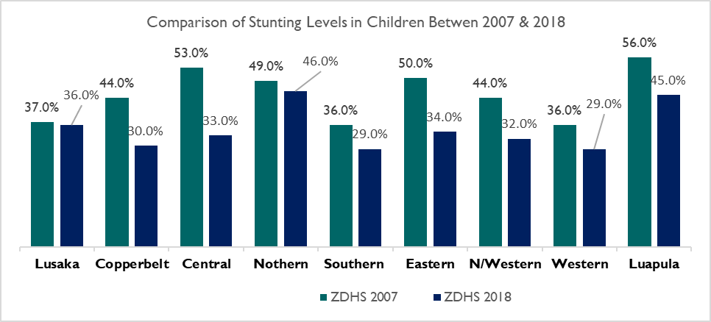
Decline in Stunting by Province, 2007–2018

Slide 14
Stage 1: Linear Regression Model
Variables retained for Stage 2
Variables without a significant association with HAZ
Variable | Coefficient (SE)
Mother smokes | -.064 (.174)
Crop yield | -.0005 (.000)
Child birth order | .035 (.020)
Paternal occupation | .048 (.032)
Bednet | .037 (.034)
Owns agricultural land | .074 (.042)
Number of children | .008 (.007)
Breastfeeding | .005 (.0008)
Variable | Coefficient (SE)
Wealth Index | .013 (.016)***
Paternal education | .111 (.029)***
Diarrhoea in the past 2 weeks | -.115 (.021)***
Maternal age | .011 (.002)***
Child's vaccination status | -.322 (.031)***
Maternal literacy level | .128 (.035)***
Maternal height | .046 (.004)***
4+ antenatal visits | .019 (.035)**
Basic sanitation | .187 (.045)***
Access to piped water | .0125 (.015)**
Birth weight | .0004 (.000) ***
* p<.05, ** p<.01, *** p< .001

Slide 15
Stage 2: Fixed Effect Model
We selected only those variables that are statistically significant at the 5% level. We accounted for survey design and weights.
  We used selected variables to run a Fixed Effect Model to derive estimates of the marginal effects on HAZ over time.
    To explain the relative contribution of each covariable over time to HAZ change, we used the Oaxaca-Blinder decomposition.
    We used the estimated parameters from the Fixed Effect Model and the (weighted) means of explanatory variables in the two time points to obtain the predicted change in HAZ due to the change in each determinant.
  The product coefficients for individual determinants were subsequently ranked to identify the relative contribution of each factor to HAZ change.

Slide 16
Relative Contribution of Factors to Stunting Decline
Notes:
R-squared: Within =3.65% Between=12.45% Overall: 4.67%
Intraclass correlation (rho), shows how much of the variance in HAZ score is explained by the difference across time. In this case is 14.2%.
The F-test to see whether all the coefficients in the model are jointly different than zero, Prob > 0.0000.

Slide 17
Impact of SUN/MCDP II on Mortality and Health Burden
Objective 2

Slide 18
Evaluating Impact Using Lives Saved Tool (LiST)
Used the Lives Saved Tool (LiST (spectrumweb.org)), Avenir Health
LiST models the impact of interventions as the reduction of mortality and morbidity rates by the change in intervention coverage and the intervention's relative effectiveness
Impact estimates are based on the coverage of 10 MCH indicators (WASH and health) covering services provided from 2019 to 2022.
  WASH data were only available for 2021-22 from 13 SUN TA districts and 3 UNICEF districts
To calculate impact for the programme, we follow the WHO CHOICE methodology for cost effectiveness analysis using LiST and compare intervention coverage to “no programme” coverage to estimate reductions in mortality and morbidity attributable to the programme.
LiST provided district-level estimates of:
  Deaths prevented for children under 5 years
  Cases of stunting prevented in children under 5 years
  Cases of diarrhoea prevented in children under 5 years
Notes:
LiST calculates changes in cause-specific mortality based on intervention coverage change, intervention effectiveness for that cause, and the percentage of cause-specific mortality sensitive to that intervention. To estimate maternal, child, or stillbirth outcomes in a projection, LiST models changing coverage for a wide range of maternal and child health interventions over time combined with inputs from the following: 1) DemProj, the demography module, provides demographic information for the projection; 2) AIM (AIDS Impact Module), incorporates the impact of HIV/AIDS and trends in HIV/AIDS treatment; and 3) FamPlan incorporates determinants of fertility into the projection.
LiST is based on the initial work of the Bellagio Child Survival Study Group, the Child Health Epidemiology Reference Group (CHERG), and the International Child Development Steering Group. Their work has sought to further specify the global burden of disease for neonates and children under five years of age both by region and by cause, and to identify and assess those interventions that will be the most effective in increasing child survival and developmental potential. This work has been published in The Lancet's global health series on child survival, neonatal survival, maternal survival, and infant and young child nutrition.
LiST was developed by the Institute for International Programs at Johns Hopkins Bloomberg School of Public Health and funded by the Bill & Melinda Gates Foundation - It is housed within Spectrum, a software package maintained by Avenir Health.
LiST estimates maternal and child deaths and illness prevented based on the coverage of key indicators using assumptions about:
Level of coverage of key interventions taken from recent population-based surveys (ZDHS 2018)
Mortality rates and prevalence of key diseases are from country-level estimates from WHO, UNICEF, UNFPA, World Bank Group and the United Nations Population Division and the UN Inter-agency Group for Child Mortality Estimation (IGME).
Effectiveness of interventions in preventing disease and death come from systematic reviews, meta-analyses, Delphi estimations, and randomized control trials based upon the Child Health Epidemiology Reference Group (CHERG) guidelines

Slide 19
Change in Estimated Under 5 Deaths (per 1,000) Attributable to Interventions, 2022
19

Slide 20
Contribution by Intervention to Reduction in Child Mortality, 2019–2022

Slide 21
Change in Estimated Stunting Prevalence (< 24 Months) Attributable to Interventions, 2022
Notes:
Because the coverage of relevant stunting interventions were not monotonically increasing, LiST does not produce estimates of stunting averted by intervention due to the complexity of the calculations.

Slide 22
Change in Estimated Diarrhoea Cases (< 5 Years) per Child-year (Incidence) Attributable to Interventions by District, 2022
Notes:
LiST is estimating that with this program, 63% of kids in a year in the 30 districts would avoid diarrhea. Or that, on the whole, the interventions reduce diarrhea among children in the 30 districts to 27% of what they would be were these interventions not in place.

Slide 23
Contribution by Intervention to Reduction in Diarrhoea cases, 2019–2022

Slide 24
Computing DALYs Based on LiST
DALYs are a measure of both morbidity and mortality due to a disease.
  DALYs measure the years of life lost and years of healthy life lost to disability to illness such as stunting.
To apply this method, used data from two sources:
  LiST analyses (projected mortality and morbidity averted due to programme)
  Institute Health Metrics and Evaluation Global Burden of Disease data
Using these data, DALYs were calculated:
  The number of child deaths were multiplied by life expectancy in Zambia to get years of life lost.
  The number of diarrhoea and stunting cases were multiplied by disability weights and duration of disease to get years of health life lost to disability.

Slide 25
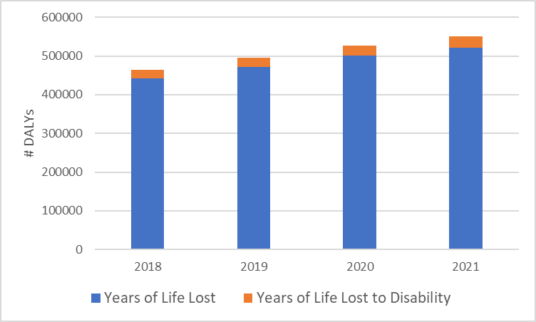
Disability Adjusted Life Years for Children Under 5 Years Averted in 30 Districts due to SUN/MCDP II by Year

Slide 26
Assess Efficient Resource Allocation Decisions
Objective 3

Slide 27
Optima Nutrition Tool
Combines an epidemiological model, cost functions, objective function defined by national strategic targets and constraints, and a mathematical optimization algorithm to estimate optimal budgets for nutrition
Objective function is to reduce the number of stunted children at age 5
  Prioritizes funding of interventions that affect stunting
Analyses interventions over period 2018–2030
Relationship to Objectives 1 and 2:
  Uses same inputs and results as found in LiST analyses
  Focuses on interventions identified in OB analysis and adds some that have been shown to reduce stunting

Slide 28
Optima Nutrition Data Requirements
Requires data on:
– Demographics: population size, fertility, mortality, morbidity, causes of death, breastfeeding prevalence
  Nutrition status: % of children that are stunted, wasted, and anaemic
  Programmatic characteristics: nutrition programme characteristics, intervention cost and coverage
    Could not access expenditure costs of programme costs, so used unit cost data from Dayton et al. 2017, An Investment Framework for Nutrition in Zambia, World Bank Group

Slide 29
Nutrition Optima Interventions Available in Tool
Infant and young child feeding education
Lipid-based nutrition supplements
Long-lasting bednets for malaria
Micronutrient powders
Multiple micronutrient supplementation
ORS+/zinc
Public provision of complementary foods
Treatment of SAM
Vitamin A supplementation
WASH: five different interventions
Zinc supplementation
Balanced energy-protein supplementation (pregnant women)
Calcium supplementation
Cash transfers
Delayed cord clamping
Family planning
Iron and folic acid fortification of staple foods
Iron and folic acid supplementation
IPTp for malaria
Kangaroo mother care
Existing Interventions
Potential interventions to be added

Slide 30
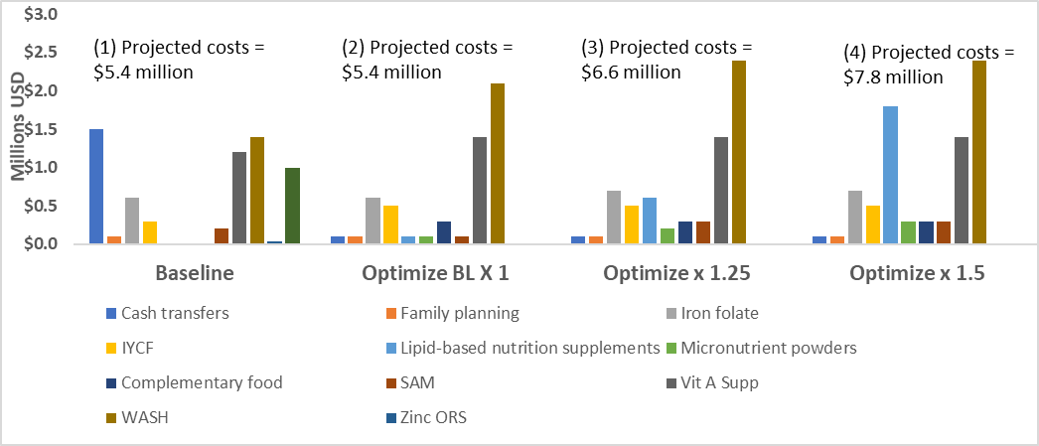
Average Optimal Nutrition Budget Allocations needed to reduce stunting, 2018–2030
Stunting is projected to decrease from 5% for BL X 1 to 6% for BL X 1.5 from baseline when the budget allocations are optimized .

Slide 31
Findings

Slide 32
Main Findings
Identify and measure the main drivers of stunting decline in Zambia
  Access to piped water, maternal education, birth weight, and basic sanitation were shown to be the main contributors to stunting decline in Zambia.
Model impact of SUN/MCDP II interventions and coverage on mortality and health burden
  SUN/MCDP II intervention coverage is attributed with:
    Average estimated reduction in under five mortality rates of 18.6 deaths per 1000
    Average estimated reduction in stunting prevalence among children <24 months of 1.1%
Assess efficient resource allocation to maximise SUN/MCDP II impact
  Introducing lipid-based nutritional supplements and complementary feeding and increasing Vitamin A and WASH intervention allocations will improve impact on stunting decline.

Slide 33
Considerations and Limitations
Lack of nutrition sensitive interventions LiST and Optima Nutrition, specifically agriculture and dietary diversity
Programme specific expenditure data was not available
Gaps in program monitoring data
Key indicators for analyzing drivers of stunting were not available in most recent Zambia Demographic and Health Surveys
  Change in child diversity measures between surveys
  Maternal height omitted in 2018

Slide 34
Works Cited
  Headey, Derek, John Hoddinott, and Seollee Park. "Accounting for nutritional changes in six success stories: a regression-decomposition approach." Global Food Security 13 (2017): 12-20.
  Tasic, Hana, et al. "Drivers of stunting reduction in Ethiopia: a country case study." The American journal of clinical nutrition 112.Supplement_2 (2020): 875S-893S.

Slide 35
Thank You

Slide 36
Extra Slides

Slide 37
LiST Details
LiST models the impact of interventions by reducing mortality rates (or morbidity rates) by the change in intervention coverage and the interventions relative effectiveness.
LiST estimates maternal and child deaths and illness prevented based on the coverage of key indicators using assumptions about:
  Mortality rates and prevalence of key diseases, which are from country-level estimates from WHO, UNICEF, UNFPA, World Bank Group, the United Nations Population Division, and the United Nations Inter-agency Group for Child Mortality Estimation
  Effectiveness of interventions in preventing disease and death, which come from systematic reviews, meta-analyses, Delphi estimations, and randomized control trials based on the Child Health Epidemiology Reference Group (CHERG) guidelines
Lives Saved = Cause-specific mortality X Coverage change X (Affected fraction X Effectiveness)

Slide 38
Regression Decomposition Model Fit
R-squared: Within =3.65% Between=12.45% Overall: 4.67%
Intraclass correlation (rho), shows how much of the variance in HAZ score is explained by the difference across time. In this case is 14.2%.
The F-test to see whether all the coefficients in the model are jointly different than zero, Prob > 0.0000.

Slide 39
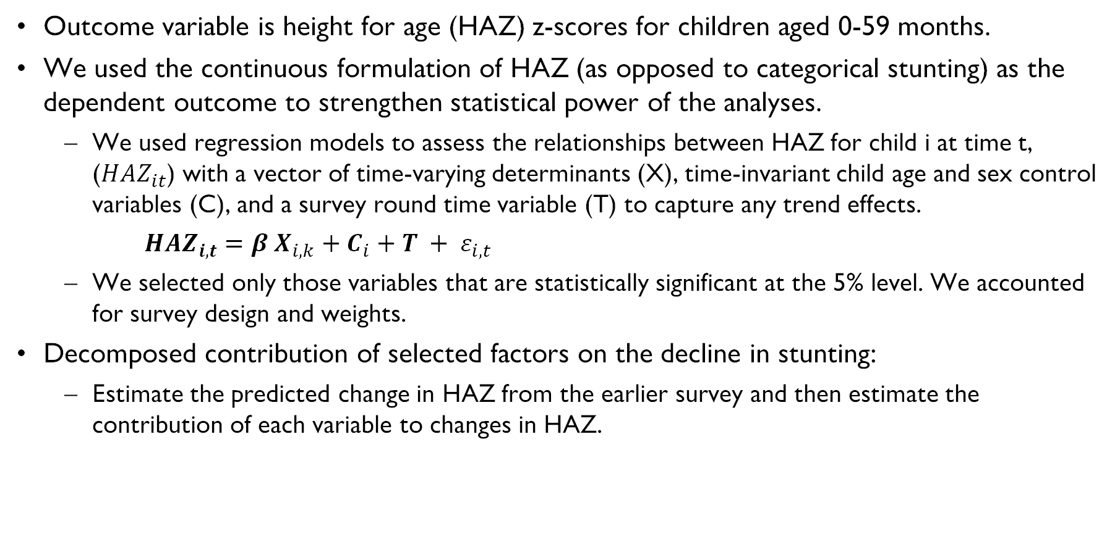
Stage 1: Linear Least Square Regression Model
Outcome variable is height for age (HAZ) z-scores for children aged 0-59 months.
We used the continuous formulation of HAZ (as opposed to categorical stunting) as the dependent outcome to strengthen statistical power of the analyses.
  We used regression models to assess the relationships between HAZ for child i at time t, (${HAZ}_{it}$) with a vector of time-varying determinants (X), time-invariant child age and sex control variables (C), and a survey round time variable (T) to capture any trend effects.
  ${HAZ}_{i,t}=β_{ }X_{i,k}+C_{i}+T + ε_{i,t}$
  We selected only those variables that are statistically significant at the 5% level. We accounted for survey design and weights.
  Decomposed contribution of selected factors on the decline in stunting:
  Estimate the predicted change in HAZ from the earlier survey and then estimate the contribution of each variable to changes in HAZ.

