Slide 1

Update on the Implementation status of Nutrition Programmes in Zambia
National Food and Nutrition Commission
2023 National Nutrition Conference
Dr Kampengele K. Mapani
13 September 2023

Slide 2

Presentation outline
INTRODUCTION
NUTRITION PROGRAMMES OVERVIEW
ACHIEVEMENTS AND CHALLENGES
WAY FORWARD

Slide 3
Introduction
The malnutrition burden in Zambia is huge, with stunting levels at 35% (ZDHS, 2018)
It is a major public health concern – Stunting depicts chronic deprivation of adequate nutrition – Irreversible - Poor social Economic status
Triple burden:
Undernutrition (Wasting, stunting),
Micronutrient deficiency ( Anemia, Blindness)
Overnutrition ( Obesity, Overweight, DR – NCDs – Hypertension, DM 2)

Slide 4
NUTRITION PROGRAMMES IN ZAMBIA

Slide 5
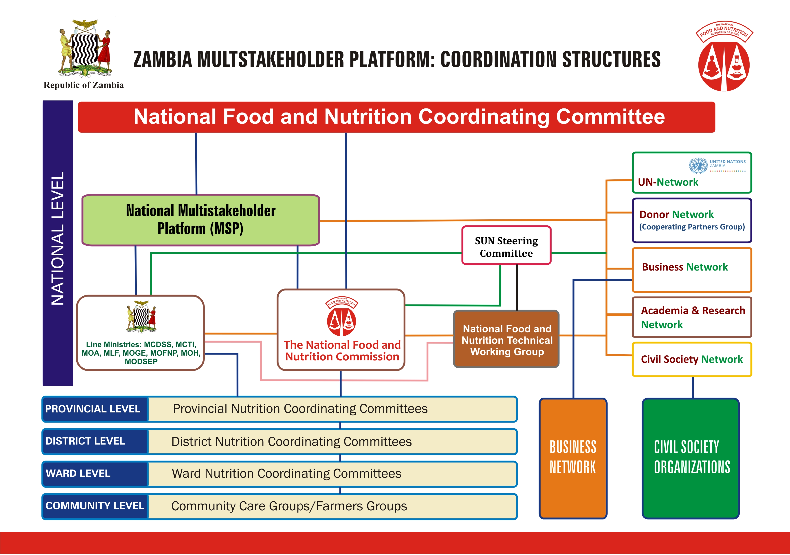
The Food and Nutrition Act No. 3 of 2020
Implementation of the Act

Slide 6
Functions of the Food and Nutrition Commission
Formulate the National Food and Nutrition Programme
Coordinate, monitor and evaluate food and nutrition programmes in order to improve delivery and access to food and nutrition services
Carry out research and surveillance on food and nutrition matters
Promote provision of adequate diets in public and private institutions

Slide 7
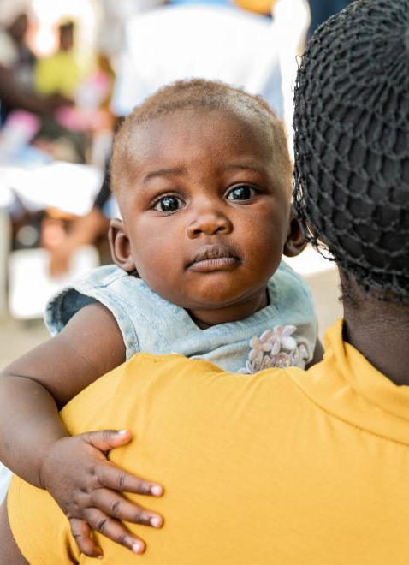
Programmes implementing nutrition interventions
SUN II / MCDP II - Flagship Programme in Zambia
Multisectoral approach
Mainly addressing stunting
Targeting the 1st 1000 days – pregnant women, lactating women, adolescents, children 0 to 23 months
Nutrition specific and nutrition sensitive interventions
Currently in 36 districts
Government is implementing with support from cooperating partners

Slide 8
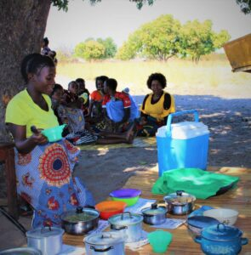
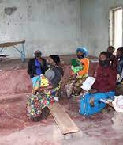
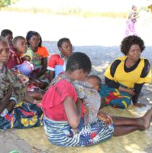
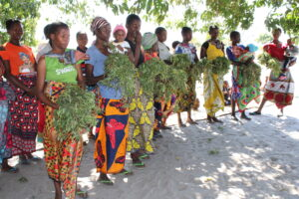
SUN II / MCDP II
Needs scale up to all districts and saturate the whole district
Sustainability of the subnational level ???
Funding for activities

Slide 9
School Health Nutrition
Baseline survey- biomedical, anthropometric and cognitive assessments
Micronutrients supplements (Iron tablets and Vit. A) and de-worming pills (Albendazole) once per year
Training teachers in Drug Administration and Life skills
Strengthening linkages between Health centres and schools
Providing small grants to schools and communities to support SHN and HIV/AIDS interventions
Community mobilisation to support SHN activities as a cross cutting activity

Slide 10
School Health and Nutrition
70 districts / 116 districts implementing
Fully funded by GRZ since July, 2019
Implemented in early childhood and primary schools
All government primary and community schools registered with the DEBS
Main food is maize meal, pulses and vegetables
Production units in every school mandatory

Slide 11
Micronutrient deficiency control
Promotion of biofortified (orange) sweet potato
Promotion of biofortified (Orange) maize
Promotion of biofortified beans (mbereshi beans)
Iron/ folate supplementation
Deworming programme
Presumptive treatment of malaria
Coordination of fortification of foods; sugar; salt;

Slide 12
Food systems approach
Zambia has developed a transformative food systems that has 5 pathways:
Ensuring access to safe and nutritious foods for all
Shifting to healthy and sustainable consumption patterns
Boosting nature positive food production
Advancing equitable livelihoods of people involved in the food systems
Building resilience to vulnerabilities, shocks and stresses

Slide 13
Development and sustaining human resource capacity in the nutrition sector
Development of food and nutrition related training in public and private training institutions at:
Levy Mwanawasa Medical University;
University of Zambia;
Mukuba University;
Mulungushi university;
St Eugene DMI University;
Livingstone International University of Tourism Excellence and Business Management etc.

Slide 14
Other programmes
Multisectoral Nutrition Information System under pilot
NiPN
Adolescent nutrition
Nutrition Friendly Schools Initiative

Slide 15
Way forward
All ministries and GRZ agencies to mainstream Nutrition interventions
Scale up nutrition interventions to all the districts
Development of a National Food and Nutrition Programme
Disseminate the Food Consumption and Micronutrient Status Survey Findings - will inform how we proceed with malnutrition control
Advocacy towards ring fencing some funds from CDF for nutrition interventions across the country
Development of an investment case for more funding towards nutrition activities

Slide 16
Conclusion
The nutrition situation in Zambia requires urgent attention if Zambia is to be on track to attain its vision 2030 of becoming a prosperous middle income nation by creating an enabling environment for sustainable socio-economic development
It is critical that stakeholders in nutrition continue to work together as an alliance to address all forms of malnutrition
It is expected that with the services government is implementing with support from cooperating partners, nutrition goals and targets will be achieved.

Slide 17
Nutrition cooperating partners supporting government

Slide 18


