Slide 1






2023 National Conference – closing remarks
13th -14th September 2023
Location: Radisson Blu Lusaka

Slide 2

Date: 1 4th September 2023
Presentation Title: Summary of Way Forward
Presenter: Executive Director: Muntanga Mapani
Organization: NFNC
“Strengthening and accelerating delivery of multisectoral nutrition interventions through evidence-driven programming”

Slide 3
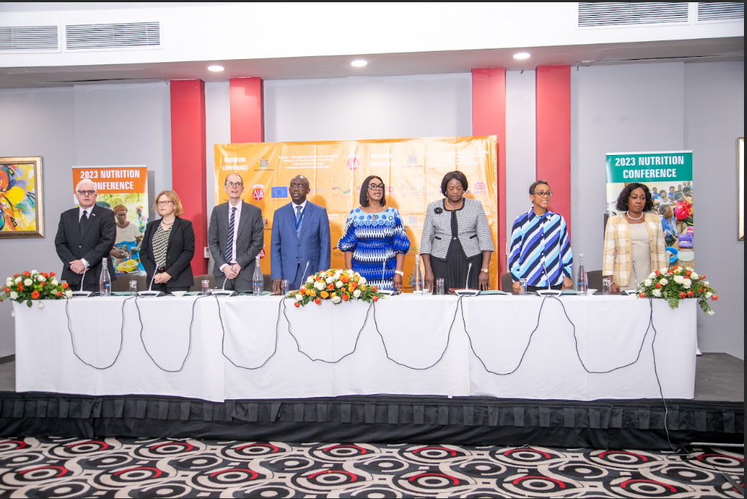
Closing remarks / Way forward
  A lot of learning has taken place
  A big hearty thank you to all colleagues, partners who have taken interest in the nutritional status of the Zambia population
  Clearly, implementation of the EB, SUN II interventions remains the priority with extension to address all forms of malnutrition throughout the life cycle
“Strengthening and accelerating delivery of multisectoral nutrition interventions through evidence-driven programming”

Slide 4
Closing remarks / Way forward
  The household remains the target of convergence for the multisectoral approach.
  The women and children identified as vulnerable groups
  But the men / males in the households must not be left behind – in all activities
“Strengthening and accelerating delivery of multisectoral nutrition interventions through evidence-driven programming”

Slide 5
Closing remarks / Way forward
  Scaling up to more districts, saturating all districts with interventions is also priority.
  Involvement of all GRZ / ministries and departments going forward is important – Nutrition sensitive interventions – this speaks to transformation of food systems
“Strengthening and accelerating delivery of multisectoral nutrition interventions through evidence-driven programming”

Slide 6
Closing remarks / Way forward
  Reduction of stunting is important as it speaks to all indicators in the MCDP
  Research / surveys remain cardinal in generating data to improve the actions that we do
“Strengthening and accelerating delivery of multisectoral nutrition interventions through evidence-driven programming”

Slide 7
Closing remarks / Way forward
  NFNC is working with all the NGOs, CPs / implementing partners is what is on the table
  The NFNC is mandated to clear / allow all the activities that are being implemented in Zambia
“Strengthening and accelerating delivery of multisectoral nutrition interventions through evidence-driven programming”

Slide 8
Closing remarks / Way forward
  My appeal on two fronts
    If we are implementing / cooperating with GRZ, NFNC is the vehicle for such cooperation in the nutrition sector
    We at NFNC are keen to work with everyone to improve the nutrition status of the country
“Strengthening and accelerating delivery of multisectoral nutrition interventions through evidence-driven programming”

Slide 9
Closing remarks / Way forward
  We are moving away from being a rubber stamp of programmes that we do not know about
  We are going to take actions to that end so that people can account for money being spent on behalf of GRZ
“Strengthening and accelerating delivery of multisectoral nutrition interventions through evidence-driven programming”

Slide 10
Closing remarks / Way forward
  There is still a nutrition funding gap, even in the 8th NDP across all programmes
  So we appeal to all the donors / funders to continue investing in the nutrition sector, to enhance the alliance of nutrition implementors
“Strengthening and accelerating delivery of multisectoral nutrition interventions through evidence-driven programming”

Slide 11
Closing remarks / Way forward
  To cut the long story short, May I report that we have brilliant new innovation on the NFNC website
  Interactive dash board of nutrition indicator
  Nutrition research in Zambia Evidence Map
“Strengthening and accelerating delivery of multisectoral nutrition interventions through evidence-driven programming”

Slide 12

Acknowledgements
“Strengthening and accelerating delivery of multisectoral nutrition interventions through evidence-driven programming”

Slide 13

Thank you
“Strengthening and accelerating delivery of multisectoral nutrition interventions through evidence-driven programming”
13

