Slide 1
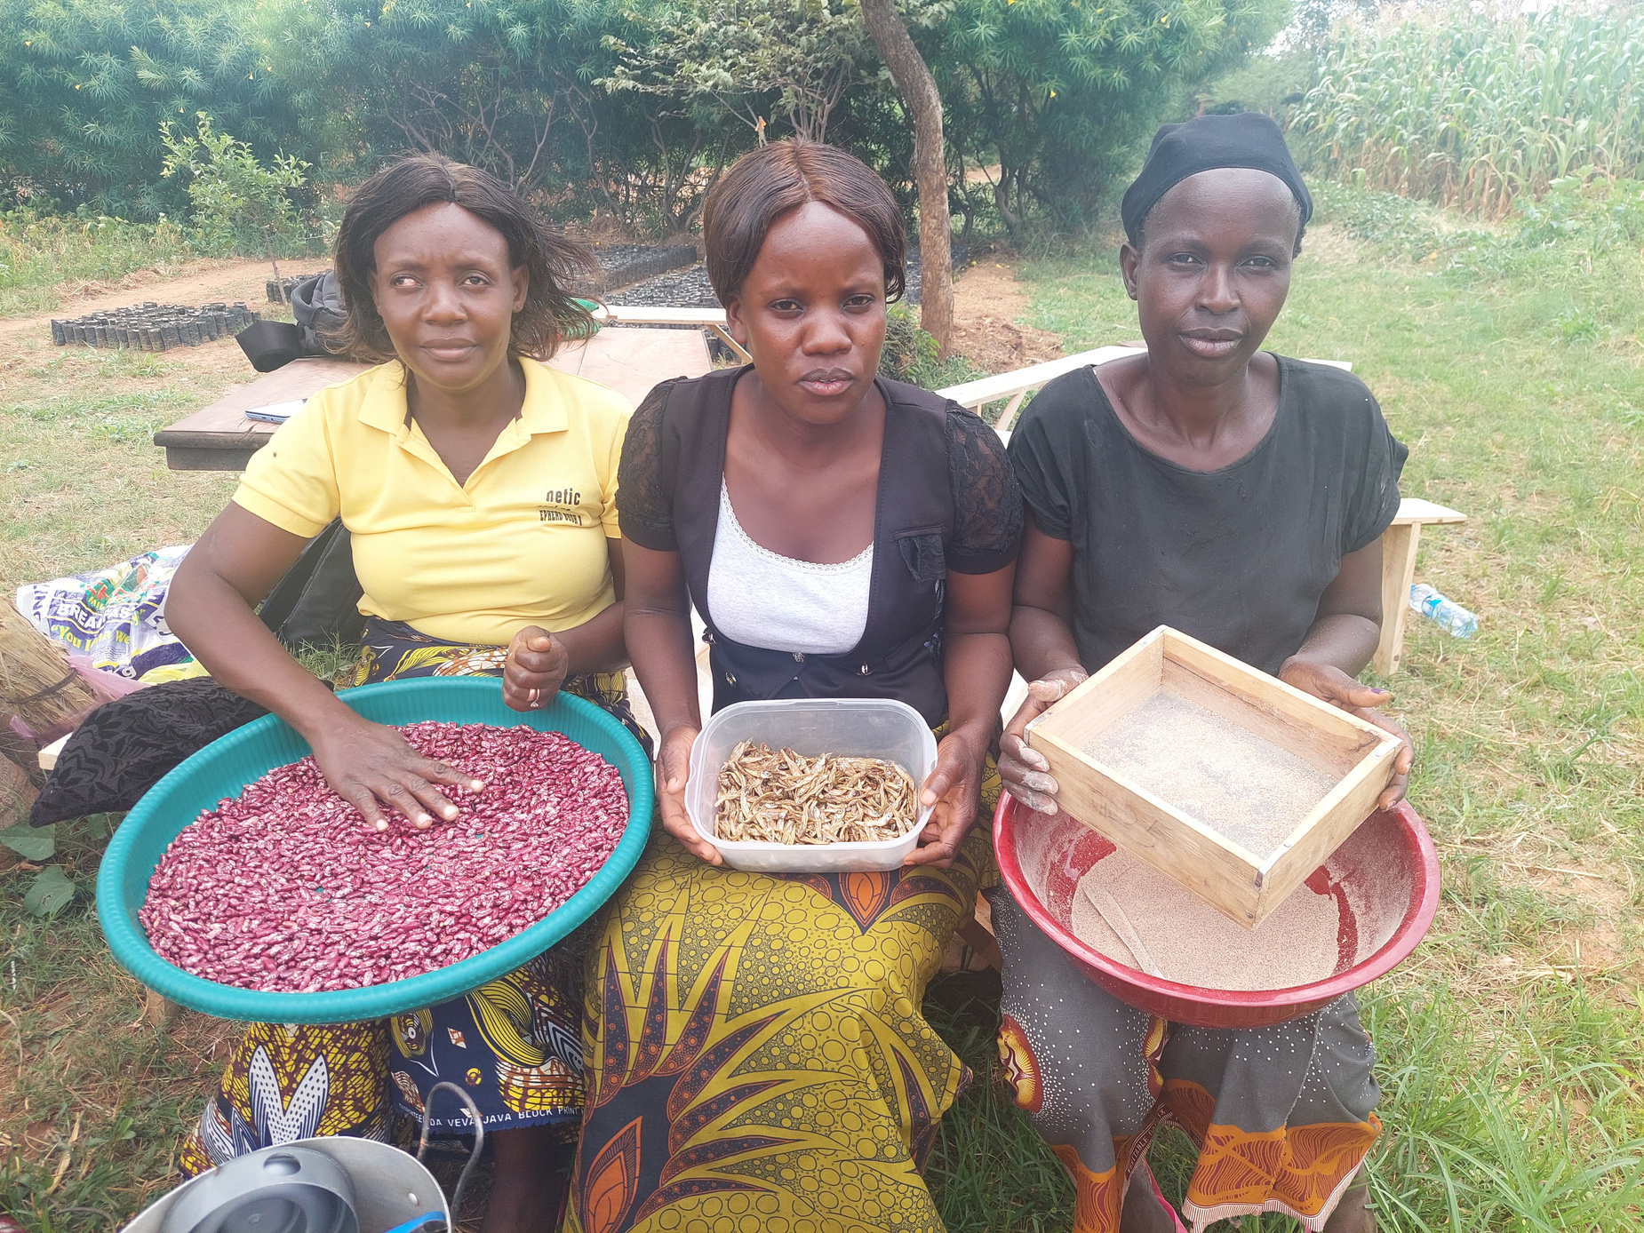
State of Food Security and Nutrition in the World: Prevalence of Undernourishment
Presented at the Zambia Nutrition Conference
Radisson Blu, Lusaka
14th September, 2023

Slide 2
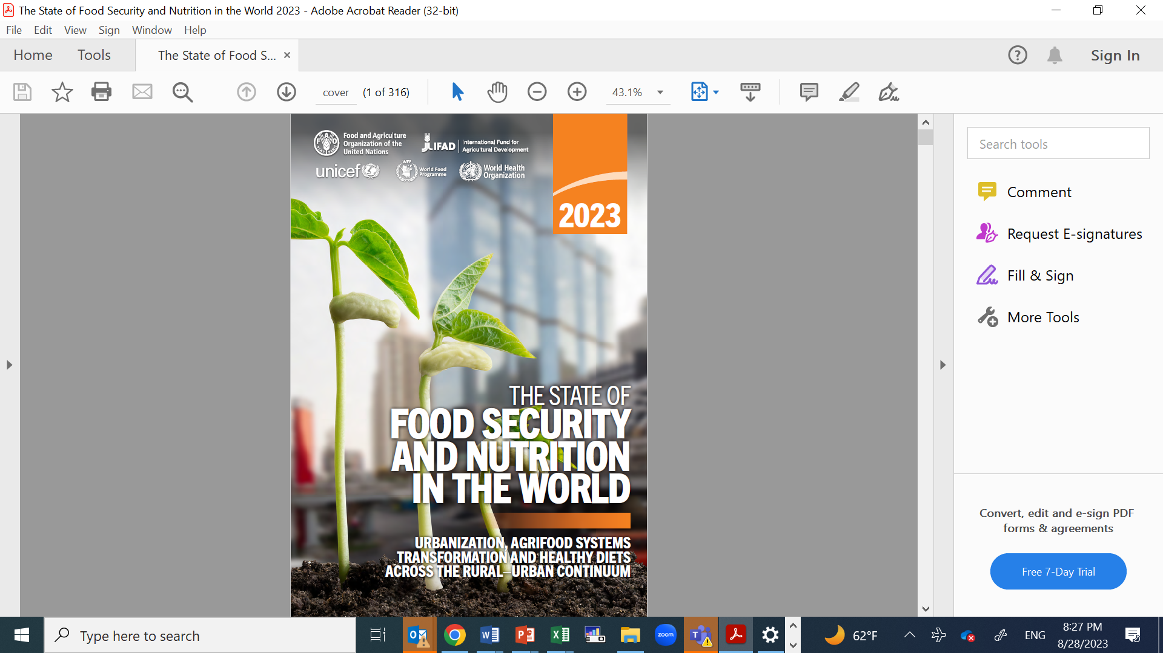
State of Food Insecurity and Nutrition in the World
Since 1999, FAO publishes Prevalence of Undernourishment (PoU) in The State of Food Insecurity in the World (SOFI) annual publication
2023 SOFI Report focuses on - Urbanization, agrifood systems transformation and healthy diets across the rural–urban continuum
Agrifood systems remain highly vulnerable to shocks and disruptions arising from conflict, climate variability and extremes, and economic contraction

Slide 3









PoU is an indicator for monitoring SDG 2:
End hunger, achieve food security and improved nutrition and promote sustainable agriculture
Target 2.1Universal access to safe, nutritious, and sufficient food
2.1.1Prevalence of undernourishment
2.1.2Prevalence of food insecurity
Target 2.5: Maintain the genetic diversity in food production
Target 2.b: Prevent agricultural trade restrictions, market distortions and export subsidies
Target 2.3: Double the productivity and incomes of small-scale food producers
Target 2.4: Sustainable food production and resilient agricultural practices
Target 2.a: Invest in rural infrastructure, agricultural research, technology and gene banks
Target 2.2End all forms of malnutrition

Slide 4
Interaction of PoU with other indicators
Malnutrition
not having right amount of nutrients needed to maintain a healthy body
Hunger
Hunger synonymous with chronic undernourishment
Under-nourishment
Inability to acquire enough food
Food Insecurity
Issues of Availability, Accessibility, utilization and sustainability
Undernourishment is a measure of Hunger Index
Global Hunger
Index
Undernourishment
Nutrition Status: Stunting,
Wasting
Under 5 Child Mortality

Slide 5
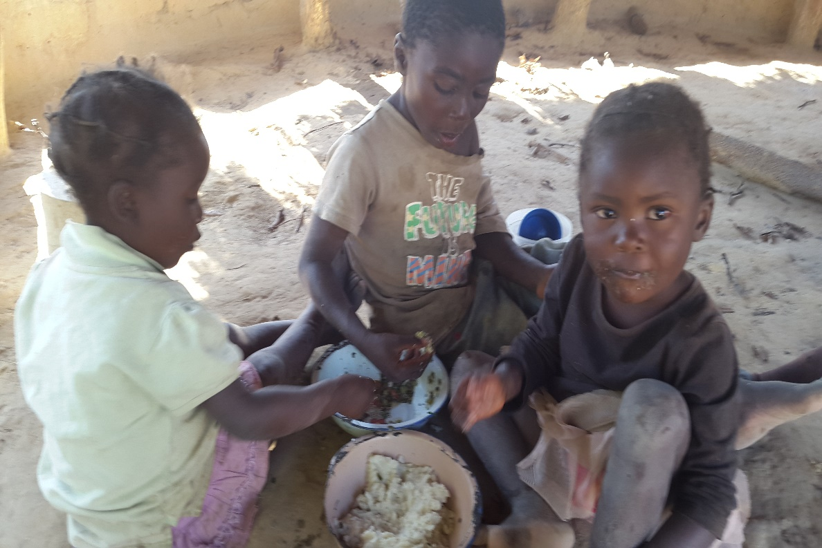
Undernourishment Estimation
Undernourishment - Insufficient food to meet Dietary Energy Requirement (DER)
Undernourishment rate = proportion of individuals in a population with DEC below the individuals’ respective DER
DEC is derived from consumption data - collected in national consumption/expenditure surveys

Slide 6
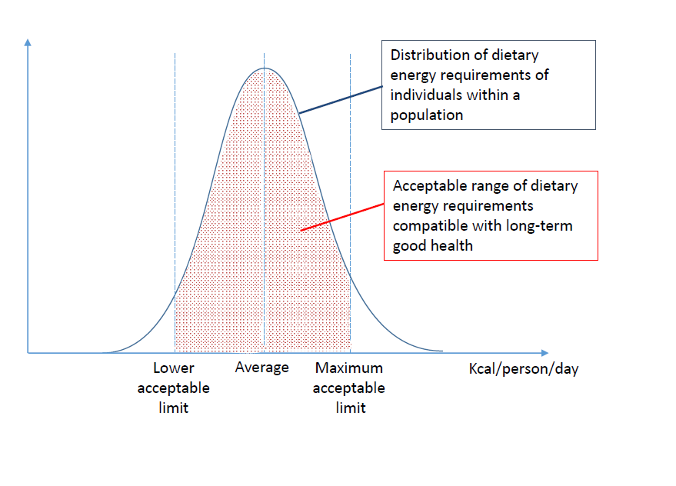
Undernourishment Estimation
The estimation of the undernourished in a population cannot be viewed as a simple accounting exercise of counting the individuals in the households with DEC < DER.
It is a probability distribution framework
Undernourishment is extreme form of food insecurity
Arising when even the mere caloric supply is inadequate to cover basic needs

Slide 7
2023 SOFI Report Key Findings
Global hunger, measured by the prevalence of undernourishment remained relatively unchanged from 2021 to 2022 but is still far above pre-COVID-19-pandemic levels
Around 9.2 percent of the world population in 2022 were malnourished compared with 7.9 percent in 2019
From 2021 to 2022, progress was made towards reducing hunger in Asia and in Latin America, but hunger is still on the rise in Western Asia, the Caribbean and all sub regions of Africa
Worldwide, food insecurity disproportionately affects women and people living in rural areas

Slide 8
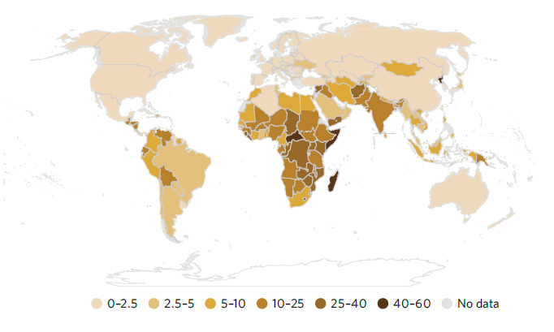
Key Highlights from the 2023 SOFI Report
2023 Prevalence of Undernourishment: Sub-Saharan Africa persistently experiencing high PoU compared to other regions

Slide 9
Zambia Undernourishment Trends

Slide 10

Conclusion
Zambia is beginning to show progress in reducing the PoU but the rate remains significantly high
The affordability of a healthy diet is becoming more critical especially for households living in peri-urban and rural areas because they rely more on food purchases
Low-income households are especially affected, as they would need to more than double their food expenditure to secure a healthy diet
Increasing urbanization, with almost seven in ten people projected to live in cities by 2050, is driving changes in agrifood systems across the rural–urban areas. These changes represent both challenges and opportunities
Need for significant food systems transformation to meet the growing demand

Slide 11
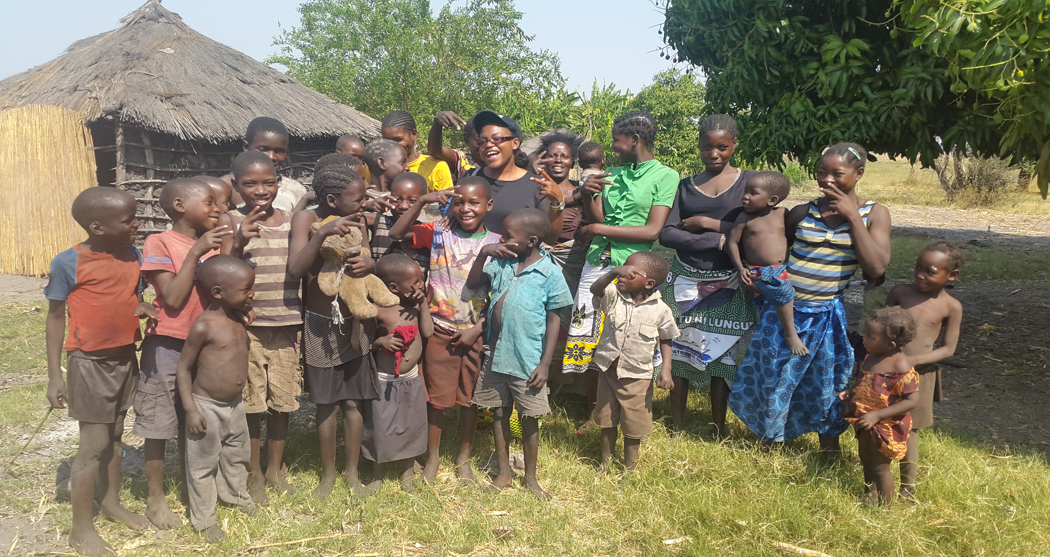
Thankyou for your attention
We dream of a Zero Hunger World

