Slide 1
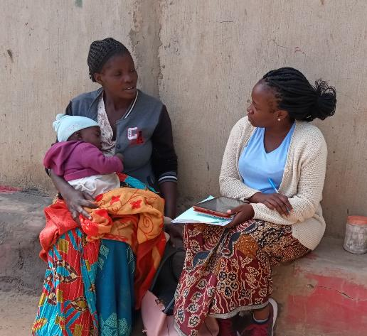
2019 SUN National Conference
MCDP II Baseline Survey Results
Intercontinental Hotel
Lusaka, Zambia
SUN LE data collector and respondent. Courtesy of SUN LE staff
31 October
2019
Notes:
© 2013 SC4CCM/JSI, Courtesy of Photoshare

Slide 2
Outline
Acknowledgements
Introduction
Methodology
Results
  Household Results
  Stakeholder perspective results (Key informant Interviews)

Slide 3
Background

Slide 4



Acknowledgement
This MCDP II Baseline Survey was made possible with the generous support of the American people through the U.S. Agency for International Development.
This survey was made possible through the infrastructural support of the Government Republic of Zambia. We are thankful to the Zambia Statistics Agency (formerly known as the Central Statistics Office) and the Ministry of Health for their Technical and Logistical Support. We also acknowledge the communities where the survey was conducted.
This survey was designed and implemented by the USAID-funded SUN LE Project with the National Food and Nutrition Commission (NFNC) of Zambia.

Slide 5




Background
Scaling Up Nutrition Learning and Evaluation (SUN LE) is a 4-year USAID-funded project implemented by Khulisa Management Services, Inc. in partnership with the Government of the Republic of Zambia (GRZ) and in consortium with 3 institutional partners.
Khulisa Management Services, Inc.
Indaba Agricultural Policy Research Institute
ICF International
University of North Carolina at Chapel Hill

Slide 6
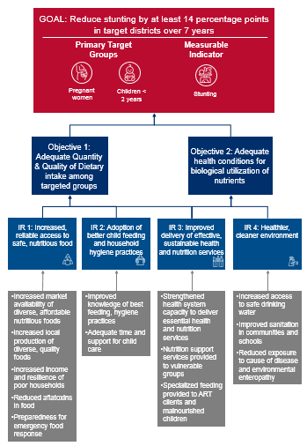
Survey Purpose and Scope
Establish benchmark measures for 26 of 33 MCDP II indicators aligned to Framework for Reducing Stunting
Future Surveys (Midline and Endline) will assess
  Trends in stunting among children aged 0-24 months across the three surveys
  Effectiveness of the SUN 2.0 program delivery and identify lessons for further program improvement

Slide 7
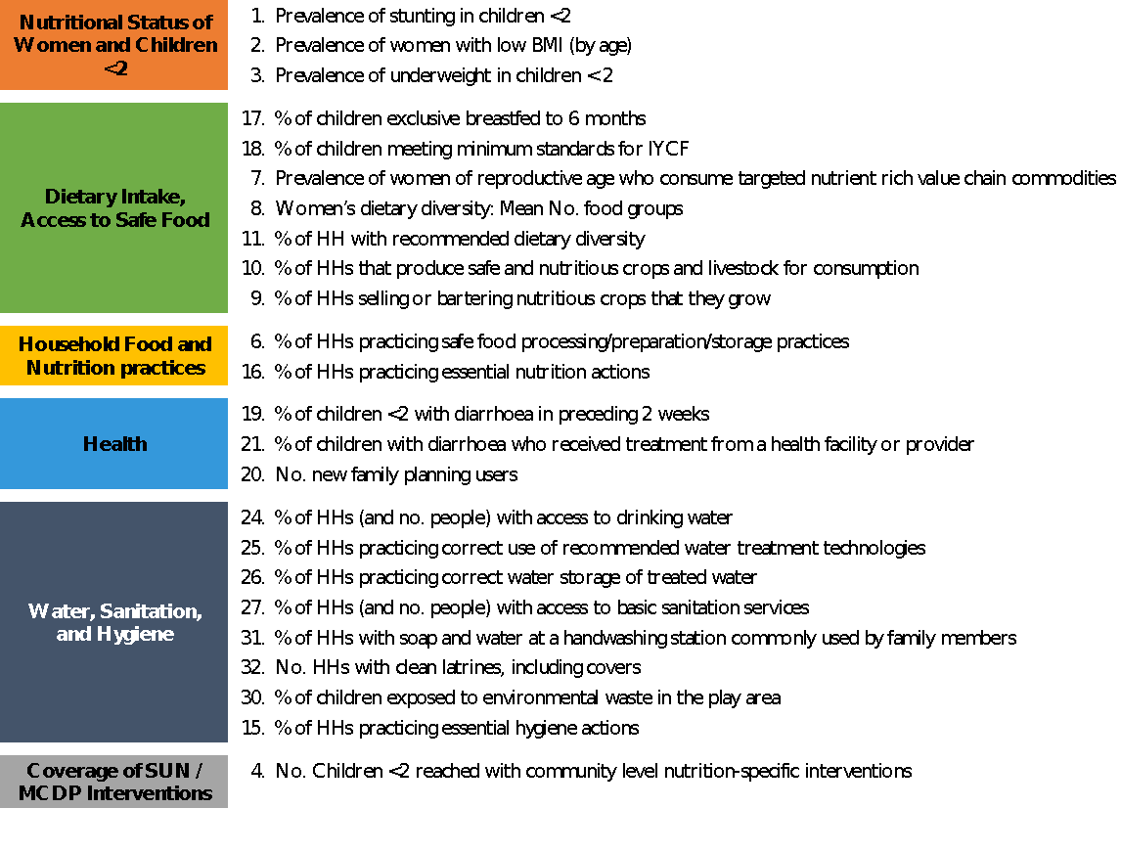
Specific Indicators

Slide 8
Key Milestones and Intended Outcome
Define Indicators
IRB Approval
Data cleaning / analysis
Report Writing
Data Use for Planning @
National
Provincial
Districts
Develop protocol and Tools
Data collection
Preliminary Results validation - TWG
National Dissemination

Slide 9
Methodology

Slide 10
Study Design: Household Survey
30 districts purposively selected (MCDPII)
Stage I
10 SEAs randomly selected using PPS from each district (n=300)
Stage II
Households with children below 24 months in selected 10 SEAs listed (n=11,498)
Stage III
Selection interval used to select HHs
25 households per SEA randomly selected
( n=7501)
Data collection App randomly selected 1 child (<24 months) & Mother/Caregivers per HH
Stage IV

Slide 11
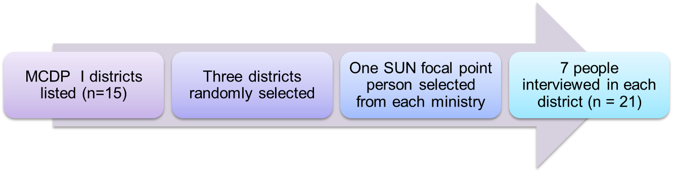
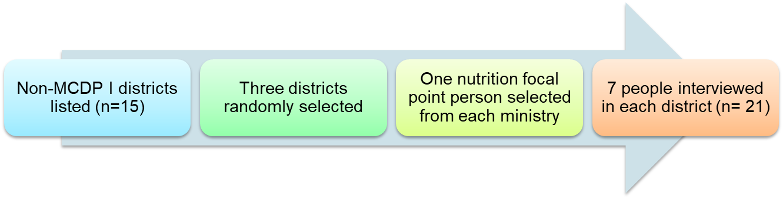
Key Informant Interview Sampling (N= 66)
District level:
Provincial level: 7 officers from key line ministries and 1 NGO staff interviewed from 3 provinces (n = 24)

Slide 12
Data collection: 27 May-15 July 2019
Household Survey
Key Informant Interviews
Structured questionnaire used to collect information
Collected electronically using tablet
Questionnaire programmed using Survey Solutions
Collected by 15 teams in the 30 districts.
Each team =
  5 Interviewers
  1 Supervisor
  1 Quality Controller
Semi-structured questionnaire used to collect data
  Open ended
  Likert scale questions administered
Collected electronically
Using JotForm App
  Collected by Quality Controllers

Slide 13
Data Quality Assurance – Data collection
Enumerator after interview
A five-tier quality control strategy was used to ensure high quality data
Supervisor check in the field
  Questionnaires with problems were sent back to the previous level for correction, and were uploaded after correction
  Scales were calibrated every two days
Quality controller check upon upload
Survey Manager checks on soft copy
Senior researcher check upon upload

Slide 14
Data Quality Assurance - Data cleaning
Household data cleaning done in SPSS:
  Frequencies and scatter plots used to identify extreme entries
  Outliers verified by calling interviewers and quality controllers
  HHs also contacted to verify some information collected
Child anthropometric data cleaned in WHO Anthro
  Check the data flags
    weight, height, age of the child were checked against standard ranges
    Flagged cases checked, verified, and corrected, where possible.

Slide 15
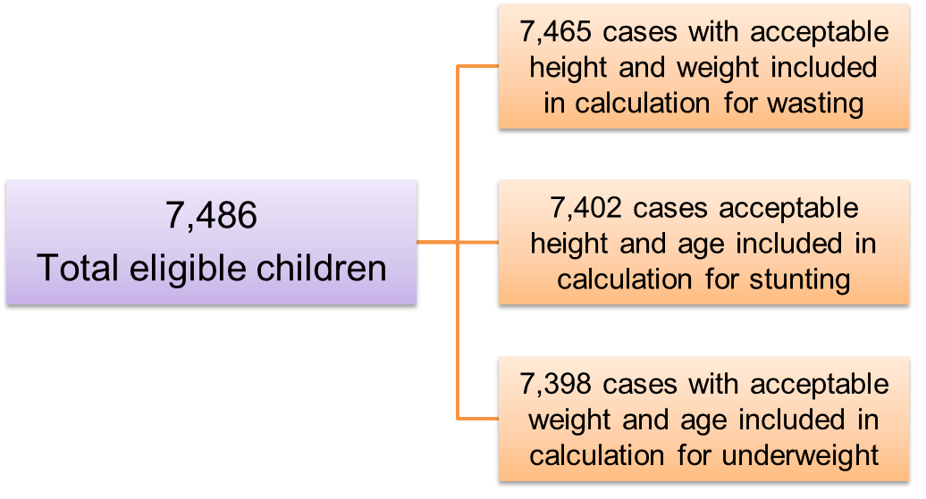
Anthropometric Data
Z-scores generated for Stunting, Wasting and Underweight
And then incorporated into Stata for analysis

Slide 16
Data Analysis
Data Analysis Plan developed
  Standard definitions of indicators used
  Validated by small team of TWG members
Data analysed using
  Stata Version 15
  MS Excel
  Tableau v2019.3

Slide 17
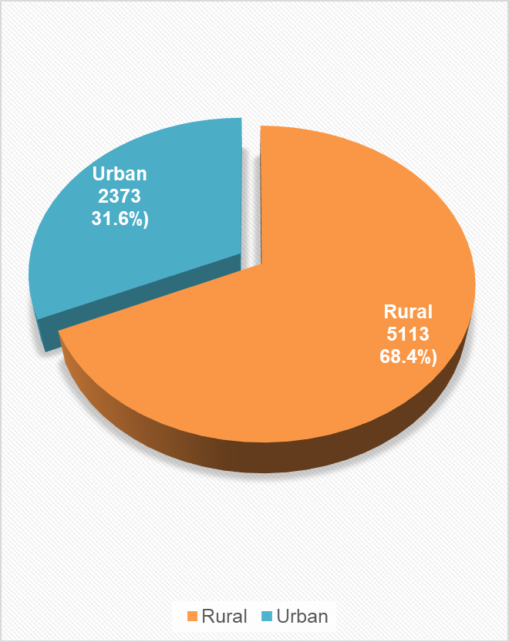
HH Survey - Sample Characteristics
 | Frequency | Percent
Targeted HHs | 7 500 | 100.0%
Refusals | -28 | 0.4%
Non-contact | -48 | 0.6%
Replaced | +76 | 1.0%
Interviewed | 7 500 | 100.0%
Notes:
Number interviewed by district by region), gender, age ranges mean median and ranges of age of household head) and main economic activity pie chart)

Slide 18
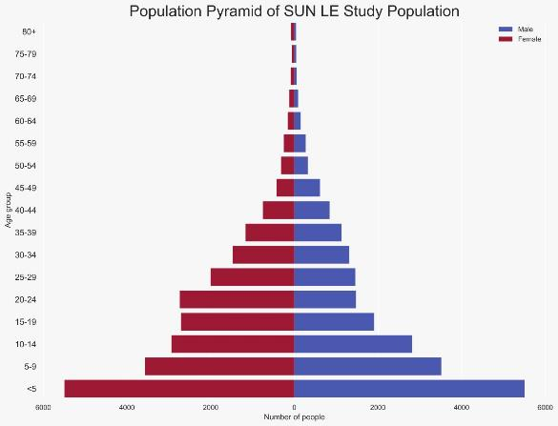
Household Demographics
Mean Age of HH head – 38.9 yrs
  min 15 years
  max 101 years
Average 6.1 people per HH
male headed: 81.5%
female headed 18.5%
Children < 5 years constitute 23.9%
50% SUN I and 50% non-SUN 1 districts

Slide 19
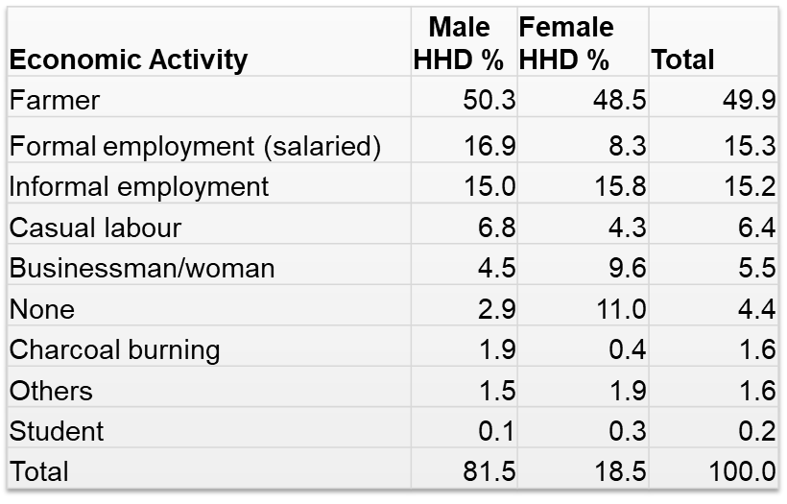
Household Economic activities (n=7486)
Farming was the most prominent economic activity accounting for 50% of livelihoods in sampled districts

Slide 20
Findings

Slide 21
Nutrition Status of Women and Children <2
Child Stunting, Wasting, or Underweight, Mothers’ Low BMI

Slide 22
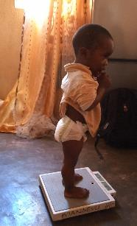
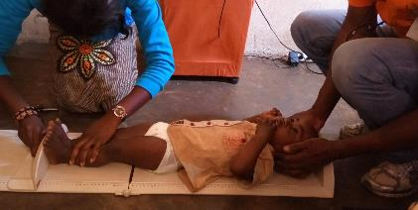
Definitions - Stunting, Underweight and Wasting among Children
Based on WHO growth standards and Z score calculations
Stunting: Height for age (HAZ )
  Moderate stunted – HAZ scores between -3SD and -2SD
  Severe stunted – HAZ scores less than -3SD
Underweight: Weight for age (WAZ)
  Moderate underweight - WAZ scores between -3SD and -2SD
  Severe underweight - WAZ scores less than -3SD
Wasting: Weight for length (WHZ)
  Moderate wasting - WHZ scores between -3SD and -2SD
  Severe wasting - WHZ scores less than -3SD
Weight Measurement of the child
Length Measurement of the child

Slide 23
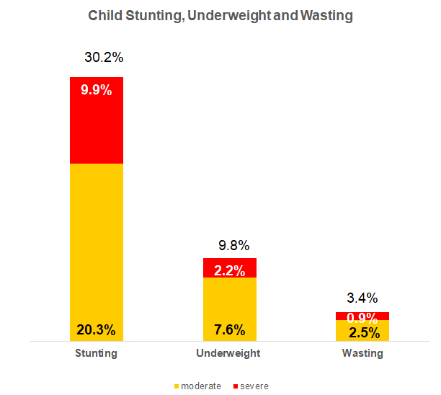
% of Children <2 years who are Stunted, Underweight, Wasted
Most children had moderate forms of under-nutrition
The observed rates mirror the 2018 ZDHS rates for children < 2 years

Slide 24
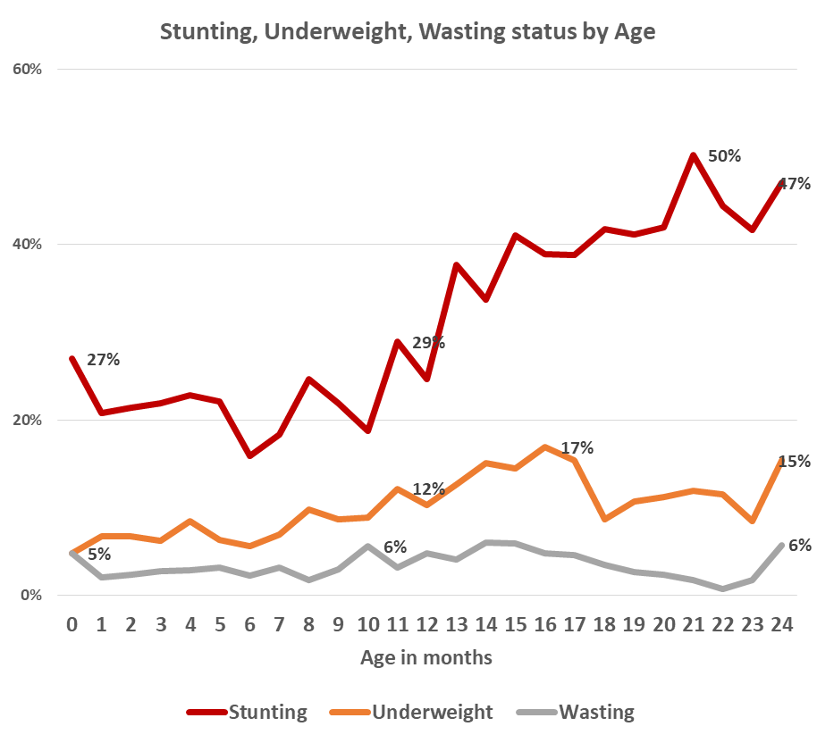
% of Children Stunted, Underweight, & Wasted by Age
Stunting ↑ with child’s age
Underweight ↑ with age during the first 1.5 years
High levels of stunting and wasting observed in children < 1 month of age
  With a steady ↑ in 9-17 month old children

Slide 25
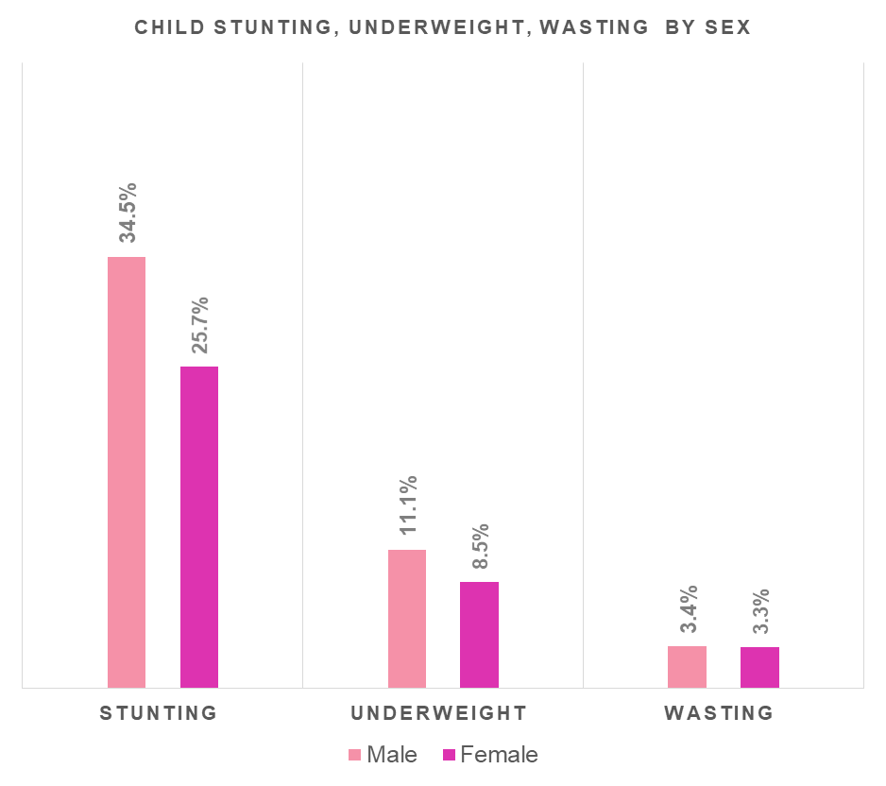
% of Children Stunted, Underweight & Wasted by Sex
Stunting, underweight, highest among male children
No differences in Wasting by Sex of the Children observed

Slide 26
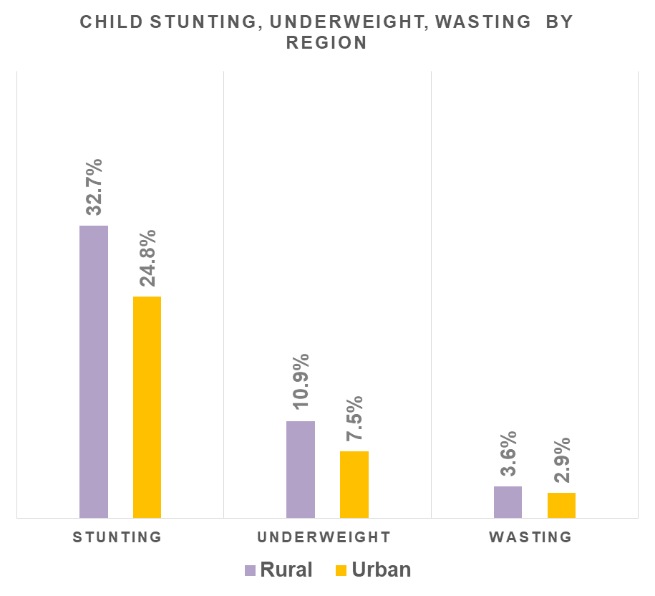
% of Children Stunted, Underweight & Wasted by region
Stunting, underweight and wasting highest in rural areas

Slide 27
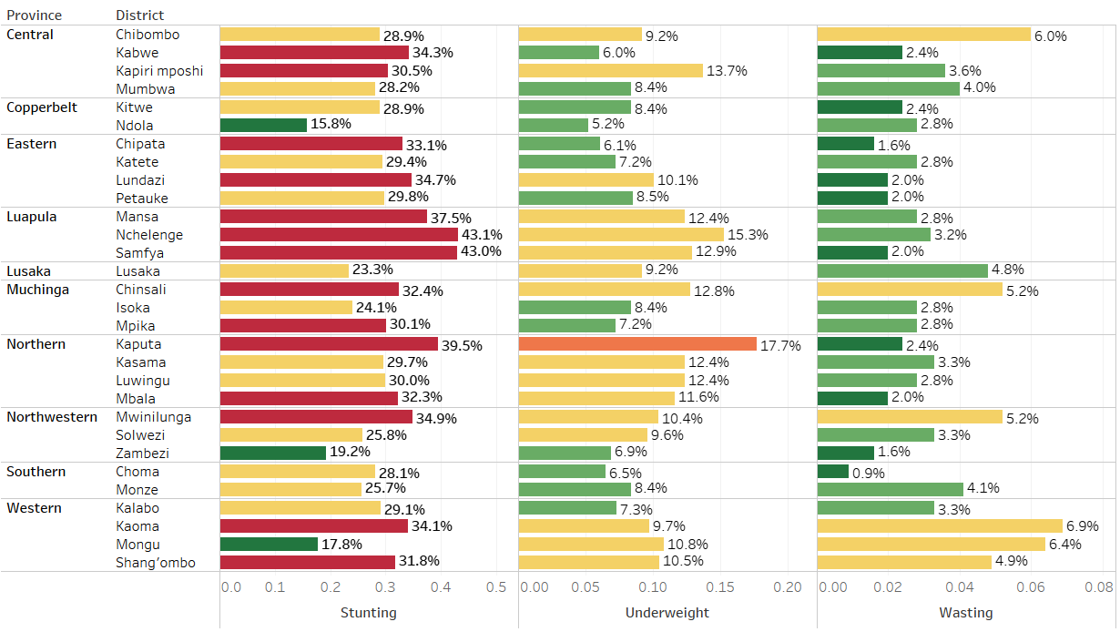
% Children Stunted, Underweight & Wasted by District

Slide 28
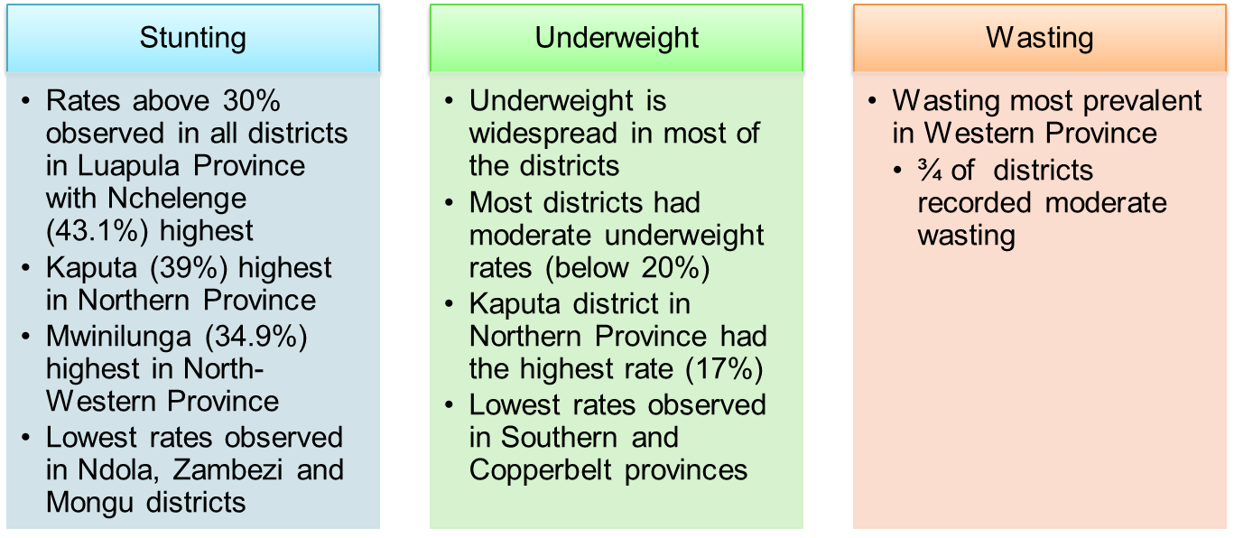
Children Stunted, Underweight & Wasted by District
Zambezi and Ndola districts have the lowest rates of stunting, underweight and wasting

Slide 29
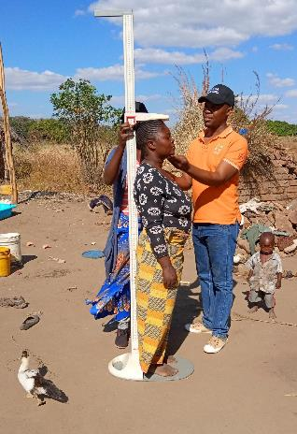
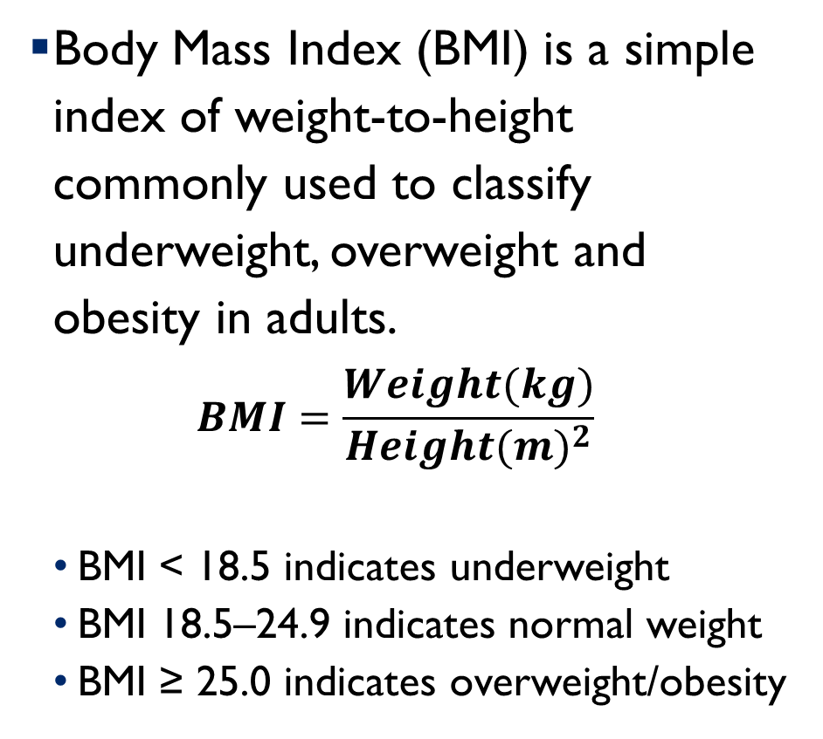
Women’s BMI

Slide 30
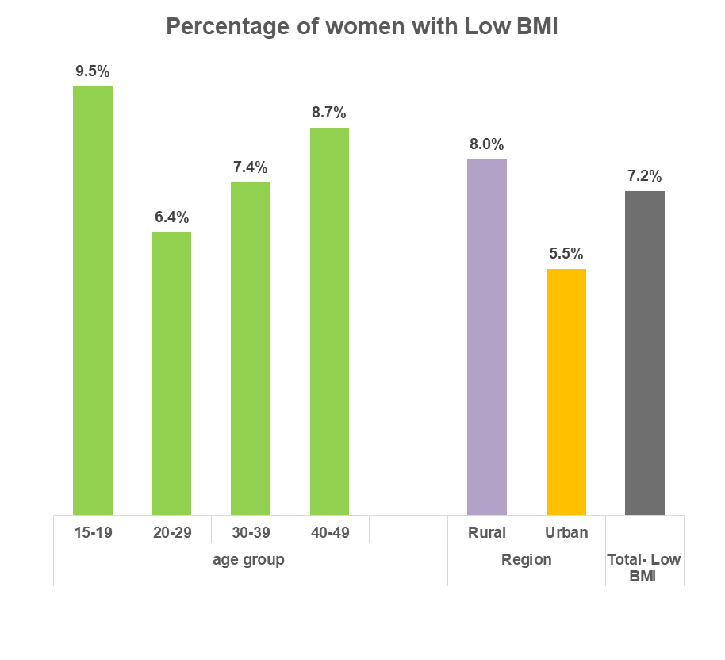
Women with low BMI (n=7166) by age and region
7.2% of women are underweight
  Indicating need for continuous monitoring
Low BMI more prevalent among
  adolescent mothers
  older mothers
  mothers living in rural areas
71.7% women had Normal BMI
21.1% were Overweight/obese

Slide 31
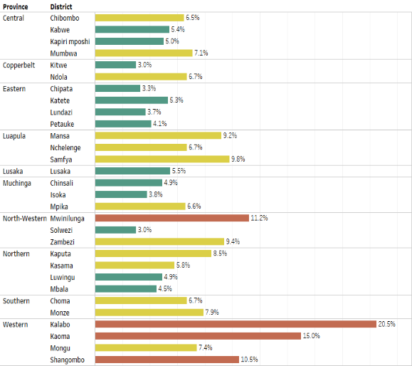
Women with low BMI by district (n=7166)
More women in Western Province were underweight than in other districts
Women with low BMI
  highest in Kalabo (20.5%)
  lowest in Solwezi and Kitwe (3%)

Slide 32
Factors Associated with Stunting
Indicator | Children not stunted | Stunted Children
Underweight | 2% | 27%
HH with moderate and severe hunger | 73% | 81%
HH producing nutritious crops for sale | 62% | 65%
HHs with a recommended diet diversity | 20% | 17%
Children exclusively breastfed to 6 months | 41% | 31%
Children meeting IYCF standards for feeding | 30% | 25%
Children who had diarrhoea in the preceding two weeks | 33% | 38%
Children with diarrhoea who received treatment from facility | 64% | 67%
Children exposed to environmental animal waste | 47% | 53%
HHs practicing essential hygiene actions | 7% | 3%
HHs with soap and water at a handwashing station | 16% | 12%
Women with low BMI | 7% | 9%

Slide 33
Factors Associated with Stunting
Indicator | Children not stunted | Stunted Children
HHs with soap and water at a handwashing station | 16% | 12%
Wasting | 3% | 4%
Reached with community interventions | 20% | 20%
Safe food handling | 8% | 6%
Value chain commodity consumption - women | 35% | 33%
HH producing safe and nutritious foods for consumption | 58% | 59%
HHs reporting stronger resilience to lean season | 36% | 38%
HHs practicing essential nutrition actions | 18% | 19%
Current family planning users | 51% | 51%
HH Correct use of treatment technologies | 10% | 8%
HH Correct storage of treated water | 96% | 98%
HH households with clean latrines, including covers | 14% | 13%

Slide 34
Factors Associated with Stunting
We conducted regression analysis to explore the association between stunting and:
  Mother’s and household head demographic information (age, highest education level, and economic activity)
  Location variables i.e. region (rural/urban) and province
  Indicators except exposures to environmental waste (indicator 30) as many respondents did not show the play ground
Odds ratios are presented in the next slide

Slide 35
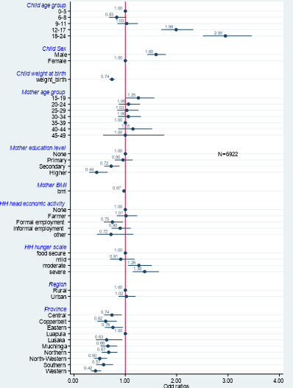
Factors Associated with Stunting
Odds of stunting increase from 12 months
Male children almost 2X more likely to be stunted than females
Children of more educated women less likely to be stunted
Children of younger and older mothers more likely to be stunted
Stunting is associated with severity of hunger
Children in Luapula more likely to be stunted than those in any other province

Slide 36
Coverage of Community Nutrition-Specific Interventions
and the relationship to Stunting

Slide 37
Coverage of community-level nutrition-specific interventions
Interventions during Pregnancy
  Iron supplementation for mothers (97.9%)
  Folic acid supplementation of mothers (98.2%)
Social Behavioural Change Communications
  Women diet during pregnancy (90.7%)
  Women’s diet during breast feeding (67.3%)
  Exclusive breast feeding (42.4%)
  Complementary feeding (74.3%)
  Feeding the sick child (40.9%)
Child Interventions
  Growth Monitoring and Promotion (87.9%);
  Vitamin A Supplementation (68.3%) – after 6 mos of age;
  Deworming (41.6%) – after 12 mos of age ;

Slide 38
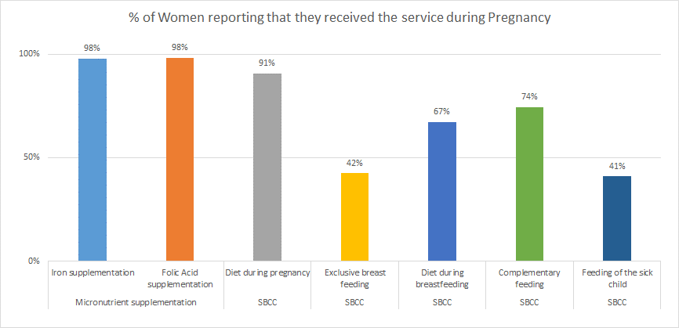
Coverage of nutrition-specific interventions to the mother

Slide 39
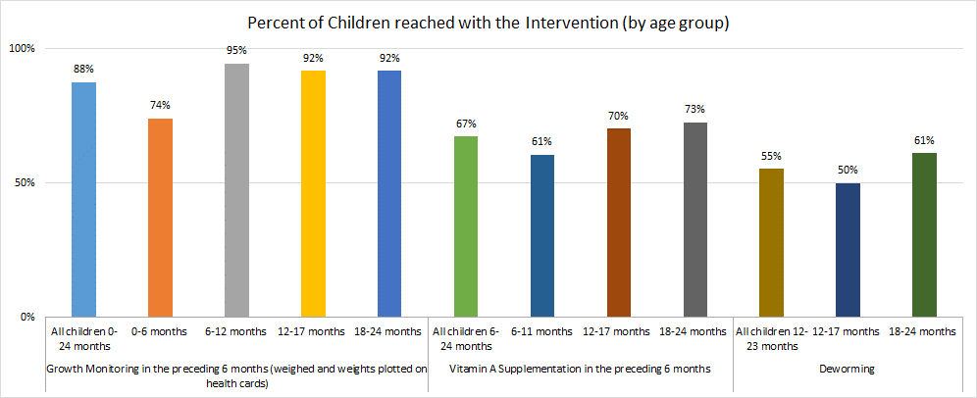
Coverage of nutrition-specific interventions to the child

Slide 40
% Children <2 years reached with nutrition-specific interventions (n=7486)
Children under 2 years of age should receive 8-10 nutrition-specific interventions (either directly or through the mother).
But convergence is low – only 9.9% of children received all intended interventions for their age.
Most children receive 70% of the intended nutrition-specific interventions

Slide 41
Children <2 years reached with nutrition-specific interventions
Shortfalls in convergence are due mostly to
  poor coverage of SBCC to mothers,
  insufficient coverage of vitamin A supplementation to children over 6 months and
  insufficient coverage of deworming to children over 12 months.
Children who are exposed to the full range of nutrition-specific interventions intended for them are less likely to be stunted (26.0%) (p=.009); conversely, children who did not receive all interventions intended are more likely to be stunted (30.7%).

Slide 42
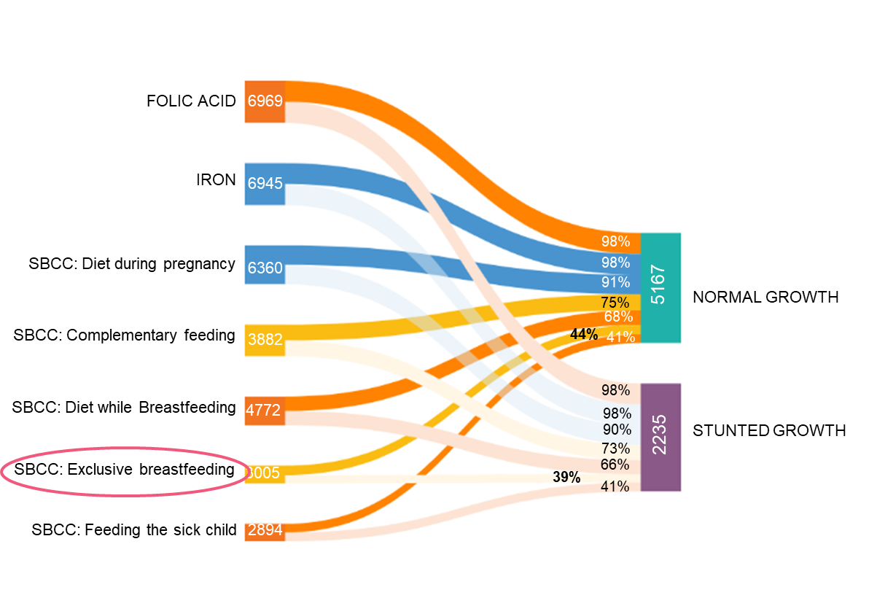
Children <2 years reached with nutrition-specific interventions – by stunting status
No difference in services received in pregnancy between stunted and normal growth children except SBCC on exclusive breastfeeding – 44% coverage for normal growth children vs 39% for stunted children (p<0.001).

Slide 43

Children <2 years reached with nutrition-specific interventions – by stunting status
Stunted and non-stunted children received child nutrition services equally
GROWTH MONITOTING (0-24 Months)
6500
88%
5167
NORMAL GROWTH
67%
VITAMIN A SUPPLEMENTATION
(6-24 Months)
56%
3706
88%
2235
STUNTED GROWTH
DEWORMING
(12-24 Months)
1902
68%
56%
Notes:
There is a difference with deworming services although it's not in the direction we would have expected... Stunted children seem to have received more deworming services than the "normal growth" children...

Slide 44
Obj 1 – IR 2: Adoption of better child feeding and household practices
Breastfeeding, IYCF practices, essential nutrition actions

Slide 45
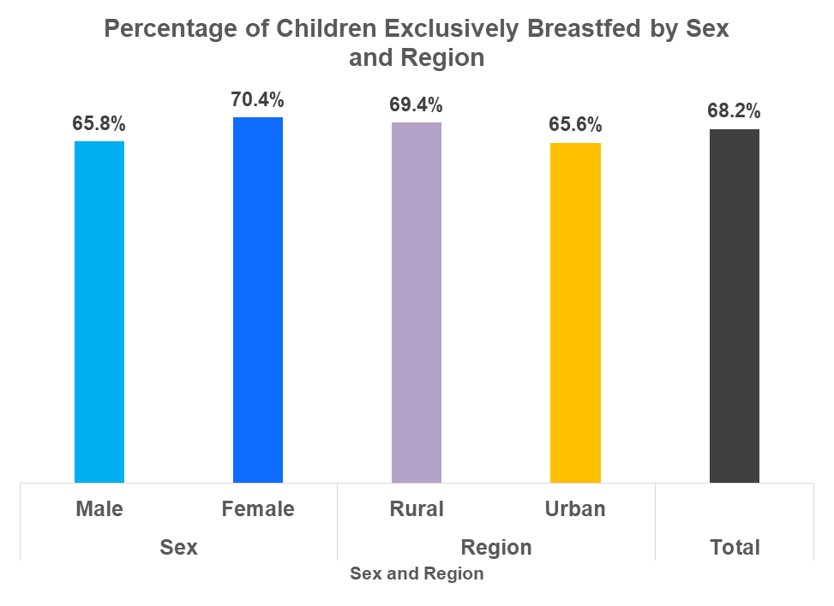
% of Children Exclusively breastfed to 6 months by region and sex (n=1936)
Definition: If in the previous 24 hours, the child was fed only on breast milk and no other food or fluids
68.2% of children < 6 months were exclusively breastfed
More exclusive breastfeeding in rural (69.4%) than in urban HHs (65.3%)
More girls (70.4%) exclusively breastfed than boys (65.8%)
Notes:
Indicators 2, 4, 19, 20, 21

Slide 46
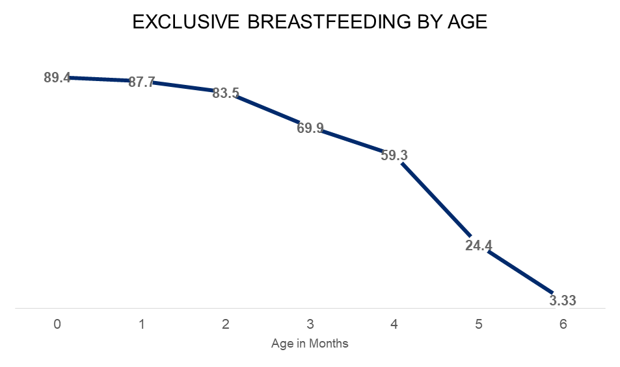
% of Children Exclusively breastfed to 6 months by region and Sex (n=1936)
More than 80% of children aged <1 month of age were exclusively breast fed
This declines to only 24.4% of children aged 5 months
Notes:
Indicators 2, 4, 19, 20, 21

Slide 47
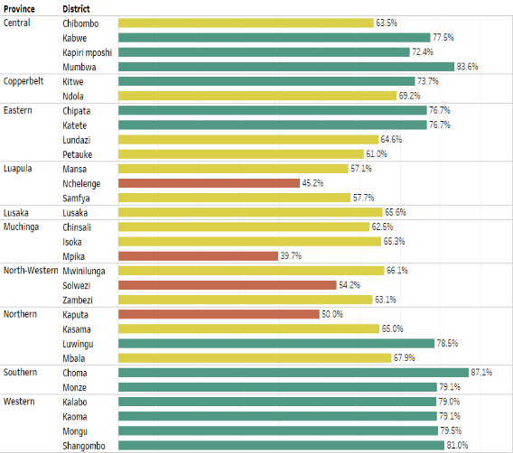
% of Children Exclusively breastfed to 6 months by district (n=1936)
Highest exclusive breast-feeding reported by HHs in Choma (87.1%), Mumbwa (83.6%) Mongu and Shang’ombo (81%)
Lowest in Mpika (39.7%) and Nchelenge (45.2%)

Slide 48
% Children meeting minimum IYCF standards IYCF
Minimum IYCF standards = core WHO IYCF indicators:
A variable was created for children who met the minimum standards for their respective age group
  Early initiation of breastfeeding at birth
  Exclusive breastfeeding for children under 6 months
  Continued breastfeeding at 1 year
  Introduction of solid, semi-solid or soft foods after 6 months
  Minimum dietary diversity – at least 4 (of 7) food groups
  Minimum meal frequency per age group (6-8 months, 9-12 months, 12-23 months)
  Minimum acceptable diet (combines standards of dietary diversity and feeding frequency by breastfeeding status)
  Consumption of iron-rich or iron-fortified foods

Slide 49
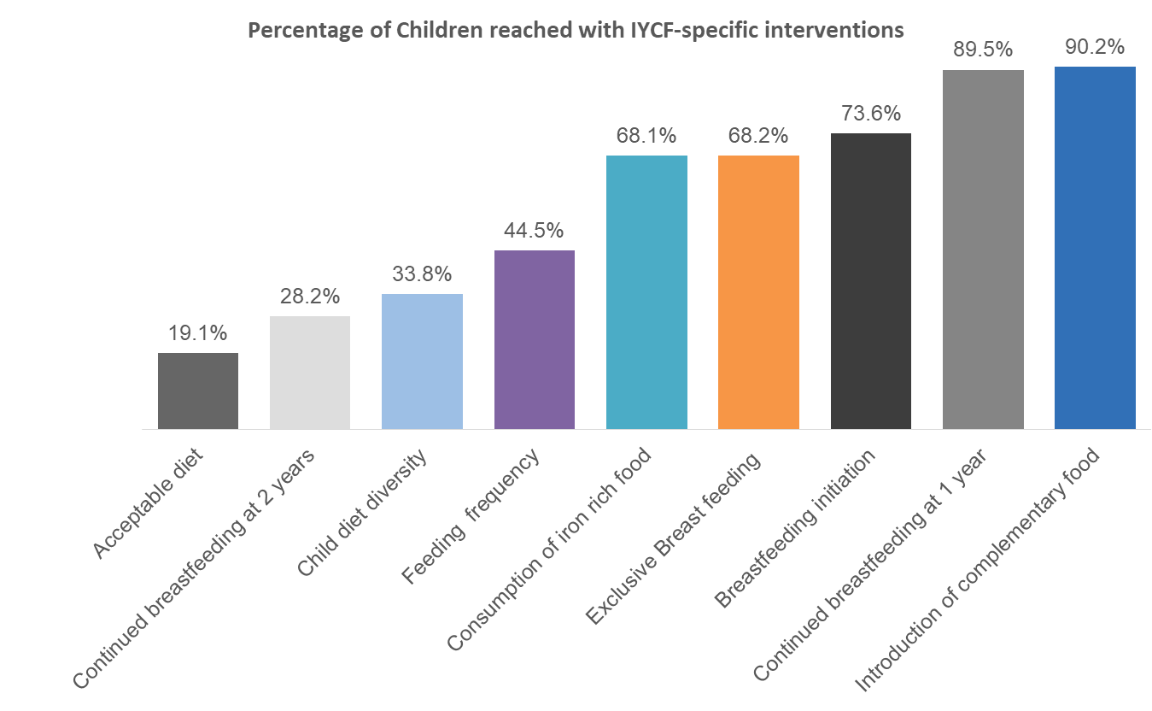
% of Children reached with IYCF minimum stds (by indicator)

Slide 50
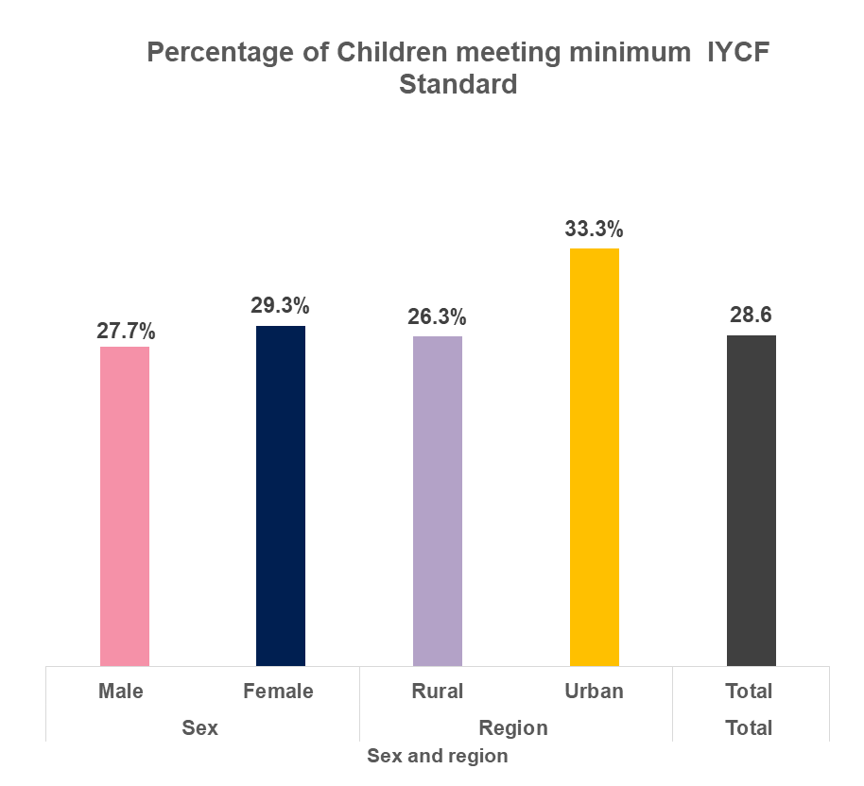
% Children <2 yrs meeting minimal standards for IYCF (n=7477)
Only 28.6 % of children meet minimum IYCF standards
More children in urban areas (33.3%) meet standards than in rural areas (26.3%).
Notes:
Indicators 2, 4, 19, 20, 21

Slide 51
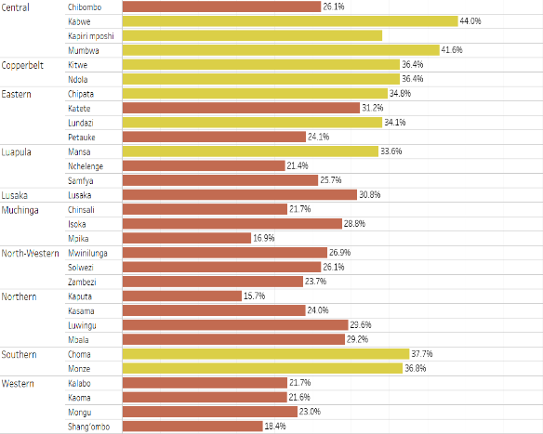
% Children <2 yrs meeting minimal standards for IYCF by district (n=7477)
No district had 50% of children meeting IYCF standards.
Highest:
  Kabwe (44.0%)
  Mumbwa (41.6%)
Lowest:
  Kaputa (15.7%)
  Mpika (16.9 %)

Slide 52
% of HHs practicing essential nutrition actions (n=7486)
A household was counted as practicing essential nutrition actions if all of the following were reported:
  Increased food consumption during pregnancy
  Iron and folic acid supplementation during pregnancy/control of anemia
  Early initiation of breast feeding
  Exclusive breastfeeding for 6 months for children below 6 months
  Continued breastfeeding after introduction of complementary feeding.
  Adequate diversified complementary foods (children 6-23 months)
  Feeding the sick child during and after illness (feeding enough fluids and foods)
  Vitamin A supplementation

Slide 53
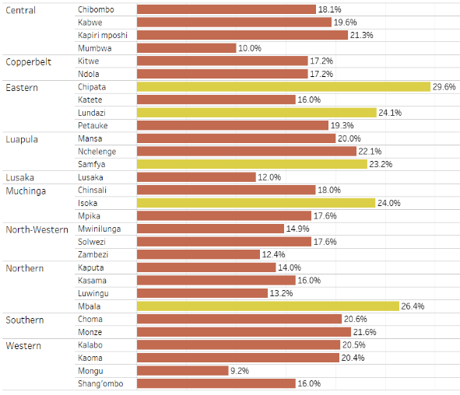
% of HHs practicing essential nutrition actions (n=7486)
Overall, 18.4% reported practicing essential nutrition actions
  urban 19.0%,
  rural 18.1%
  Lowest in Mongu (9.2%)
  Chipata (29.6%) performed better than other districts.

Slide 54
Objective 2 – Biological Utilisation of Nutrients
Incidence of Diarrhoea

Slide 55
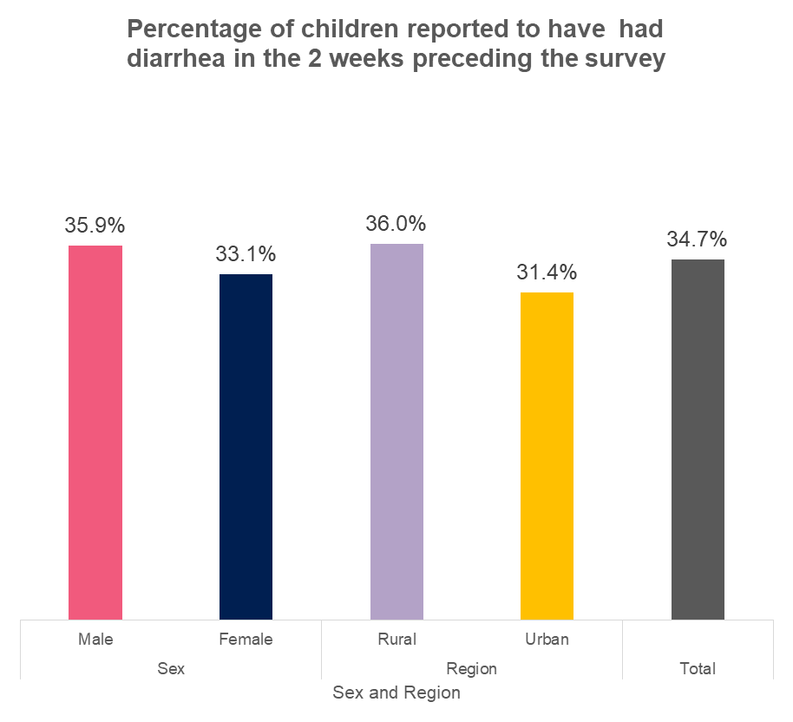
% Children <2 years who had diarrhea in the preceding two weeks to survey (n=7486)
Overall, one third (34.7%) of children were reported to have had diarrhea in the 2-weeks preceding the survey
Slightly higher proportions seen in rural (36%) than urban (31.4%) areas.

Slide 56
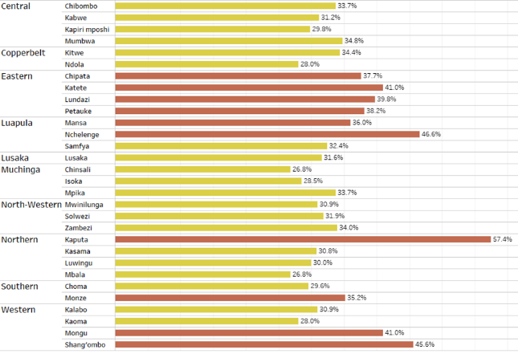
% Children <2 years who had diarrhea in the preceding two weeks to survey by District (n=7486)
Most diarrhea reported in
  Kaputa (57.4%)
  Nchelenge (46.6%)
Least reported in
  Chinsali, Mbala, (26.8%)

Slide 57
Objective 2 / IR 3: improved delivery of health/nutrition services
Diarrhoea Treatment, Family Planning

Slide 58
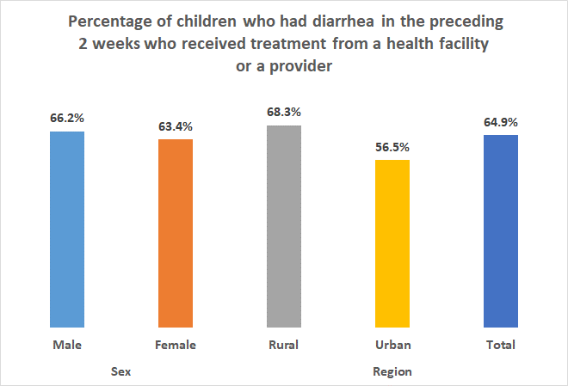
% Children <2 years who had diarrhea in two weeks preceding the survey who received treatment (n=2579)
64.9% of children who reported having diarrhea received treatment from a health facility
  68.3% of children in rural areas
  56.5% of children in urban areas
Notes:
Indicators 2, 4, 19, 20, 21

Slide 59
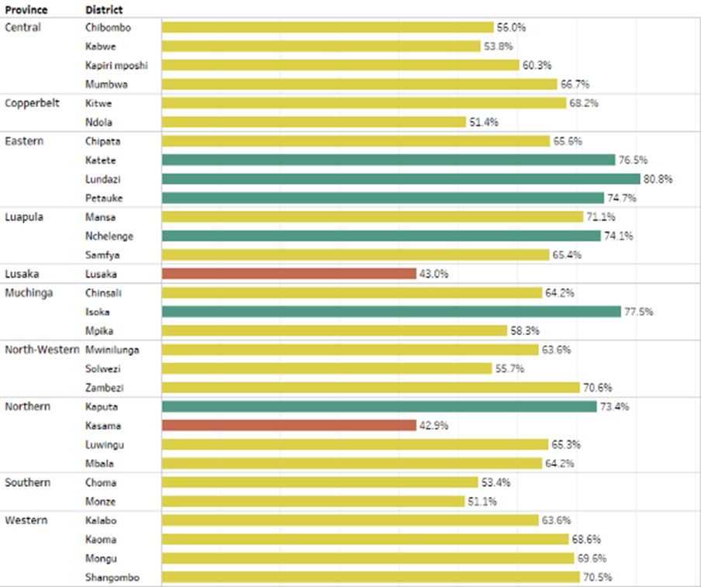
% Children <2 years who had diarrhea in the preceding 2 weeks who received treatment from a health facility - by district (n=2579)
More children with diarrhea received health care in Lundazi (80.8%)
Fewer children received medical attention at the facility in Kasama (42.9%)

Slide 60
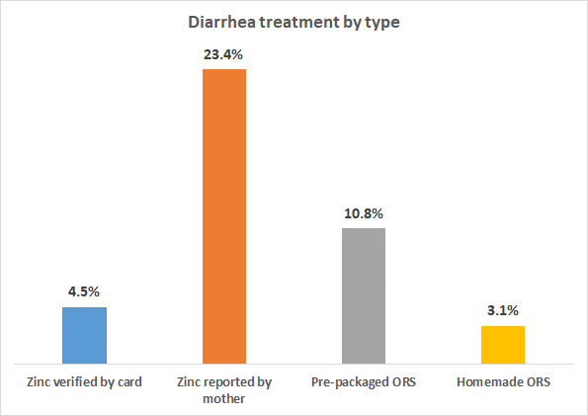
% of Children with diarrhea reported receiving treatment by type (n=2579)
Zinc was the most common treatment for diarrhea
Use of home-made ORS for diarrhea treatment was low (3.1%)

Slide 61
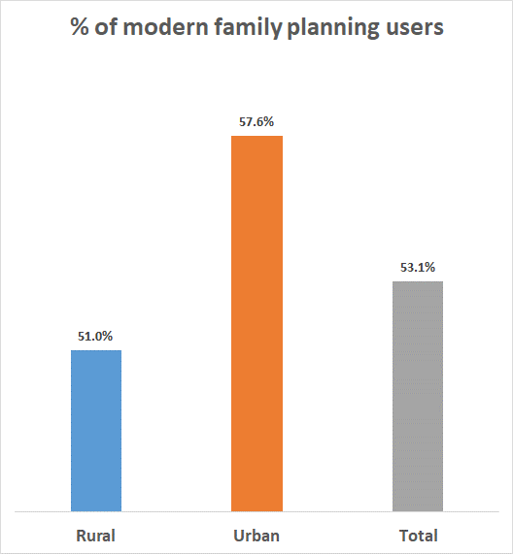
% of modern family planning users (n= 7177)
Family Planning User = woman who reported that she or her sexual partner used any modern family planning method
Overall use of modern FP methods (53.1%) was slightly higher than reported by ZDHS 2018 (48%)

Slide 62
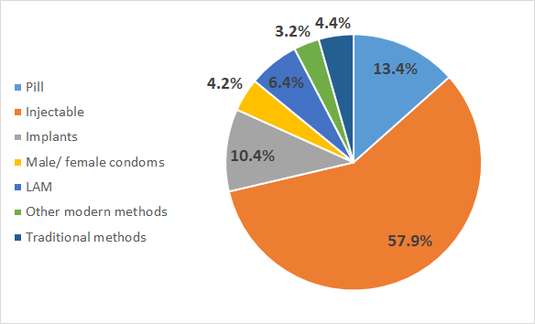
Family Planning Users by type of Modern Method
Injectables are the most widely used modern method (57.9%),
Followed by the Pill (13.4%) implants (10.5%), and condom (4.2%).
Note:
Other modern methods include IUD, Diaphragm and Standard days method
Traditional methods include abstinence, exclusive breast feeding and withdrawal
Denominator = 3,981 women who indicated using a family planning method

Slide 63
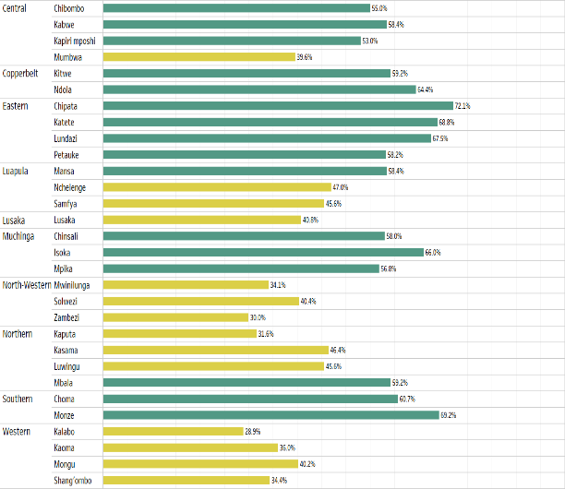
% of Modern family planning users – by district
More women in Eastern Province used modern family planning methods with Chipata (72.1%) reporting the highest.
Lowest use reported in Kalabo (28.9%) and Zambezi (30%)

Slide 64
Objective 2 / IR 4: Healthier Cleaner Environment
Access to water and sanitation; water treatment and storage; essential hygiene practices, child exposure to animal waste

Slide 65
% of HH with access to basic drinking water services
A household was counted as having access to basic drinking water if they met all the criteria below:
  Received water from a safe water source (66.7%)
    Tube or borehole,
    protected shallow well,
    harvested rain water,
    piped water/public tap,
    protected spring
  The water was usually accessible (82.4%)
  They could get to the water source in 30 minutes or less (83.5%)

Slide 66
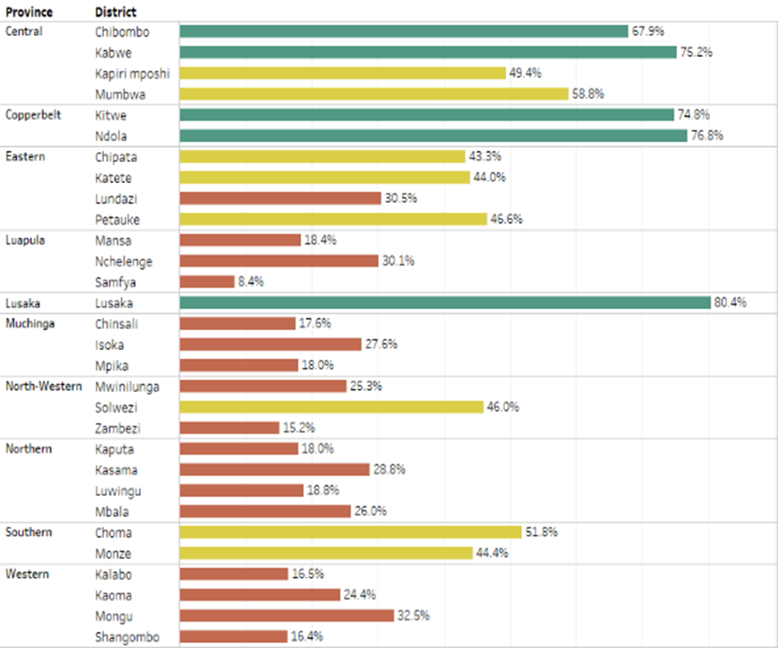
% of HH with access to basic drinking water services (n=7486)
Overall 37.7% of HH had access to basic drinking water (urban 60.1%, rural 27.2%,
highest percentages in Lusaka 80.4%
lowest in Samfya 8.4%

Slide 67
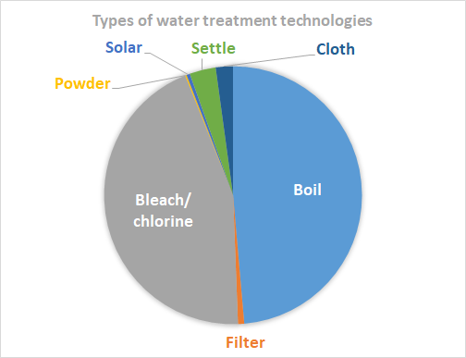
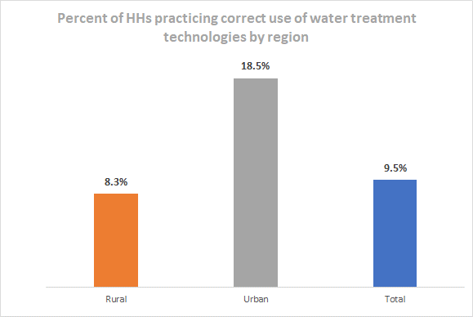
% HHs in target areas practicing correct use of recommended HH water treatment technologies
A household was counted if it:
  reported an unsafe source of water as their primary or alternative source of drinking water
  showed the treatment materials and demonstrated correct treatment method

Slide 68
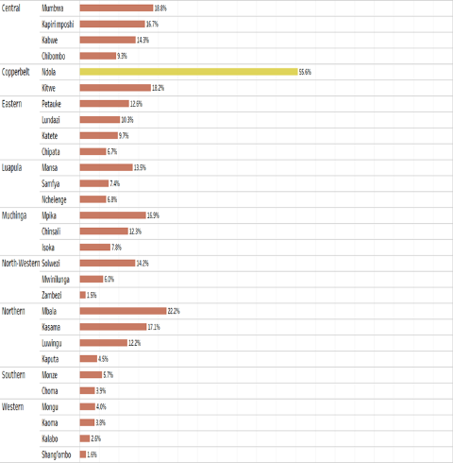
% HH in target areas practicing correct use of recommended HH water treatment technologies - by district (n=3,438)
Other than in Ndola (55.6%) , the use of recommended water treatment technologies was very low among all districts
lowest seen in Zambezi (1.5%) and Shangombo (1.6%)
Notes:
Indicators 24, 25, 26, 30, 31, 32

Slide 69
% HH practicing correct water storage of treated water
The indicator assesses the proportion of HHs storing treated drinking water in a way that protects its quality and prevents contamination
A household is counted if
  Correct treatment is followed (per indicator 25)
  The water containers were clean (no visible dirt as inspected by interviewers)
  Water containers had narrow necks/protecting covers
  Water containers had a tap or narrow mouth for drawing the water

Slide 70
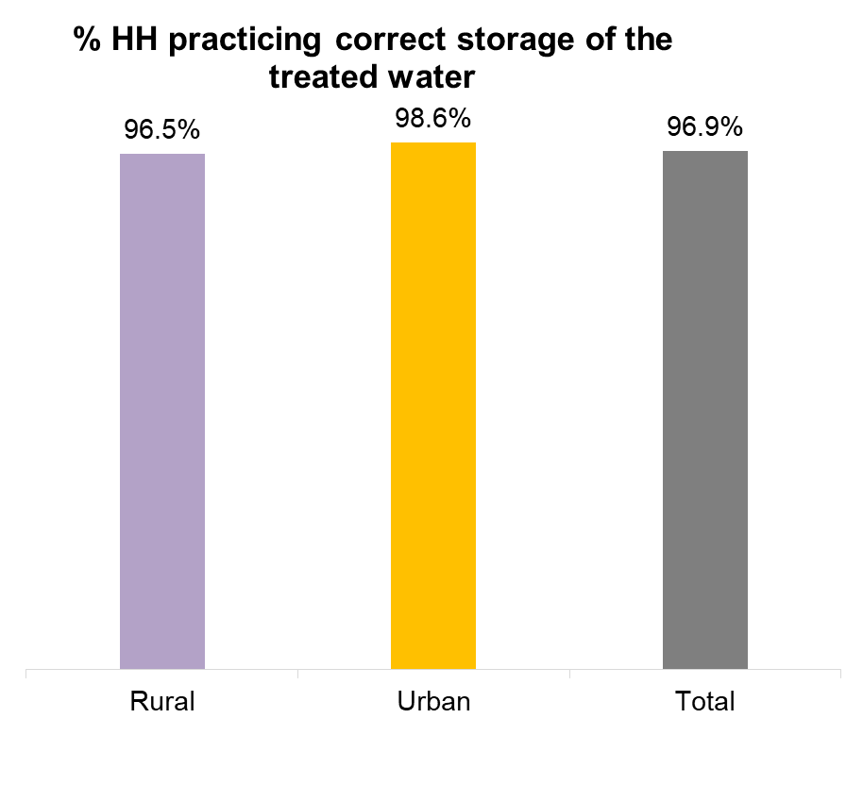
% HHs practicing correct water storage of the treated drinking water (n=324)
Of the 9.5% of HHs who treated water correctly, nearly all stored it correctly
When HHs treat water correctly using recommended methods, they are also more likely to store water correctly
Notes:
Indicators 24, 25, 26, 30, 31, 32

Slide 71
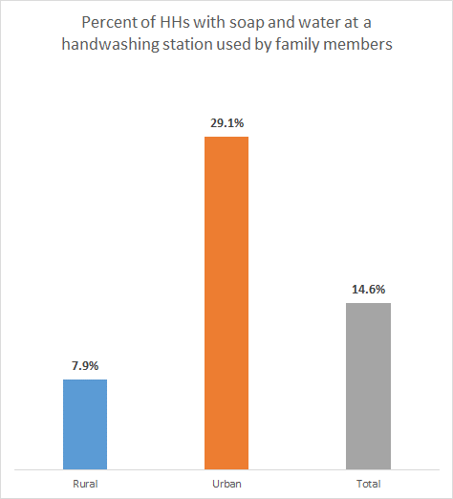
% of HHs with soap and water at a handwashing station commonly used by family members (n=7486)
A HH is counted if there was a hand washing station hand washing station with water and soap within 1 minute of reach of the HH
Overall, 14.6% of HHs had access to soap and water at a handwashing station commonly used by family members.
This varies between rural (7.9%) and urban (29.1%)

Slide 72
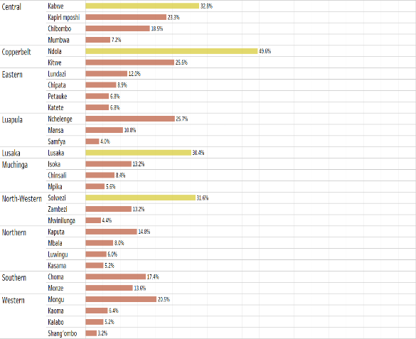
% of HHs with soap and water at a handwashing station commonly used by family members - by district (n=7486)
In most districts, less than 30% of HHs had soap and water at a handwashing station commonly used by family members
Districts in Western province had the lowest percentage
Notes:
Indicators 24, 25, 26, 30, 31, 32

Slide 73
Households using improved Sanitation services - Definition
A household was counted if the HH used
  ventilated improved pit latrine,
  flush or pour toilet connected to a sewer system or
  septic tank or composting toilet
The latrine was observed for visible signs that the facility was being used

Slide 74
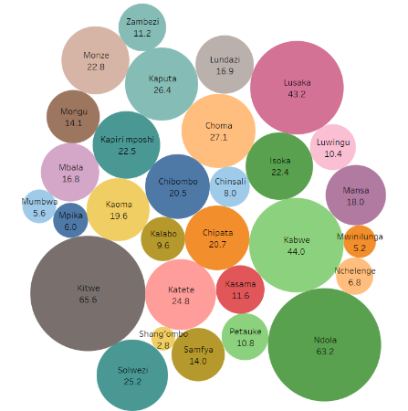
Households using improved Sanitation services (n=7486)
HH USING IMPROVED SANITATION FACILITY BY DISTRICTS (%)
Overall 20.5% of HHs had improved sanitation facilities.
  40.3% urban
  11.4% rural
Kitwe, Ndola and Lusaka had the highest proportion of HH using improved Sanitation facilities
The least was Shangombo (2.8%)

Slide 75
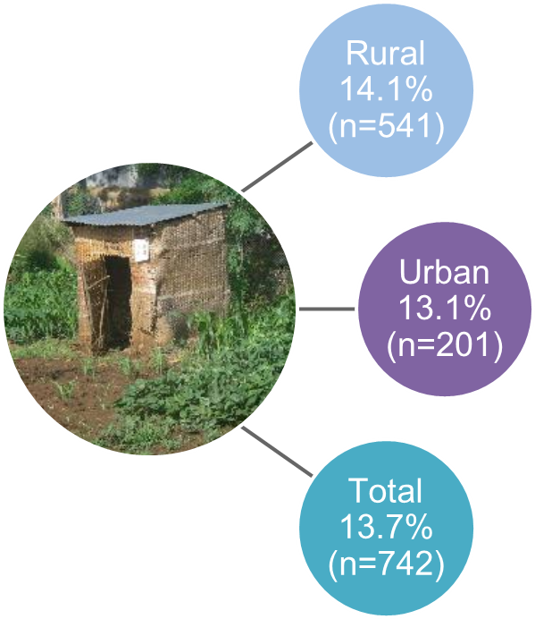
% of households with clean latrines, including covers (n=5414)
A HH was counted if
  the HH showed the toilet/latrine, and upon observation:
  There were visible signs the toilet was being used
  The toilet had a cover
Access to basic sanitation is low in general
Overall only 13.7% of HHs had clean latrines with covers

Slide 76
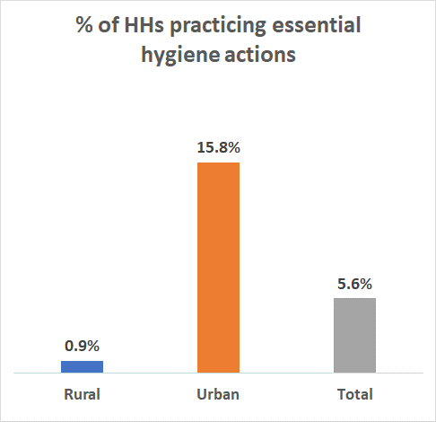
% of HHs practicing essential hygiene actions (n=7486)
Essential hygiene actions =
  Access to clean drinking water; (Water sources, treatment, quantity, storage) (37.7%)
  Access to hand washing facilities, (Tippy Tap, availability of soap) (14.6%)
  Access to clean latrines and environment (safe disposal of feces through latrines, safe play areas for children) (13.7%)
HHs were counted if they practiced all of the above
Overall practice of essential hygiene is low (5.6%)
Notes:
Indicators 24, 25, 26, 30, 31, 32

Slide 77
% of children exposed to environmental animal waste in the play areas (n=3,028)
Children were counted towards this indicator if:
  The child’s play area was shown by the mother/ caregiver
  there was evidence of animal presences such as feathers, feaces etc) where the child usually play, and
  animals go to the child’s play area at least once per week

Slide 78

% of children exposed to environmental animal waste in the play areas (n=5915)
Overall, nearly half children (48.8%) are exposed to environmental animal waste in their play areas.
Children in rural areas have higher exposure (68.3%)
Notes:
Indicators 24, 25, 26, 30, 31, 32

Slide 79

% of children exposed to environmental animal waste in the play areas - by district (n=5915)
Highest exposure of children to animal waste observed in:
  Monze
  Mumbwa
  Shangombo
  Kalabo
Notes:
Indicators 24, 25, 26, 30, 31, 32

Slide 80
Obj 1 – IR 1: Increased and Reliable Access to Safe and Nutritious Foods
Dietary Diversity, Production and consumption of high nutrient foods, Safe food processing / preservation

Slide 81
Women’s dietary diversity: Mean No. food groups consumed by women of reproductive age
Foods categorized into 10 groups based on FAO recommendation on MDD-W.
A variable was created for each food group and a woman given a score of “1” for each food group she consumed and a score of “0” for each food group she did not
Maximum score = 10 food groups
FAO recommends 5+ food groups

Slide 82

Women’s dietary diversity: Mean No. food groups consumed by women of reproductive age (n=7486)
On average, dietary diversity below FAO recommendation
Women in urban areas have higher dietary diversity compared to those in the rural areas

Slide 83

Women’s dietary diversity: Mean No. food groups consumed by women of reproductive age by district (n=7486)
Women’s dietary diversity
  lowest in Western province in Shang’ombo (2.5)
  highest in Kitwe (5.9) and districts in Copperbelt Province

Slide 84

% of HHs with a recommended diet diversity (n=7486)
This is a proxy indicator calculation
  as HH’s dietary recall not collected during the survey
    only mother and child dietary recall recorded
  HH Dietary Diversity = when both mother and child consume the recommended number of food groups
    5 food groups for the mother
    4 food groups for the child over 6 months of age
Overall, 19.4% of HHs reported recommended diet diversity, more commonly in urban areas.

Slide 85

% of HHs with a recommended diet diversity (n=7486)
No district had ≥50% of HHs meeting dietary diversity targets
Districts in Western province had the lowest rates

Slide 86

Prevalence of HHs practicing safe food preparation/ improved storage practices (n=7486)
Food safety = handling of food to avoid contamination (i.e. washing fruits, time between cooking and eating, handling of left-over foods, hand washing, etc.)
Food preparation = extent of cooking, cleanliness of utensils used
Food storage = storage of food after preparation and preservation methods
Performance on this indicator was generally low, below 10%

Slide 87

Prevalence of HHs practicing safe food preparation/ improved storage practices (n =7486)
Mongu had lowest prevalence (0.4%) and Monze highest prevalence (37.2%)
Generally food processing, preparation, and storage practices are very low

Slide 88
Prevalence of women of reproductive age who consume targeted nutrient-rich value chain commodities - definition
Women were counted if, in the previous 24 hours, they had eaten any of the following foods:
  Legumes (e.g. pulses, nuts and seeds)
  Animal products (e.g. milk and milk products, organ meat, fish, eggs, insects and other small animal proteins)
  Fruits and vegetables (dark green leafy vegetables, vitamin A rich vegetables, other vegetables or fruits, and palm oil)

Slide 89

Prevalence of women of reproductive age who consumed targeted nutrient-rich value chain commodities (n=7166)
Overall, 34.5% WRA consumed targeted nutrient- rich value chain commodities
Urban women (40.5%) are more likely to consume nutrient-rich foods than rural women (31.6%)
Western province (especially Shang’ombo) had the lowest percentage (4.8%) and Mbala in Northern province had the highest (53.6%)

Slide 90

% of HHs that grew nutritious crops (n=7486)
Nutritious foods = higher nutrient foods specifically promoted in SUN programme
  Vitamin A rich foods
  Vitamin C rich foods
  Iron rich foods
  Protein rich
Twice as many rural HHs grow nutritious foods compared to urban HHs

Slide 91

% of HHs that grew nutritious crops (n=7486)
Most grown = dark green vegetables
Least grown = carrots and lentils / peas / beans

Slide 92

% of HHs that sold or bartered nutritious crops and livestock that they grew / kept (n=5874)
These are HHs that grew and then sold / bartered at least one nutritious foods
Rural HHs tend to sell or barter more compared to rural ones

Slide 93

% of HHs that sold or bartered nutritious crops that they grew – by district (n=5874)
Most HHs barter or sell the nutritious foods they grow
  Highest in Monze (84.3%)
  Lowest in Lusaka (32.3%)

Slide 94

% of HHs producing safe and nutritious foods (Crops and Livestock) for Consumption (n=5874)
Nutritious foods =
  protein rich food and
  micronutrient-rich vegetables and fruits
HHs were counted if they produced and consumed at least 2 nutritious foods from each group
More rural HHs (63.2%) produced and consumed nutritious foods than urban HHs (39.9%)

Slide 95

% HHs producing safe and nutritious foods (Crops and Livestock) for Consumption - by district (5876)
Lowest in Lusaka (9.7%)
Highest in Lundazi (89.4%)
Districts in Western province have low percentages compared to other districts (<38%)

Slide 96
Stakeholders’ Perspective of MCDP Implementation
Stephanie Martin – SUN LE/ UNC

Slide 97
Key informant interview results
Participant Characteristics (n=51) | # | %
Sector
Agriculture | 8 | 16
Livestock and Fisheries | 7 | 13
Community Development & Social services | 10 | 19
Health | 8 | 16
Education | 5 | 10
WASH | 5 | 10
Local government | 4 | 8
Multi-sectoral (NGO) | 4 | 8
Level
District | 31 | 61
Provincial | 20 | 39
SUN Phase
Two | 31 | 61
One | 20 | 39
Gender
Male | 26 | 51
Female | 25 | 49
Notes:
Participants were from 9 districts/7 provinces – interviewed and asked open and close-ended questions about their experiences
Close ended questions were summarized, we did not examine statistical significance because of the small sample and qualitative nature of this research

Slide 98
KII Areas of Inquiry
Coordination
  Committee present
  Participation
  Management
  Satisfaction
Planning for nutrition interventions in the district
  One integrated plan
  Jointly developed by partners
  Level of involvement
Partnerships and Collaboration
  Frequency of collaboration
  Satisfaction with collaboration
Implementation
  Perceived quality of nutrition-specific and nutrition-sensitive interventions
Policy and governance
  Existence of a clear vision, policies, guidelines and manuals that are well disseminated
Political support
  Level of political support for nutrition programmes
General Successes and Lessons
  MCDP1 successes
  Areas of improvement for future programming
  Lessons learned

Slide 99

Multisectoral nutrition coordinating committee members (SUN1 n= 20; SUN2 n= 30)

Slide 100

Respondent impressions of nutrition policies and support
SUN 1 respondents were more likely to say that
  There is political support for nutrition
  Nutrition policies / guidelines / operating procedures / advocacy materials are available
About half of respondents feel the national nutrition program has a clear vision

Slide 101
Political Support for Nutrition Program
Reasons for choosing "a lot of support:"
  High level advocacy and support
    “High government officials like the vice president, DCs and counselor are advocating for nutritional activities national wide.” – Health Official, Phase 1
Reasons for choosing "some support:"
  Lack of sustained financial support
  Limited funding for nutrition-specific programs compared to other programs
    “Most of the programmes that deal with nutrition receive less funding and attention.” – Community Development and Social Services Official, Phase 2
Reasons for choosing "no support:"
  Limited support given to Ministry of Agriculture
      “Ministry of Agriculture receives very little support if any.” – Agriculture Official, Phase 2
  Room for improvement in government policies around nutrition
    “There is more that the political support can do that would promote productivity, production, consumption, nutrition, and health services.” – NGO Official, Phase 1

Slide 102
Successes from SUN 1.0 (1000 MCDP)
Effective implementation of nutrition-specific and -sensitive programs / activities (Phase 1 and 2)
    "WASH activities were implemented, volunteers were trained, boreholes were rehabilitated; seed stocks were bought, and reporting and monitoring were good." -Provincial local government officer
Increased coordination for nutrition activities (Phase 1)
    "Planning and implementation of SUN activities was very good. The multi-sectoral approach to nutrition was excellent.” -District Health Official 1
Changes in households’ nutrition and WASH behaviors (Phases 1 & 2)
    “Households have learnt and adopted the production of high nutrient foods” -Provincial Agriculture Official
Increased reach and scale of nutrition programs (Phase 1)
    “Information disseminated on the importance of child nutrition; scaling up to other communities from 12 to 22 communities " -District Education Official
However, several respondents from both phases said they did not know of any successes (Phase 1: 4/21 and Phase 2: 10/31)
Notes:
Note 4 respondents in Phase 1 and 9 respondents in Phase 2 didn’t know

Slide 103

Areas for improvement
“Funding was only made available to the districts and nothing to the provinces.” -Provincial Education Official
“Feedback and responses where minimal from coordination office.” -District Agriculture Official
“It would have been more effective if a bottom-up approach was used as opposed to top-down approach which hindered the flow of resources at grassroots” -District Agriculture Official
“Appoint officers to specifically be involved in SUN so that it is easy to monitor programs, as opposed to having general players”. -District Local Government Official

Slide 104
Funding needed to reduce stunting
Funding for…. | Sun 1.0 districts | Sun 2.0 districts
Improved nutrition resources accountability | 46% | 54%
Increased nutrition services | 36% | 64%
Increased nutrition staffing at the service delivery point. | 42% | 58%
Improved targeting of funds to specific vulnerable groups. (i.e. children and women) | 44% | 56%

Slide 105
Elaborating on ways that MCDP-I could have been better implemented
Coordination of Service Delivery
  “Lack of coordination from implementing partners means beneficiaries don’t receive the full package” - Agricultural Official, Phase 1
Funding Flows
  “Late disbursements mean insufficient time to expend funds.” -Community Development and Social Services Official, Phase 1
Other
  “Coordinators personalised the project by being selective in who they involved.” -Community Development and Social Services Official, Phase 1
  “Need decentralised trainings, decision making, and implementation”
  -Health Official, Phase 2

Slide 106

Respondent ratings of nutrition interventions (%)

Slide 107
Facilitators and Barriers to implementing nutrition interventions
IFA supplementation, vitamin A supplementation, growth monitoring and promotion, and exclusive breastfeeding rated good or excellent by most respondents
Community sensitization was frequently mentioned as a facilitator
  The MOH has serious campaign on breastfeeding especially with the coming of SUN project -District Local Government Official
  Training community based volunteers who facilitate door to door campaigns (IFA supplementation) helps a lot. -Provincial NGO staff
Traditional norms were listed as a barrier to many nutrition practices
  Traditional norms hamper the success of implementing IFA supplementation - Provincial CDSS Official
Dietary diversity, nutrient dense crops, and WASH activities were rated as neutral or poor by many respondents
  The water supply is very bad and access to clean water is still a big challenge in most parts of the district. standards are also not being followed when installing water points in communities." -District Education Official
Several respondents said they didn’t know about these activities
Notes:
Notes:
One respondent identified lack of partner support for Vit A supplementation
‘Inadequate sensitization in that is mainly focused on mothers because they are the one who visit health facilities. The male folk attach little importance to the program because they lack information on the importance of such programs to support their spouses.’ - Cop-4-Ag-2-M
respondents identified distance to health facilities as a barrier to Vitamin A and IFA supplementation
respondents listed traditional norms and inconsistent supplies were also barriers to IFA
Traditional norms hamper the success of implementing the iron/folic acid supplementation Muc-4-CD-1-M

Slide 108
KII Summary
Structures exist in SUN 1 districts
  These districts are more aware of the management and implementation structures
There is need to improve coordination and service delivery mechanisms overall
Need to build structures for SUN 2 districts

Slide 109
Closing

Slide 110

Special thanks to the Indaba Agricultural Policy Research Institute (IAPRI) for their leadership in survey fieldwork and data cleaning as well as their contribution to report writing
An Eastern Province team with their Quality Controller

Slide 111
Additional Resources
The full presentation and baseline survey report will be loaded on the NFNC website in 2020.
http://www.nfnc.org.zm/

Slide 112
Thank you!
SUN LE Contact Details
Tel: + 260-211-252-299 / 300
Mobile: +260-976-552-342
Email: monyango@khulisa.co.zm

