Slide 1

MCDP II 2022 Midline Survey Results
17 July 2024
Dissemination at National Forum
Mulungushi Conference Centre
28 November
2022
Notes:
© 2013 SC4CCM/JSI, Courtesy of Photoshare

Slide 2
Outline
Acknowledgements
Background
Methodology
Results
Conclusions and recommendations

Slide 3





Acknowledgements
 | This SUN/MCDP II Midline Survey was made possible with the generous support of the American people through the U.S. Agency for International Development
 | The survey was made possible through the infrastructural support of the Government Republic of Zambia and the key line ministries for their Technical and Logistical Support. We also acknowledge the communities where the survey was conducted
 | We are grateful to UNICEF Zambia for supporting the logistics for anaemia data collection component of the survey
 | This survey was designed and implemented by the USAID-funded SUN LE Project with the National Food and Nutrition Commission (NFNC) of Zambia.
 | We are grateful to GIZ for supporting the data collection in Mwense and Kawambwa districts

Slide 4
Background

Slide 5
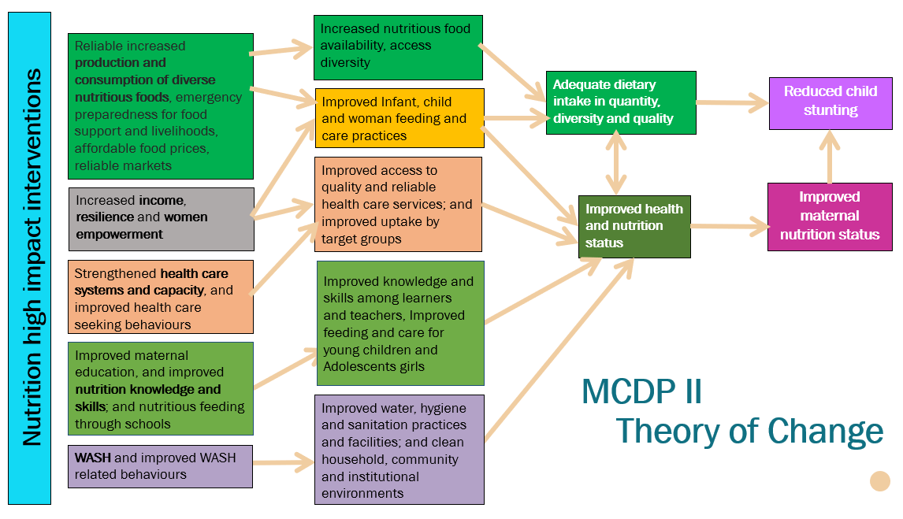
SUN/MCDP II Programme - Theory of Change

Slide 6
SUN/MCDP II Midline Survey – Purpose and Scope
Assess the changes in child and maternal nutritional status
Assess the progress made in addressing major determinants of maternal and child nutrition
Provide recommendations on areas that need improvements

Slide 7
Survey indicators
% of children <2 yrs who are stunted
% of children <2yrs who are underweight
Dietary intake and access to safe food
% of children exclusively breastfed to 6 months
Nutritional status of women and children
% of women (WRA) with low BMI
% of children meeting minimum IYCF standards
% of women of reproductive age who consume targeted value chain commodities
Women's dietary diversity: mean no. of food groups consumed
% of HHs with dietary diversity
% of HHs that produce safe and nutritious crops and livestock for consumption
% of HHs selling or bartering nutritious crops that they grow
Water, Sanitation and Hygiene
% of HHs with access to basic drinking water
% of HHs practising correct use of recommended water treatment technologies
% HHs practising correct water storage of the treated water
% of HHs with access to sanitation services
% of HHs with soap and water at handwashing stations commonly used by family members
% of HHs with latrines including covers
% of children exposed to environmental waste in the play area
% of HHs practising essential hygiene actions

Slide 8
Midline survey indicators (cont.)
Household Food and Nutrition Practices
% of HHs practising safe food processing, preparation, and storage practices
Health
% of children <2 yrs. with diarrhoea in the preceding 2 weeks
% of HHs practising essential nutrition actions
% of children with diarrhoea who received treatment from a health facility or provider
% of family planning users
Coverage of SUN/MCDP II Interventions
% of children reached with community-level nutrition interventions

Slide 9
Six additional indicators added at midline survey
% of women of reproductive age (15 – 49 years of age) with anaemia
% of children under 2 years with anaemia
% of children under age 2 (0-23 months) reached with a minimum package of interventions (nutrition-specific and nutrition-sensitive)
% of HHs reached with recommended social protection interventions
% of children aged 0-23 months who have learning materials at home
% of children 0-23 months left alone or in the care of another child younger than 10 years of age for more than one hour at least once in the past week

Slide 10
Methodology

Slide 11
Sampling
Districts purposively selected (MCDPII)
Baseline-32
Midline-32
10 SEAs randomly selected using PPS from each district
Baseline=10 (n=320)
Midline=10 (n=320)
25 households randomly selected
Baseline (n=8,001)
Midline (n=7,999)
Households with children below 24 months in selected 10 SEAs listed
Midline (n=18,523)
Selection interval used to select HHs
Data collection App randomly selected 1 child (<24 months) per HH
Stage I
Stage II
Stage III
Stage IV

Slide 12
Data analysis
Data Analysis Plan developed collaboratively with stakeholders
Data analysis (using Stata Version 16)
Descriptives analysis
Regression analysis
Qualitative Comparative Analysis (QCA)
Contextual information to explain the results
Note: Unweighted results presented
Notes:
Ex- Post power is the actual power of detecting true results after the data collection

Slide 13
Possible limitations
Use of 2010 sampling frame. Some EAs had to be replaced due to change of land use
Sample size calculated to detect 14% change from baseline to endline at overall and districts level
Limited power to detect smaller changes (less than 10%) at district level
  Reported district-level changes should therefore be understood as a ‘trend’ rather than absolute estimates
Repeated cross sectional surveys can identify associations but not causes of the observed situation

Slide 14
Midline Survey
Sample characteristics

Slide 15
Household characteristics
Notes:
Number interviewed by district by region), gender, age ranges mean median and ranges of age of household head) and main economic activity pie chart)

Slide 16
Household characteristics (continued)
Notes:
Number interviewed by district by region), gender, age ranges mean median and ranges of age of household head) and main economic activity pie chart)

Slide 17
Household, Child, and Mother characteristics (continued)
Population characteristics similar at baseline and midline
Therefore, observed differences in measured parameters are not a result of differences in background factors.
Notes:
Number interviewed by district by region), gender, age ranges mean median and ranges of age of household head) and main economic activity pie chart)

Slide 18
Findings

Slide 19
Obj 1 – IR 1: Increased and Reliable Access to Safe, Diverse, and Nutritious Foods
Dietary diversity; production and consumption of high nutrient foods; safe food processing / preservation

Slide 20
% of HHs producing crops and livestock (B=7,971; M=7,990)
% of HH producing crops
% of HH producing livestock
% of households who produced crops and livestock declined overall (p<0.001)
Production of crops declined more in urban areas, while production of livestock declined more in rural areas
Notes:
Assessed crops: protein rich food and micronutrient-rich vegetables and fruits
Assessed livestock: poultry, large and small livestock

Slide 21
Groups of nutritious food produced for consumption and sale
Crops and livestock | Sub-groups | Main Groups
Orange fleshed sweet potatoes | Vitamin A rich fruits and vegetables | Micronutrient-rich fruits and vegetables
Carrots
Squash
Pumpkin
Orange maize
Fruits (papaya, oranges and mango)
Dark green leafy vegetables | Dark green leafy vegetables
Groundnuts | Plant Protein | Protein-rich food
Lentils
Iron rich beans
Peas
Pig | Animal proteins
Chicken
Ducks
Goats
Cattle
Rabbits
Sheep
Guinea fowls
Fish
A household was counted towards this indicator if it grew and then consumed at least one type of food from each main group (i.e. at least 2 nutritious foods)

Slide 22
Percent of HHs producing and consuming nutritious crops and livestock (B= 7,986; M=7,976)
Overall, households producing and consuming nutritious crops and livestock declined
  Baseline: 47.3% CI [46.2-48.4]
  Midline: 30.8% CI[29.8-31.9], p<0.0001
More rural households produced and consumed nutritious crops and livestock than urban households
Decline in rural areas and increase in urban area

Slide 23
Percent of HHs producing and selling nutritious crops and livestock (B=5,874; M=5,221)
Overall, there was an increase in households producing and selling nutritious crops and livestock.
  Baseline: 62.5%; CI [61.3-63.7]
  Midline: 66.8%; CI [65.5-68.0], p=0.000
Rural households produced and sold more nutritious crops and livestock than urban households.

Slide 24
Prevalence of HHs experiencing food insecurity (Household Hunger Scale)
The indicator measures the scale of households’ food deprivation. It focuses on the food quantity dimension of food access and does not measure dietary quality:
  Households are asked:
    Three “occurrence” questions representing an increasing severity of food insecurity
    Three “frequency-of-occurrence” questions as a follow-up to each occurrence question to determine how often the situation occurred
  A score is calculated for each household by summing up the scores for each frequency-of-occurrence question.
  The median (not average) value of the individual households’ scores is then calculated.

Slide 25
Prevalence of HHs experiencing food insecurity
(B=7,985; M=7,976)
Overall, the prevalence of hunger (both moderate and severe) declined, and the change is statistically significant
  Baseline: 76.3%; CI [75.4-77.2]
  Midline: 74.1%; CI [73.1-75.1], p=0.001
Households in urban areas have a lower prevalence compared to rural households, despite it increasing since the baseline compared to rural areas
However, the prevalence of severe food insecurity increased in urban areas
Notes:
Results consistent with Global Nutrition Report (2022) which reports that:
People affected by hunger leaped by 150 million since the Covid-19 outbreak, from 618 million in 2019 to 768 million in 2021
Those unable to afford a healthy diet rose by 112 million to 3.1 billion in 2020 alone.
Almost a third (29.3%) of the world’s population, 2.3 billion people, were moderately or severely food insecure in 2021, up from 25.4% before the pandemic

Slide 26
% of HHs with recommended dietary diversity (B=7,978; M=7,990)
Note: HDD at baseline was calculated using a proxy measure (woman’s minimum dietary diversity + the child’s minimum dietary diversity
Overall, the percent of households meeting MDD-HH declined from the baseline
Baseline = 19.3% [18.4-20.2]
Midline = 18.2% CI [17.4-19.1] (p=0.080)
The decline in MDD-HH was more pronounced in urban areas
Notes:
Note: Household dietary diversity at baseline was calculated using a proxy measure that combined both the woman’s minimum dietary diversity and the child’s minimum dietary diversity. For midline survey, HH dietary diversity was calculated as per FAO's guidelines, which includes all foods eaten in the household.

Slide 27
% of women of reproductive age meeting minimum dietary diversity (MDD-W)
Foods categorized into 10 groups based on FAO recommendation on MDD-W
A variable was created for each food group and a woman given a score of “1” for each food group she consumed and a score of “0” for each food group she did not
Maximum possible score = 10 food groups
FAO recommends 5+ food groups

Slide 28
Women’s dietary diversity (MDD-W): % of women meeting MDD-W (B= 7,643; M= 7,976)
Overall, MDDW slightly declined (about 0.8%) from baseline to midline
  Baseline: 53.7%
  CI [52.6-54.8]
  Midline: 52.9%
  CI [51.8-54.0], p<0.309
Despite more urban women meeting MDD-W than rural women, a slight decline was also noted in urban areas.

Slide 29
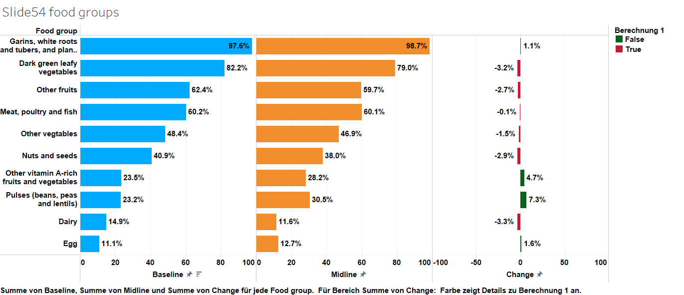
Food groups consumed by women (B= 7,643; M= 7,976)

Slide 30
Percent of HHs practicing safe food preparation/ improved storage practices (B= 7,486; M= 7,976)
Significant improvement in HHs practicing safe food preparation/ improved storage practices
  Baseline: 7.6 % CI [7.0- 8.21]
  Midline: 10.8 % [10.1 11.5], p<0.0.0001
Safe food preparation and storage practices still very low

Slide 31
Objective 2 / IR 4: Healthier Cleaner Environment
Access to water and sanitation; water treatment and storage; essential hygiene practices; child exposure to animal waste

Slide 32
% of HHs with access to basic drinking water services
A household was counted as having access to basic drinking water if they met all the criteria below:
  Received water from a safe water source
    tube or borehole
    protected shallow well
    harvested rainwater
    piped water/public tap
    protected spring
  The water was usually accessible
  They could get to the water source within 30 minutes or less

Slide 33
% of HHs with access to basic drinking water (B: 7,986, M: 7,990)
Overall, access to basic drinking water improved
  Baseline 36.9%; CI [35.9-38]
  Midline 52.40%; CI [51.3-53.5], p<0.001
access to drinking water improved significantly, particularly in rural areas.

Slide 34
% of HHs with soap and water at a handwashing station commonly used by family members (B= 7,986; M= 7,967)
A household was counted if they met the following criteria:
  the household showed a place where household members usually wash their hands
  there was soap and water within 1 minute of reach
No significant difference was observed overall
  Baseline: 14.8%; CI [14.1-15.6]
  Midline: 14.9%; CI [14.1-15.7], p=0.916
Slight increase in rural and a decline in urban

Slide 35
Households using improved sanitation services - definition
A household was counted if it used:
  ventilated improved pit latrine
  flush or pour toilet connected to a sewer system or
  septic tank or composting toilet
The latrine was observed for visible signs of use

Slide 36
Households with access to basic sanitation facilities (B=7,986; M=7,990)
Access to basic sanitation facilities improved overall
  Baseline 20.6% CI [19.8-21.5]
  Midline 31.7% CI [30.6-32.7], p=0.000
A significant improvement registered in urban areas
Access to basic sanitation still very low in rural areas
Notes:
A household was considered to have improved sanitation if it used either a ventilated improved pit latrine, a flush or pour toilet connected to a sewer system or septic tank, or a composting toilet, and the latrine/toilet was shown to the enumerator and had visible signs of being used

Slide 37
% Children <2 years who had diarrhoea in the preceding two weeks to survey (B=7,979; M=7,610)
All groups saw declines in diarrhoea incidence from baseline
  Baseline: 35.1%, CI [33.5-35.6]
  Midline: 27.4% CI [26.2-28.3], p<0.0001
Girls had lower incidence of diarrhoea in both surveys
Urban areas had lower incidence of diarrhoea in both surveys

Slide 38
% Children <2 years who had diarrhoea in the 2 weeks preceding the survey who received treatment (B= 2,794; M= 2,097)
A similar proportion of children received treatment at baseline and midline
  Baseline 65.8%; CI [64.0-67.6]
  Midline 63.9%; CI [61.8-66.0], p=0.110
Notes:
Mothers and caregivers were asked whether treatment was sought for the case of diarrhoea

Slide 39
Obj 1 – IR 2: Adoption of better child feeding and household practices
Breastfeeding, IYCF practices, essential nutrition actions

Slide 40

Exclusively breast feeding among less than 6 months remained the same
Exclusive Breast feeding remained the same
  Baseline 68.4%
  CI [66.4-70.5]
  Midline 69.6%
  CI [67.6-71.6], p=0.422
Notes:
Similar trends across the 5 months were observed in both surveys
Introduction of solids and liquids to children increases around 2 months
More children at 5 months were exclusively breast fed at midline than at baseline

Slide 41
Minimum acceptable diet (MAD) among children <24 months reduced at midline
A significant decrease in % of children who achieved MAD
Reductions observed cross all age groups.
Significant reduction in MAD in older children 18-24 months observed
MAD in both surveys higher than 2018 ZDHS (13%) and the average for sub–Saharan countries (9.89%)*
  CI: [17.9-19.9]
CI: [13.7-15.6])
*Zambia Statistics Agency, Ministry of Health (MOH) Zambia, and ICF. 2019. Zambia Demographic and Health Survey 2018. Lusaka, Zambia, and Rockville, Maryland, USA: Zambia Statistics Agency, Ministry of Health, and ICF
Notes:
This is owing to
the observed significant reduction of CDD( p<0.001),Children mainly
ate 3 food groups,with breastmilk most common (98.9% of children) followed by grains (81.6%) and Vitamin A rich foods (60.0%) Protein foods (meats, eggs, dairy)
A significant reduction in the MMF ( p=0.025)

Slide 42
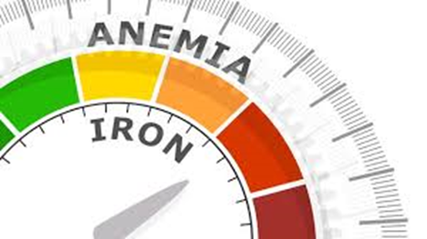

Nutrition Status of Women and Children <2 years
Women LBMI & anaemia
Children – Child feeding ; EBF, MAD
Child nutrition status : Stunting, Underweight, wasting , anaemia

Slide 43
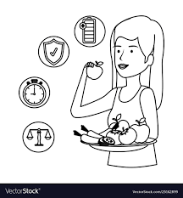
Nutrition status of women of reproductive age (15-49 years old)
Percent of women with low BMI remained the same (B=7,643; M=7,778)
% of women with low BMI by age group
  Baseline CI [6.8-8.0])
  Midline CI[6.4-7.6], p=0.479
Moderate improvement in women nutrition status observed
Largest reduction observed among younger women aged 30 to 34 years old

Slide 44
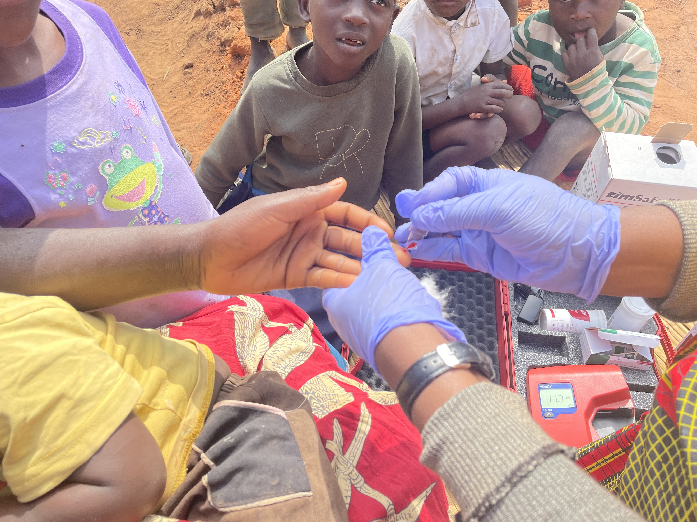
Anaemia in women of reproductive age (15-49 years old) n=6,587
Mean Haemoglobin- 12.9g/dl vs 12.0g/dl recommended by WHO
25.1% women anaemic
0.5% women with severe anaemia

Slide 45
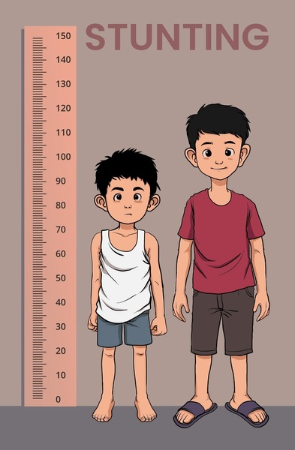
Nutrition status of children <2 years old
Stunting, Underweight, Wasting, and Anaemia

Slide 46
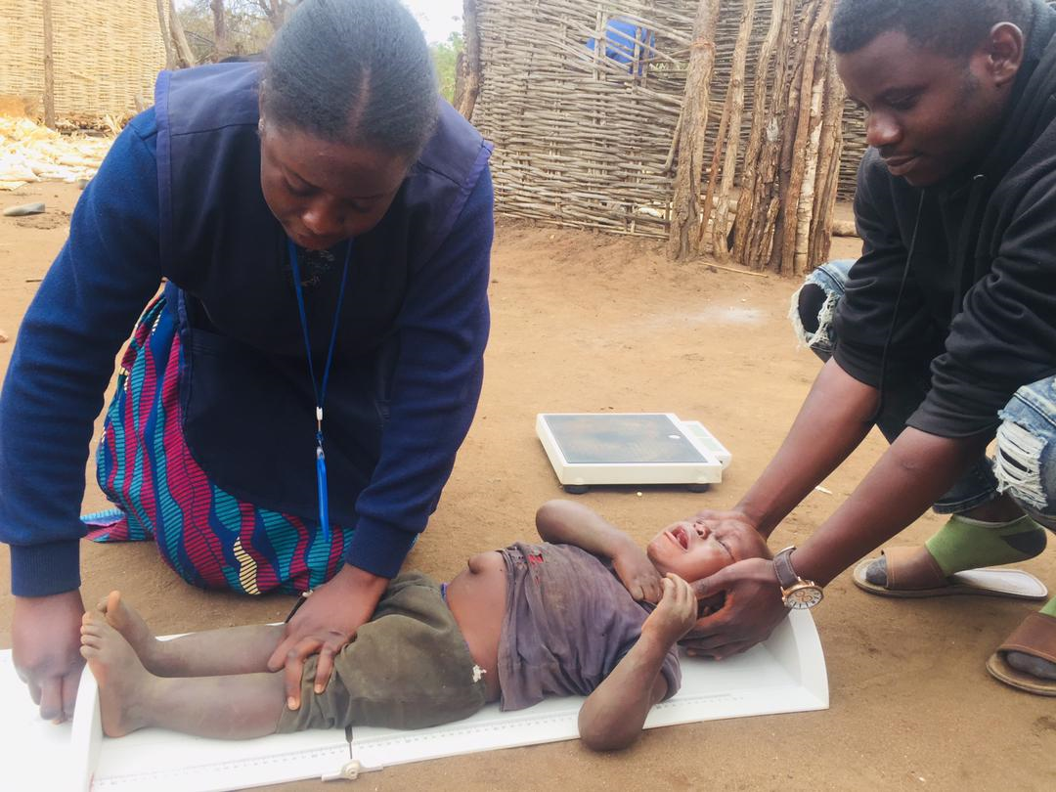
Significant increase in % of children <2 years who are Stunted & Underweight; and no change in wasted
  p<0.01
CI: [3.0-3.8]
  CI [2.9-3.7], P>0.05

Slide 47
Stunting among children by age group , region and Sex
Stunting by child age group
Stunting by region and sex
Notes:
Stunting by Sex: Stunting increased among male children and female children in both rural and urban areas
Larger increase observed among males than females
Sex by Region and Sex : Observed Increased change in stunting was observed among older children 18-23 months old compared to younger children

Slide 48

Anaemia among children 6-23 months (n=5,059)
Anaemia is a serious problem among children across all age groups

Slide 49
Other Factors potentially associated with Child Stunting
SUN/MCDPII environment

Slide 50

Potential risk factors associated with stunting in the survey
Poor economic situation of the household
Low HDDs
Female household head
Mother with low BMI
Low MDD-W
Poor economic status of the mother
Child level factors
Left alone or in a care of another child
Suffered from diarrhea 2 weeks prior to the survey
Underweight Child
Fed food of low diversity
Being older than 12 months
Necessary conditions required to reduce stunting (QCA-analysis)
Improvement in (1) Minimum dietary diversity for women (MDD-W); (2) Minimum meal frequency (MMF); (3) Child dietary diversity (CDD) ; (4) Access to basic drinking water (BW), and (5) Access to Basic sanitation (BSN)

Slide 51
Potential Contextual factors associated with stunting among children
Delayed commencement and roll out of the SUN /MCDPII programme thereby limiting the coverage of interventions
Onset of COVID 19 limited service provision resulting in low accessibility of beneficiaries
Limited resources to support the implementation of high impact interventions in the target population
Deteriorating economic situation in the country between 2019 and 2021, resulting in increased food prices

Slide 52
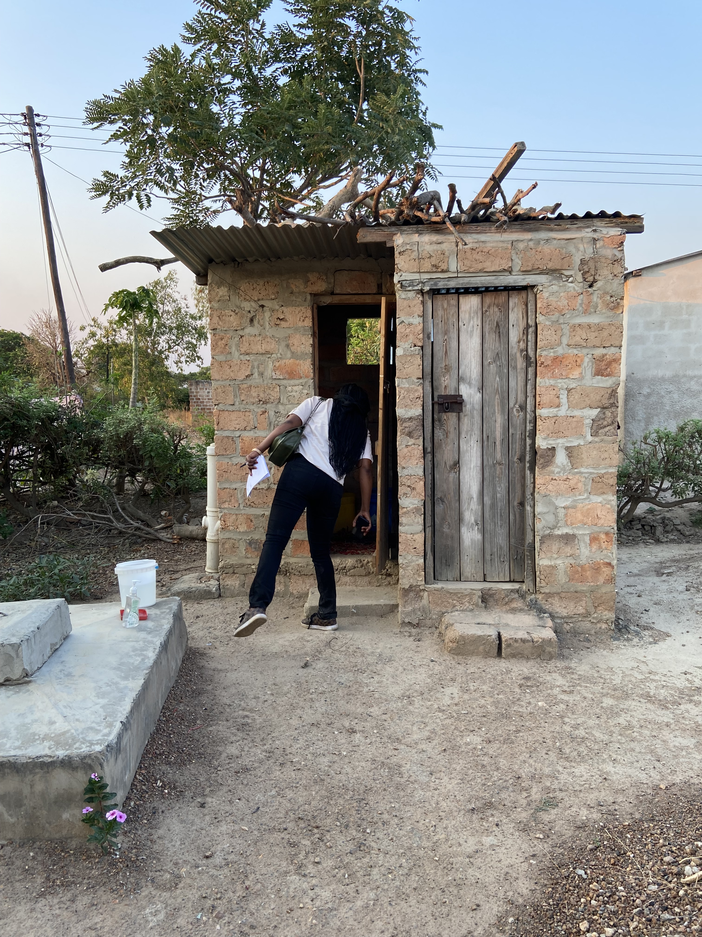
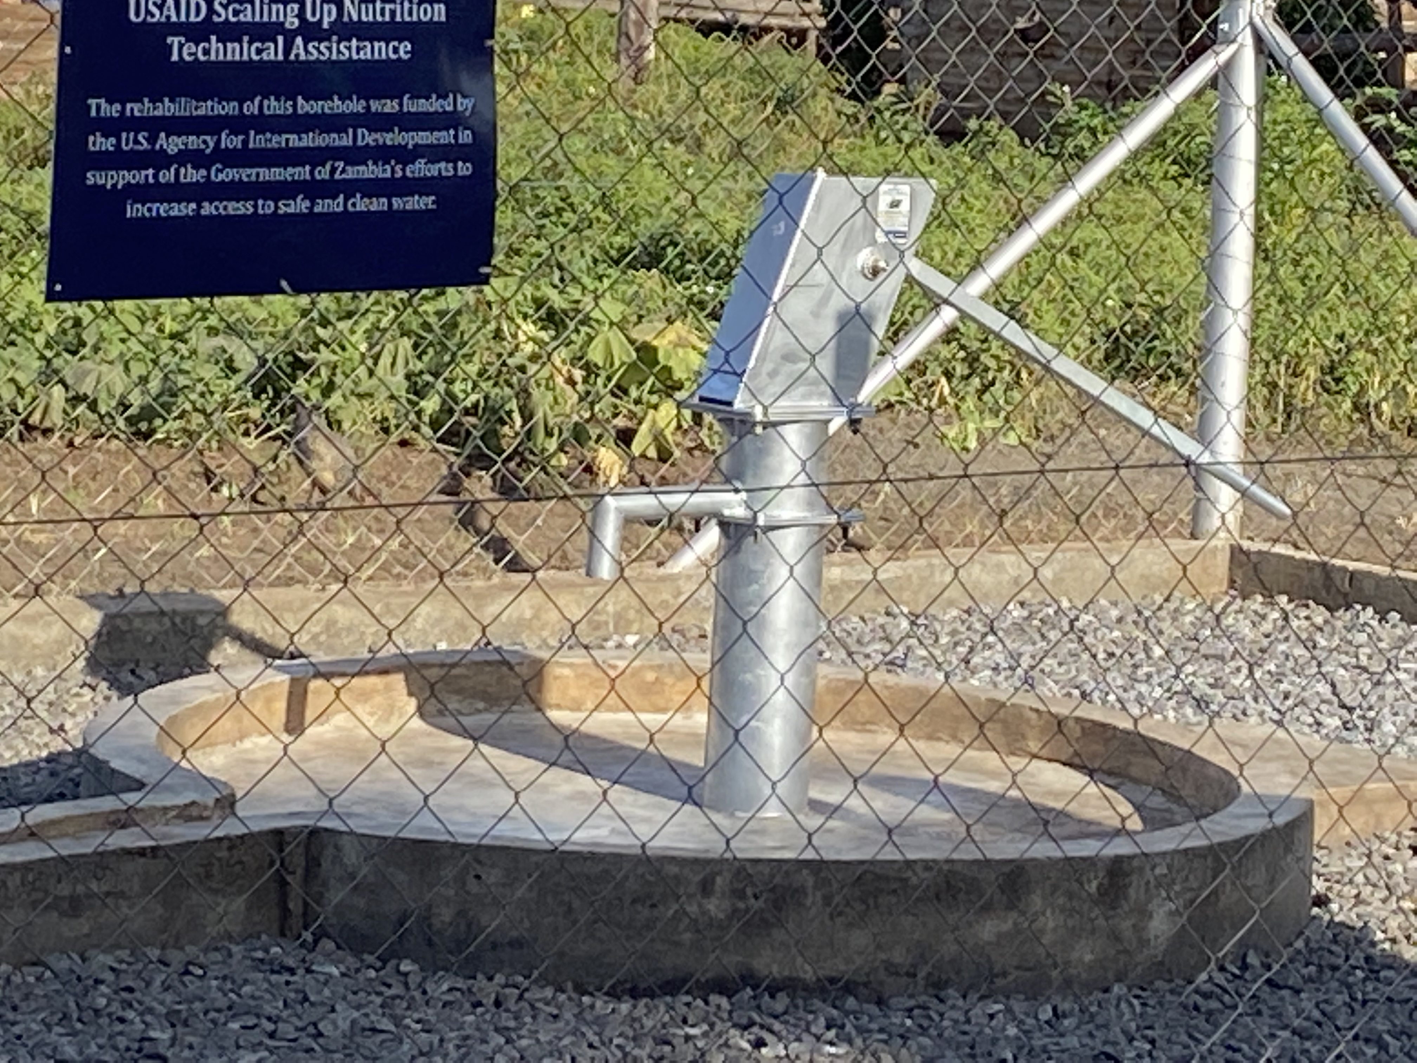






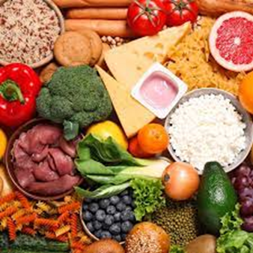


Conclusions
Basic water and sanitation improved
Food Production and Consumption declined
Animal production
Crop production
Children nutrition status deterioration
MMF
MAD
Production and consumption of nutritious foods
HDD

Slide 53
Recommendations
Targeted iron fortification of complementary foods to address high levels of anaemia in children
Promote climate-smart agricultural practices to address the adverse effects climate change
Design urban tailored programmes that address nutrition gaps in urban areas
Community/household awareness on the importance of consuming nutrient rich foods
Adopt an intensive approach for nutrition social behaviour change communication to target all key community members
Build on success of WASH
Identify lessons from the positive deviant districts
Notes:
Reduce? Or improve ?

Slide 54
Disclaimer
The 2022 SUN/MCDP II Midline survey report presents findings derived from a population-based study conducted in 32 target districts in Zambia
While every effort has been made to ensure the accuracy and reliability of the data presented herein, certain unexpected findings have emerged that warrant caution in the interpretation
Some unexpected findings like increase in stunting relatively in short period and improved water access in absence of major water and sanitation services require careful interpretations
Readers are, therefore, encouraged to interpret the findings with caution and consult additional sources of information where possible
Additional research is needed to understand these trends and inform the interventions

Slide 55
Additional Resources
The full presentation and midline survey report will be uploaded on the NFNC website by quarter 3 of 2023.
http://www.nfnc.org.zm/

Slide 56
Thank you!
SUN LE Contact Details
Tel: + 260-211-252-299 / 300
Mobile: +260-976-552-342
Email: monyango@khulisa.co.zm

